Slide 1
Right of the Month
UNCRC Article 42- Everyone should know about their rights

Slide 2
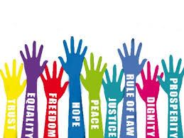
What are rights?
Rights are rules about what people are allowed to do or to have.
Notes:
Basic entitlements that all humans have

Slide 3
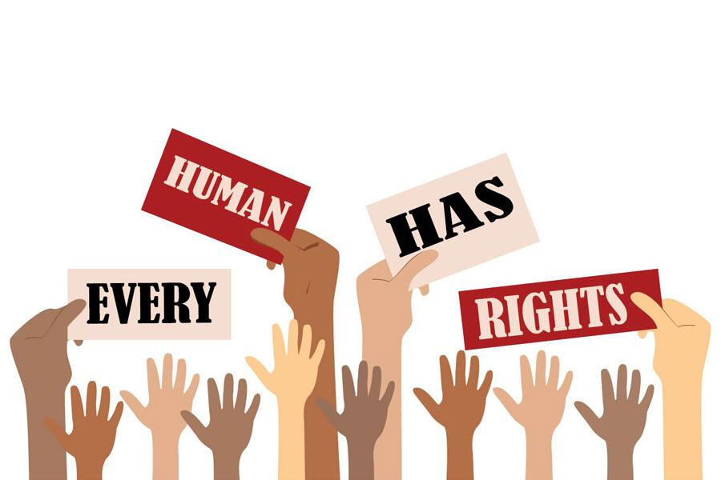
Who has rights?
Everyone in the world has rights.
Children and young people need extra protection and have special rights.

Slide 4
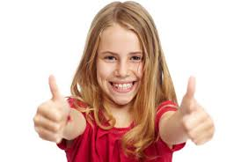
Why are children’s rights important?
Rights help children to:
grow up safely
be happy
be the best that they can be.

Slide 5
What is the UNCRC?
United Nations Convention on the Rights of the Child
It is an important agreement by countries which have promised to protect children’s rights.
Notes:
The UNCRC explains how adults and governments must work together to make sure all children can enjoy all their rights.
life. The UNCRC is a promise to look after the rights of everyone under the age of 18. Most countries in the world have agreed to do this.

Slide 6
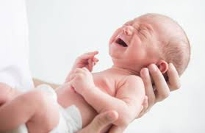
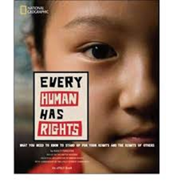
Understanding Rights
Rights are universal- they are for everyone
We are born with our rights
Rights cannot be taken away

Slide 7
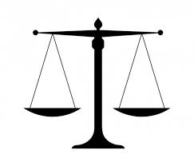
Understanding Rights
You don’t have to earn your rights
All rights are important

Slide 8
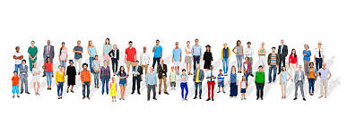
Duty Bearers
A Duty Bearer is responsible for making sure that children learn about their rights and enjoy their rights.
Every adult is a Duty Bearer.

