Slide 1
Robert Burns Academy Supported Learning Centre Children’s Rights

Slide 2
What are rights?
Reminder: Rights are rules about what people are allowed to do or to have.
Everyone in the world has rights- children and adults.
Notes:
Basic entitlements that all humans have

Slide 3
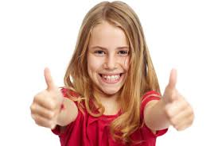
Why are rights important?
Rights help people to:
be safe
be happy
be the best that they can be.

Slide 4
Article 12
In April and May our Right of the Month was Article 12- the right to be listened to and taken seriously.
You put this right into practice by completing a questionnaire about how you feel in school. You also took part in a consultation exercise to tell us what you like about SLC and what you think could be better.
Staff in SLC completed this exercise
too.

Slide 5
Here are some of the many positive things that you told us about SLC:
SLC is a place where kids can feel good
The staff listen
Everyone is respected and treated equally
Covid routines keep us safe
We get help with work
Pupil of the week
Going to some mainstream classes
The Teachers and Classroom Assistants are kind and supportive
SLC is a loving place to be
We are allowed time out when needed
Teachers understand you
I get to see my friends

Slide 6
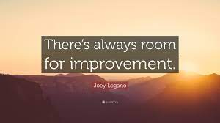
Here are some of the things that pupils and staff feel need to improve:
Less noise with less shouting outside our classroom especially when we are working – we don’t want learning interrupted!
There is too much fighting in the playground
Some pupils need to be more respectful towards staff and other pupils, especially at lunchtimes.
Some pupils can be inappropriate i.e swearing at interval and lunchtime.
When Classroom Assistants ask pupils to do something to keep them safe they are often ignored
Some pupils use unkind and inappropriate language towards or about each other
Pupils don’t always keep their masks on.

Slide 7
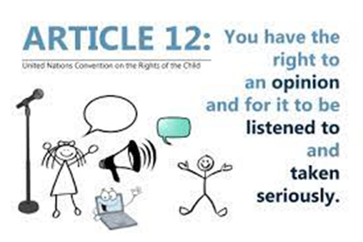
We are listening!
It is very important that pupils and staff in SLC feel that their views are taken seriously and that action is taken to address concerns- this is your right!
Although staff and pupils had lots of positive things to say about SLC, some of you have told us that you don’t always feel safe and respected in SLC- this is not good enough and is something that we need to work together as a team to address!

Slide 8
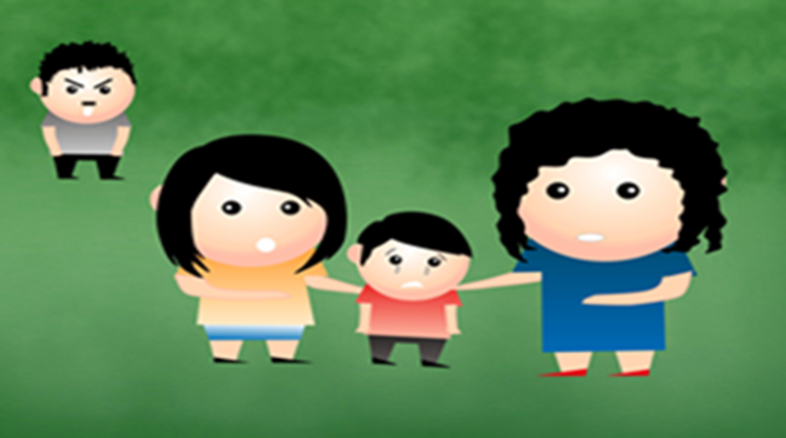
Right of the Month
To help everyone feel safe and respected in SLC we are going to have a big focus on Article 19-the right to be safe and protected from violence and abuse.
This will be our right of the month for the remainder of May and June.

Slide 9
Article 19-Right to Protection from Violence and Abuse
Violence is behaviour involving physical force that is intended to hurt or damage someone or something.
Abuse means to hurt or injure someone by acting badly or neglectfully. Abuse can be physical (e.g kicking, hitting, throwing things, spitting), or it can be verbal. Calling someone a hurtful name is a form of verbal abuse.
It’s normal to feel angry or annoyed with other people at times but it’s NEVER ok to behave towards other people in a violent or abusive way! This behaviour is disrespectful and wrong and can be very harmful to others. It could even be considered a crime and lead to police charges.

Slide 10
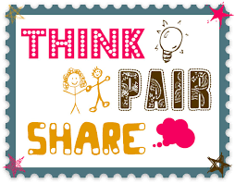
Group task:
Think, Pair, Share
1.It’s never acceptable to lash out at others verbally or physically, no matter how angry or upset you feel. What strategies could you use instead if you have these feelings?
2. What would be the right thing to do if you saw someone behaving in a violent, abusive or unkind way towards another person in school or in the community?
3. Why do you think we have rules in school? Why is it important to follow the rules and instructions that adults give?

Slide 11
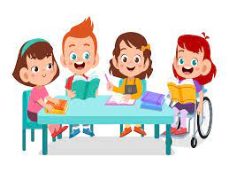
Group task 1
In groups discuss behaviours that are inappropriate, unsafe or unkind. Make a list of these in the first column of the template that your teacher will provide. Your teacher may also give you some prompt cards to help you.
Think about how you would feel if you were on the receiving end of these types of behaviours- perhaps you have been? Discuss as a class.
These behaviours are not acceptable in SLC and will not be tolerated!

Slide 12
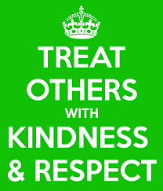
Group task 2
Now let’s focus on the type of behaviour and attitude that we want to encourage in SLC!
In the second column of the template make a list of safe, kind and respectful behaviours. Give some examples of what this type of behaviour might look like and sound like in the classroom, corridors and playground.
As a class discuss how it feels when others do
kind things for you, and when you do something
kind for someone else.

Slide 13
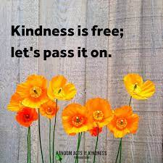
Now choose one of the following tasks to encourage kind and respectful behaviour in SLC:
Create a kindness poster to display in SLC noticeboards.
Create a kindness checklist to display in your classroom and corridors and refer to each day.
Nominate a pupil or member of staff in SLC for a kindness award- state the reason why they deserve the award.

Slide 14
Be Kind!
Challenge yourself to do at least one kind thing each day.
Let’s work together to make sure that SLC is always a happy, kind, safe and welcoming place for everyone!

