Slide 1
December’s Right of the Month:
Article 30
Every child has the right to learn and use the language, customs and religion of their family, whether or not these are shared by the majority of the people in the country where they live

Slide 2
How much do you know about languages, customs and religions other than your own? This quiz will help you to find out.
This is a joint effort- you can discuss answers with other people in your class and you can use the internet to do some research to help you find the answers.

Slide 3
Your teacher will note your answers and pass them on to Mrs Devine and the Rights Respecting School Group for marking.
Answers to the questions will be revealed at the end of term and the class with the highest score will get an early Christmas treat!

Slide 4
SECTION 1- RELIGIONS & CUSTOMS

Slide 5
1. Can you match the religions to the symbols that represent them?
A
B
C
E
Hinduism
Judaism
Islam
Christianity

Slide 6
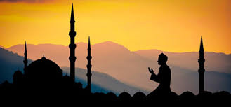
2. A follower of Islam is called a:
a.Christian
b.Jew
c.Muslim
d.Hindi

Slide 7
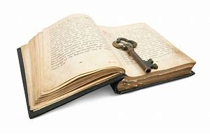
3. The holy book of Christians is called the:
a. Bible
b. Vedas
c. Qu’ran or Koran
d. Torah

Slide 8
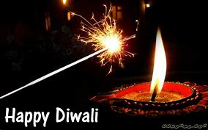
4. Which religion celebrates Diwali, the festival of lights?
a.Judaism
b.Islam
c.Hinduism
d.Christianity

Slide 9
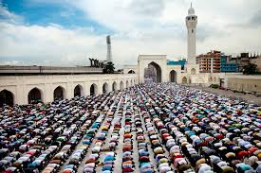
5.Ramadan is the holy month of fasting for which religion?
a.Christianity
b. Hinduism
c. Islam
D. Judaism

Slide 10
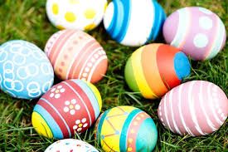
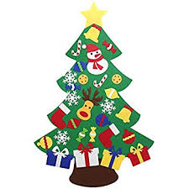
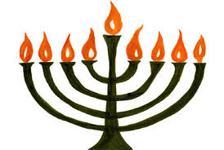
6. Which of the following is not a Christian festival?
a.Easter
b.Christmas
c.Lent
d.Hanukkah

Slide 11
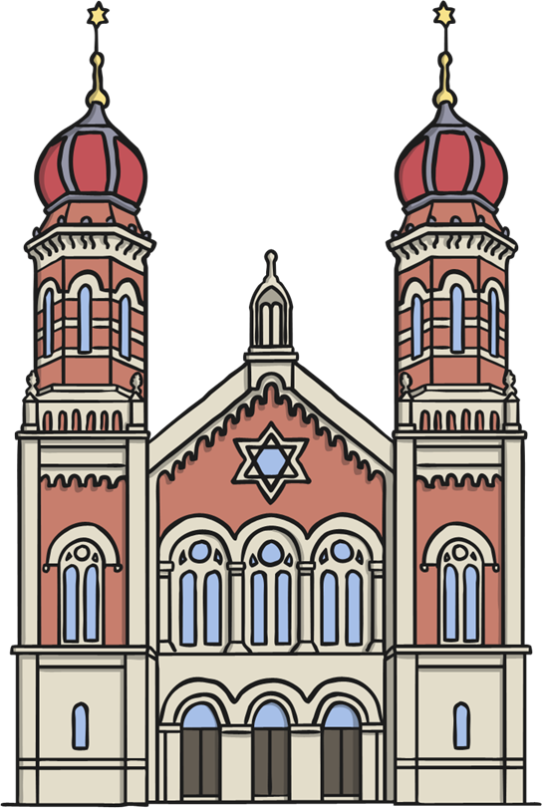
7. A synagogue is a place of worship for which religion?
a.Judaism
b.Christianity
c. Islam
d.Hinduism

Slide 12
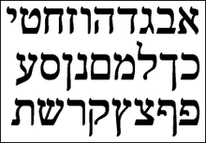
8. What is the language of Judaism?
a.French
b.Arabic
c.Hebrew
d.German

Slide 13
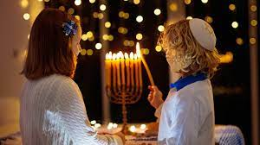
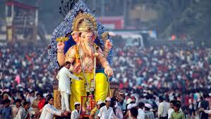
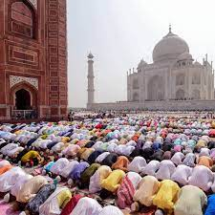
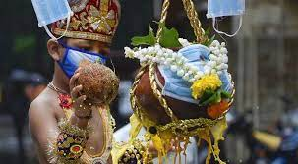
9. How many religious festivals can you name?

Slide 14
Section 2: LANGUAGES

Slide 15
1. CAN YOU RECOGNISE THE LANGUAGE?
All these words mean hello, but what are the languages?
1) Ciao
2) Guten Tag
3) Bonjour
4) Hola
5) cześć
6) Olá

Slide 16
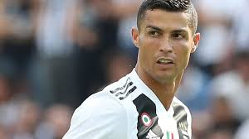
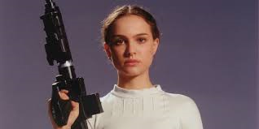
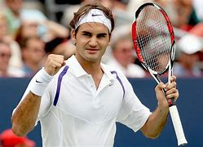
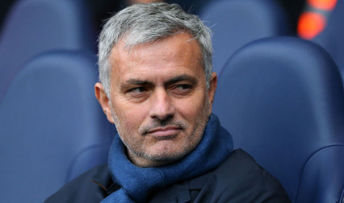
2.Can you match these well known people to their native language?:
a. Cristiano Ronaldo
b. Natalie Portman
c. Roger Federer
d. Jose Mourinho
German
Italian
Portuguese
Hebrew

Slide 17
3)After English, what do you think is the second most commonly spoken home language in Scotland?
French
Polish
Mandarin

Slide 18
4)True or false? At least half of the world’s population speaks 2 or more languages

Slide 19
5)True or False? English is the most
widely spoken language in the world

Slide 20
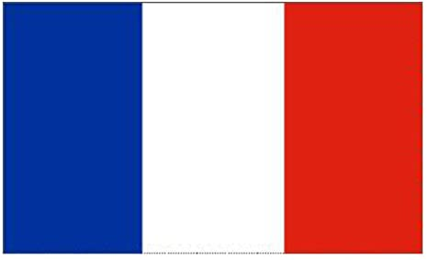
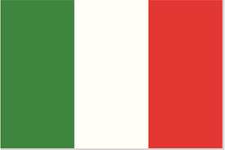
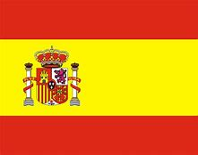
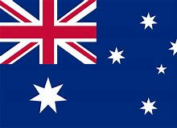
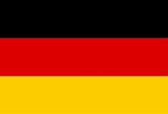
6a.Which countries do the following flags represent? b. What is the language of each of these countries?
1
2
3
4
5
6

Slide 21
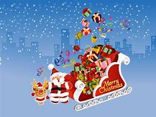
7. How many languages can you say Merry Christmas in?

Slide 22
Final Question..

Slide 23
8)Which article from the United Nations Convention on the Rights of the Child states that nobody should be discriminated against because of their ethnicity, religion, language, family background, or any other status?
Article 2
Article 38
Article 28
Article 12

