Slide 1
March 2022 Right(s) of the Month
Article 22
You have the right to special protection and help if you are a refugee (if you have been forced to leave your home and live in another country), as well as all the rights in this Convention.
Article 24
You have the right to the best health care possible, safe water to drink, nutritious food, a clean and safe environment, and information to help you stay well.

Slide 2
What is Fairtrade…?

Slide 3
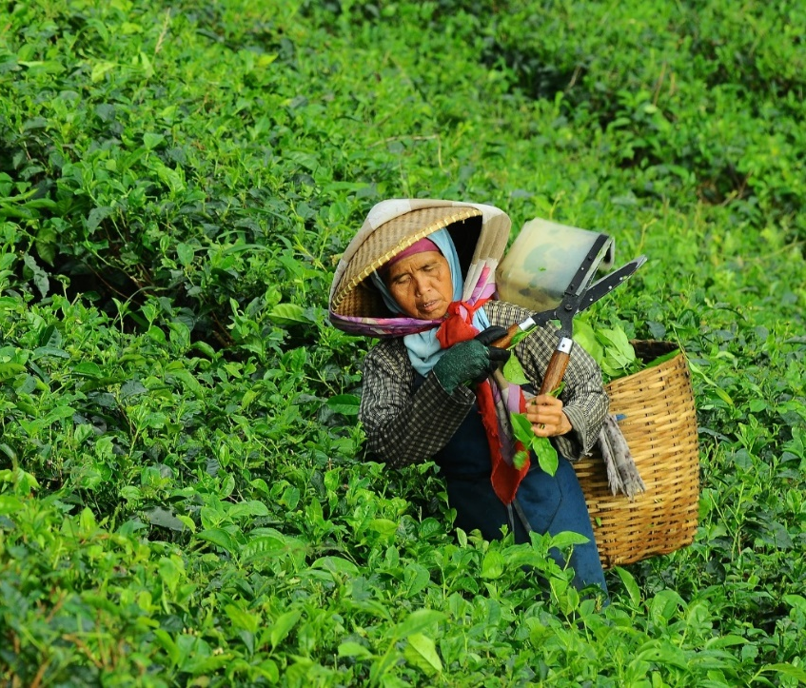
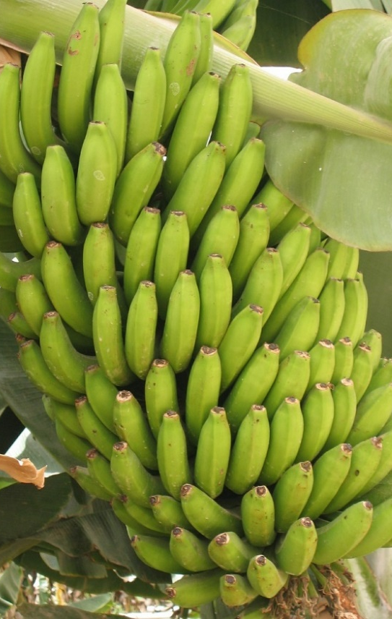
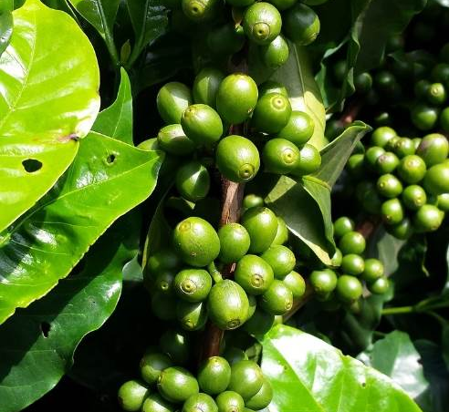
Growing and Making
People all over the world earn their living by growing food or making things to sell.

Slide 4
Shipping
Their food and products are shipped to other parts of the world and sold in shops.
Many products in our supermarkets are made from things imported from poor countries in Africa and Asia for example.

Slide 5
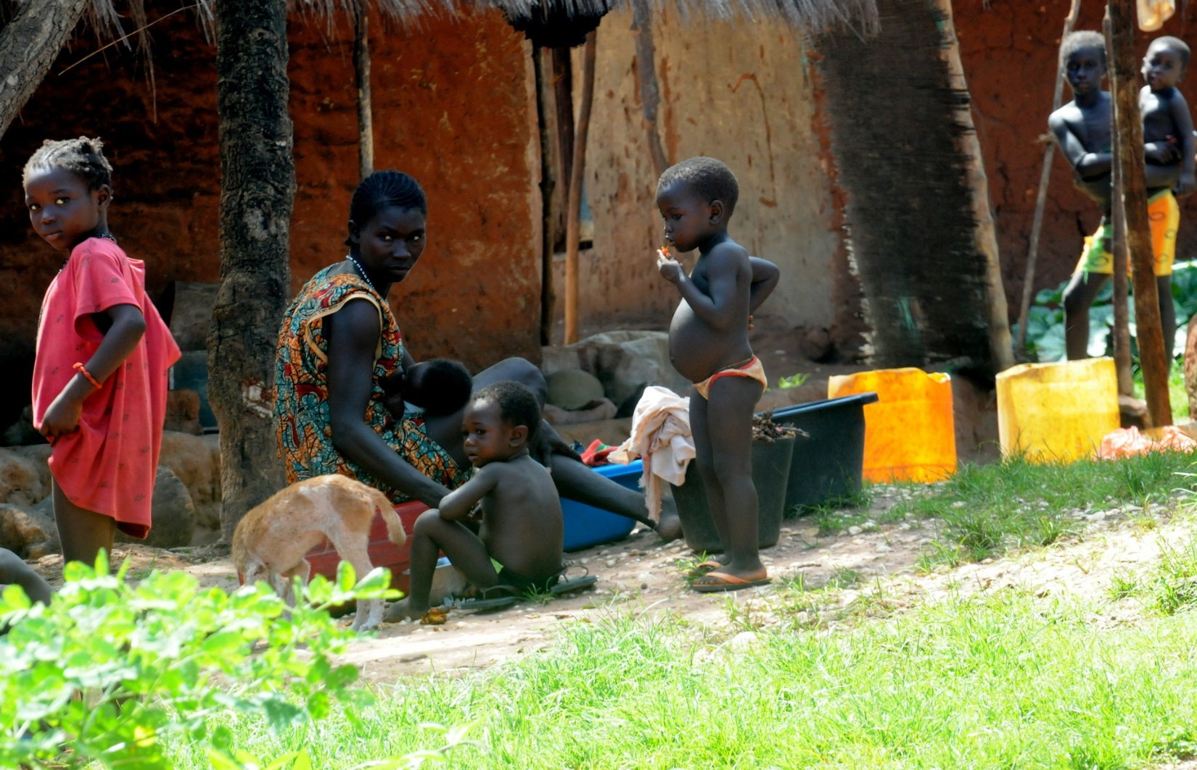
Selling
However, unless they are paid a fair price for what they have produced, they will not have enough money for food, schooling, medicine or clothing.

Slide 6
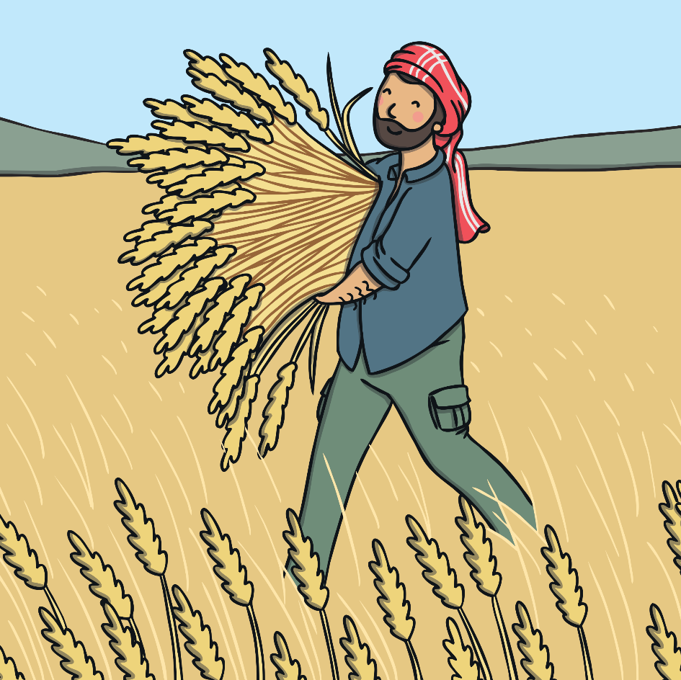
How Can Fair Trade Help?
Fair Trade is about paying a fair price for things that we buy.
This helps to improve the lives of families all over the world.
Did you know?
Fair Trade helps over one million farmers and workers in 74 countries across the world!

Slide 7
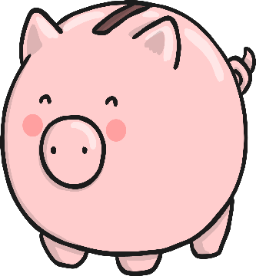
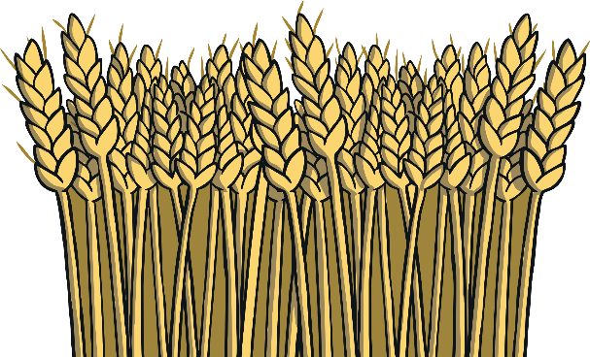
How Does Fair Trade Help?
The great things about choosing to buy Fair Trade items:
Extra money goes into projects that help the local community such as bicycles to get to work or wells to provide water.
Workers receive better prices for crops so people can live better lives.
Workers have better working conditions.

Slide 8
What is traded fairly?
Where does it come from?
Coffee
Bananas
Chocolate
Sugar
Tea
Honey
Cotton
Africa
Asia
Latin America
Wine
Fruit
Flowers
Gold
Handicrafts
Nuts
Have you eaten any of these foods today?

Slide 9
When a product carries the International Fairtrade Certification Mark, it means that all the ingredients have been produced according to Fairtrade political standards. The mark is used in over 50 countries.

Slide 11
What can you do to help?
Buy bananas and other products that have the Fairtrade symbol on them. If you do this, you know that a fair price has been paid to the workers. Over 4,500 different Fairtrade products are now available to UK shoppers.
.

Slide 12
Time for Reflection
Do all of the workers get a fair price for the produce they grow?
Think about the workers who grow all of the foods we like to eat.
Would buying Fairtrade products help improve the lives of others?

Slide 13
What’s next for SLC?
A – Z of Fairtrade Let’s Make our own logo? Keep looking for fairtrade logo

