Slide 1
Seasons for Growth

Slide 2
What is it?
Seasons for Growth aims to strengthen the social and emotional wellbeing of children and young people (aged 6-18) who are dealing with significant life changes by:
• Exploring the impact of the change and loss on everyday life
• Learning new ways to respond to these changes
Seasons for Growth is based on the belief that change, loss and grief are a normal and valuable part of life.

Slide 3
Who is it for?
Anyone who is living with the effects of change and loss. Many factors can cause change such as:
• Friends can come and go
• Loss of someone or something you love
• Parents and families separate
• Moving to a new place
• Impact of illness
• Family work-life changes

Slide 4
How it will run!
5 pupils will be in the Group along with 2 trained adult companions.
You will attend 8 sessions (1 per week)
You will have 2 follow up sessions.
Parents/Carers will be invited in to celebrate the completion of the course with you. (restrictions because of Covid may postpone this)
*If you are not selected for this group starting in August you will be put on a waiting list to begin with the next group so please do not worry!

Slide 5
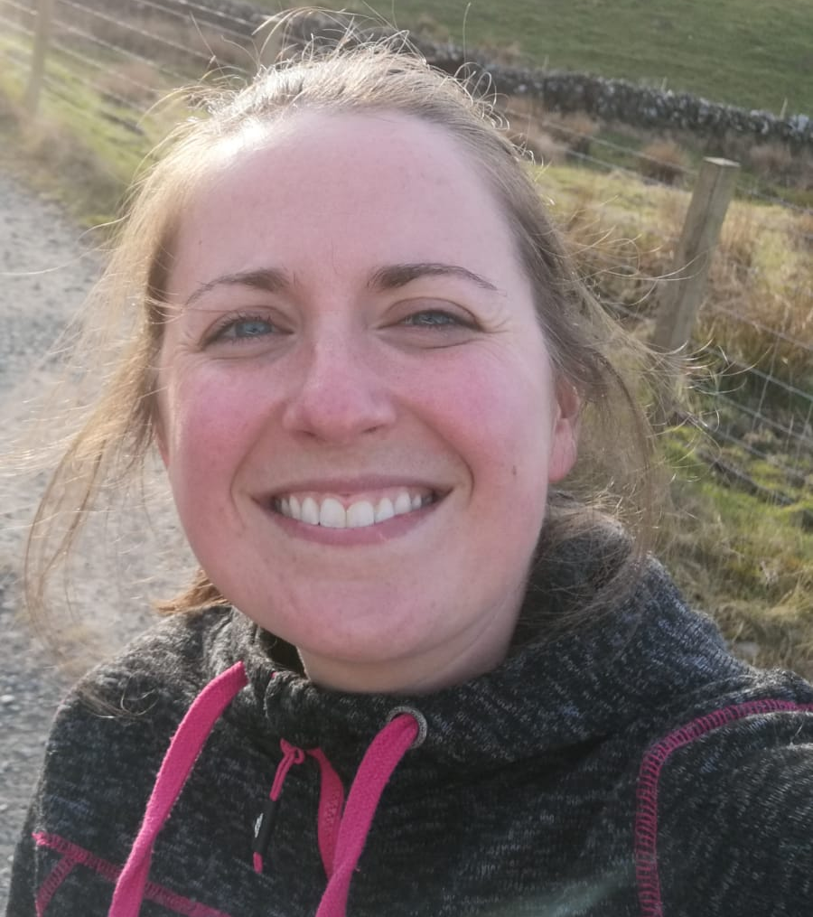
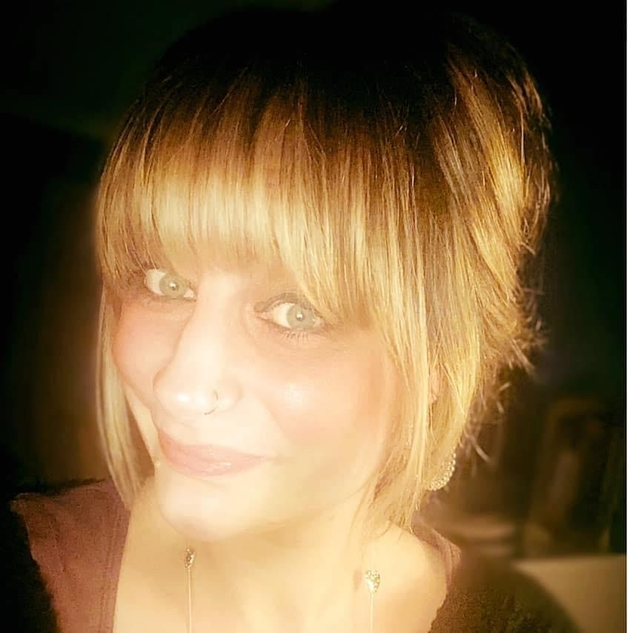
Your Companions…
Mrs Burgoyne
Guidance Teacher
Mrs Cummings
Inclusion Teacher

Slide 6
If you think you would like support…
Your Guidance teacher will hand out little cards.
Pop your full name and class down
Either put YES or NO below the question ‘Do you think you would like support from Seasons for Growth’

