Slide 8
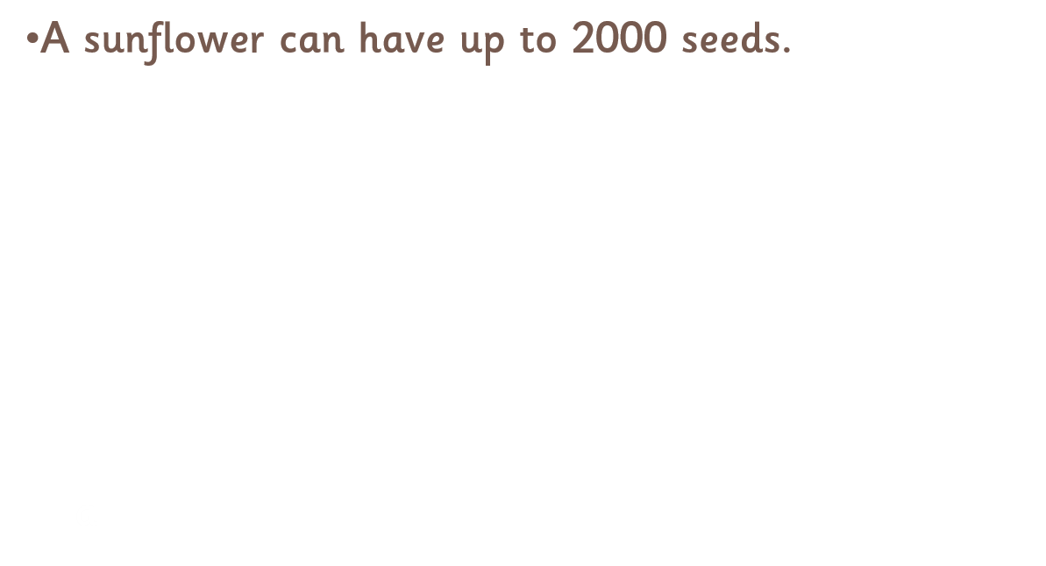

Slide 9
THE END

