Slide 1
Totals and change
L.O.
I can work out the total.
I can work out change.

Slide 2
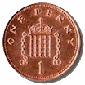
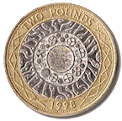
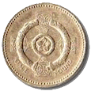
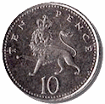
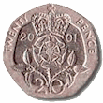

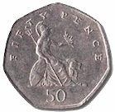
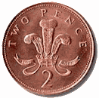

Slide 3
What is the total of these coins?
What is the total of these coins?
What is the total of these coins?

Slide 4
What is the total of these coins?
What is the total of these coins?
What is the total of these coins?

Slide 5
What is the total of these coins?
What is the total of these coins?
What is the total of these coins?

Slide 6
What is the total of these coins?
What is the total of these coins?
What is the total of these coins?

Slide 7
What is the total of these coins?
What is the total of these coins?
What is the total of these coins?

Slide 8
What is the total of these coins?
What is the total of these coins?
What is the total of these coins?

Slide 9
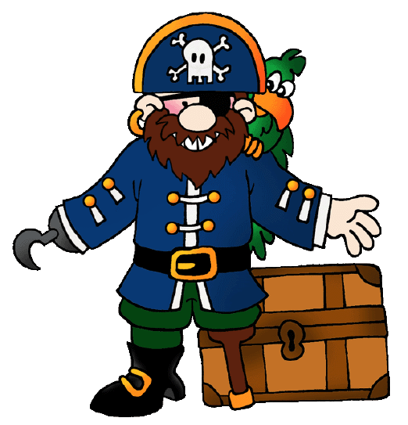

Ha! Ha! You silly landlubbers will not be able to help Captain Shipshape. I will always be able to steal his money when he comes to my shop. There is no way YOUR CLASS can learn to do totals and change.
I will fly by and get your answers tonight and I might even leave you a treasure map!
I need to get some provisions for my ship but every time I go to pirate Cheat’s shop he adds up the total of my items wrong or gives me the wrong change.
Your teacher says you are super at maths so I hope you can help me by working out the totals and the change for the things I need to buy. Thanks shipmates.
Hello My name is Captain Shipshape. I am a great pirate and always have lots of treasure but I am no good at maths.

Slide 10


How much change would Captain Shipshape get if he gave Pirate Cheat 20p?
How much does a cutlass cost?
7p
How much does a cutlass and a rope cost cost altogether?
How much does a rope cost?
3p

Slide 11


How much change would Captain Shipshape get if he gave Pirate Cheat 20p?
How much does a bandana cost?
6p
How much does a telescope cost?
How much does a bandana and a telescope cost cost altogether?
10p

Slide 12





What is the total of these items?
What is the total of these items?
What is the total of these items?
12p
5p
£1
20p
4p
75p
How much change would you get from 20p
How much change would you get from 50p
How much change would you get from £4.95

Slide 13

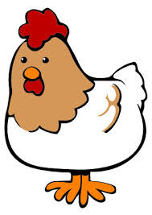



What is the total of these items?
What is the total of these items?
What is the total of these items?
10p
25p
£2.00
20p
7p
£1.50
How much change would you get from 20p
How much change would you get from 50p
How much change would you get from £5.50

Slide 14






What is the total of these items?
What is the total of these items?
What is the total of these items?
65p
30p
6p
7p
£3.00
8p
How much change would you get from 20p
How much change would you get from 50p
How much change would you get from £5.90

Slide 15

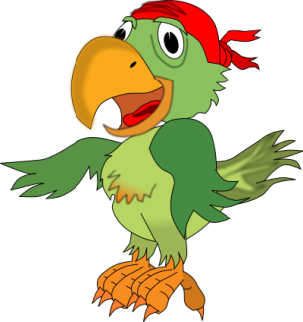

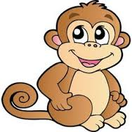
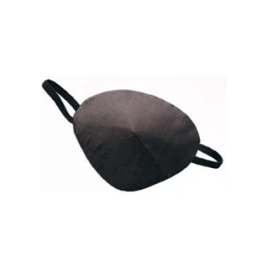
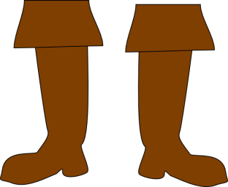
What is the total of these items?
What is the total of these items?
What is the total of these items?
21p
10p
£1.20
8p
19p
£4.25
How much change would you get from 20p
How much change would you get from 50p
How much change would you get from £5.50

Slide 17
Can you solve these tricky problems?

Slide 18
10 p
8p
Captain Shipshape bought some oranges and a treasure chest.
He gave Pirate Cheat 20p.
Pirate Cheat gave Captain Shipshape 1p change.
Is that the correct change?

Slide 19

10p
6 p
Captain Shipshape bought a parrot and a pirate hat.
He gave Pirate Cheat 20p.
Pirate Cheat gave Captain Shipshape 3p change.
Is that the correct change?

Slide 20
14p
30 p
Captain Shipshape bought a compass and a chicken.
He gave Pirate Cheat 50p.
Pirate Cheat gave Captain Shipshape 6p change.
Is that the correct change?

Slide 21

£1.00
£2.00
Captain Shipshape bought a monkey and some rum.
He gave Pirate Cheat £5.00.
Pirate Cheat gave Captain Shipshape £1.00 change.
Is that the correct change?

Slide 22
£5.50
£3.25
Captain Shipshape bought a treasure map and a telescope.
He gave Pirate Cheat £10.00.
Pirate Cheat gave Captain Shipshape £1.25 change.
Is that the correct change?

Slide 23



Captain Shipshape spent 18p.
What could he have bought?
Captain Shipshape spent 40p.
What could he have bought?
2p
8p
10p
4p
4p
10p
6p
4p

Slide 24



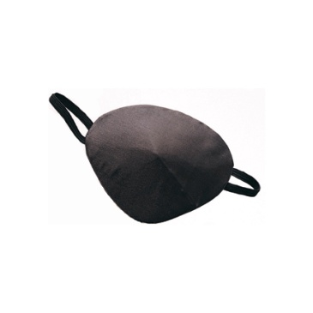

Captain Shipshape spent 60p.
What could he have bought?
Captain Shipshape spent £2.00.
What could he have bought?
20p
80p
50p
40p
10p
40p
60p
30p

Slide 25

Captain Shipshape spent 90p.
What could he have bought?
Captain Shipshape spent £5.00.
What could he have bought?
£2.00
50p
£1.00
90p
£2.00
10p
£1.10
40p
£1.00

Slide 26
TOTALS

Slide 27










What is the total of these 2 items?
What is the total of these 3 items?
+
5p
4p
25p
£1.00
£3.99
30p
£1.50
+
£5.42
+
+
8p
10p
+
+
+
10p
4p
+
+
+
4p
6p
+
+
+
10p
5p

Slide 28
Link to BBC programme on money and change. Click smiley face!

Slide 29
Pirate pictures to edit for further slides

Slide 30





