Slide 1
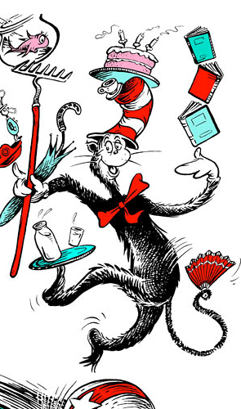
The Cat in the Hat
From the fish’s point of view

Slide 2
Your task:
This week in Big Writing we will be rewriting the Cat in the Hat story from the point of view of the goldfish.
Look through the following slides with your grownup and talk about what the goldfish can see, and how he feels. What is happening in the pictures?
Try to write some words/ sentences to add detail to the story.
Sound out your words to help. ☺

Slide 3
It was a wet day
For example:
I could see the children were bored in the house.

Slide 4
Then,

Slide 5
A cat in a hat walked in on the mat

Slide 6
The cat wanted to play but I said,

Slide 7
You do not want to play!

Slide 8
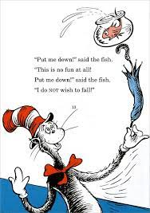
Then he held me up high!
I was

Slide 9
And then
I felt

Slide 10
I ended up in

Slide 11
Then

Slide 15
Finally,

