Slide 1
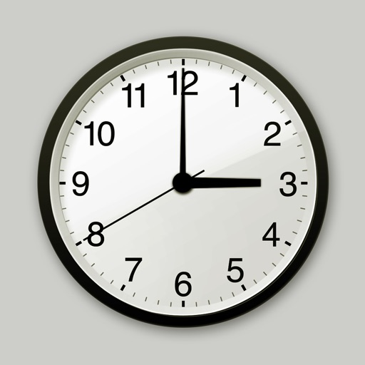
Time

Slide 2
Minute hand
Hour hand
Notes:
-The minute hand is the long hand
-The hour hand is the short hand

Slide 3
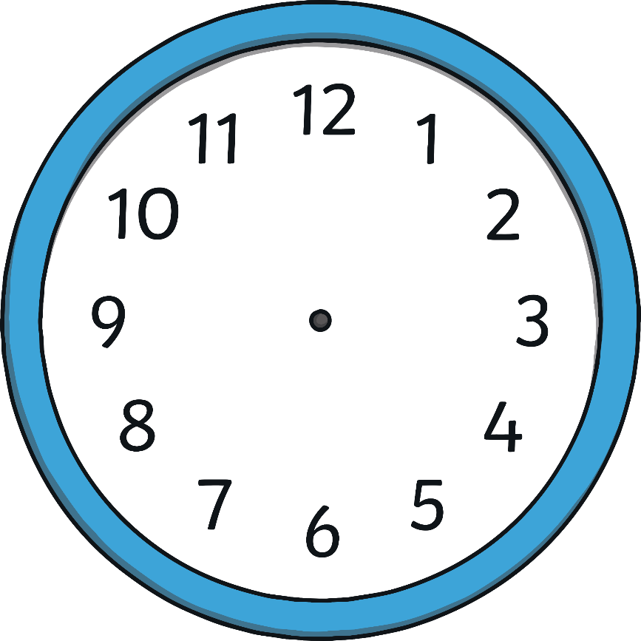
Hours and minutes
When the minute hand is pointing to 12 it is showing a full hour.
This clock is showing 8 o’clock
This is called o’clock.
Notes:
When the minute hand is pointing to 12, it is showing a full hour. We call this time ‘o’clock’.
On this clock, the hour hand is pointing at the 8 and the minute hand is pointing to the 12.
This clock is showing that the time is 8 o’clock.

Slide 4
What time is it?
1 o’clock

Slide 5
What time is it?
5 o’clock

Slide 6
What time is it?
6 o’clock

Slide 7
What time is it?
9 o’clock

Slide 8
What time is it?
12 o’clock

Slide 9
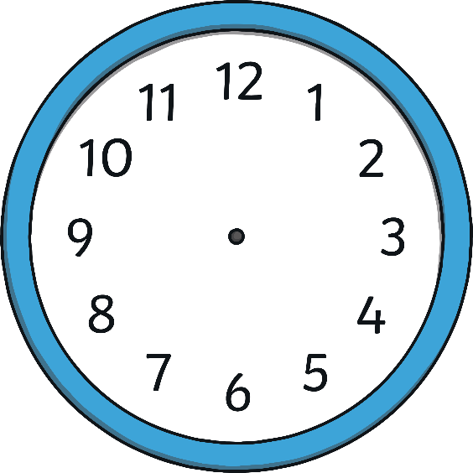
Which clock shows 2 o’clock?

Slide 10
Which clock shows 4 o’clock?

Slide 11
Which clock shows 10 o’clock?

Slide 12
Which clock shows 3 o’clock?

