Slide 1
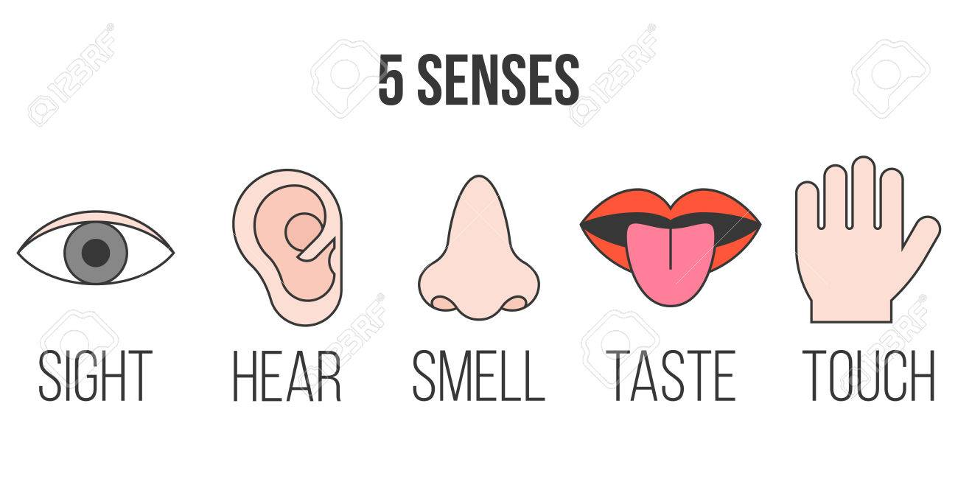
Our 5 Senses Week 5
P1/2 Super Science

Slide 3
BBC Teach - Using our sense of touch.

Slide 21
https://thedadlab.com

Slide 23
BBc Bitesize How does touch work?

