Slide 1
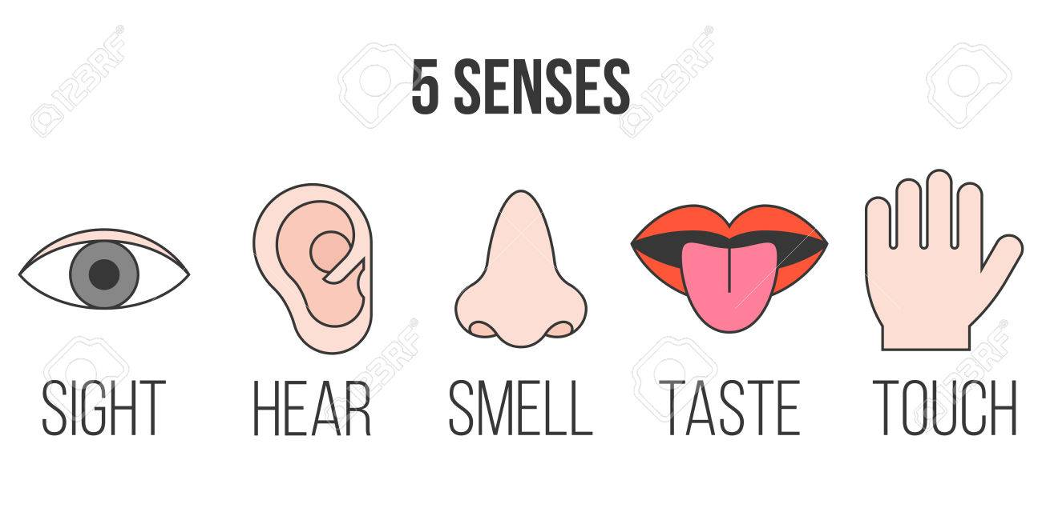
Our 5 Senses Week 4
P1/2 Super Science

Slide 3
Video- Your Tounge the Taste Maker

Slide 7
https://www.fantasticfunandlearning.com/fun-taste-test-science-experiments-kids.html Copy and paste Into browser or find link in the lab.
Video - Handa's Surprise

Slide 10
Taste
Useful describing words:
sweet cool bitter
zesty warm hot
sour sharp rich
bland rotten tart
strong citrus mild
umami tangy salty
savoury spicy

Slide 12
BBC Video Dr Ouch Taste!

