Slide 1
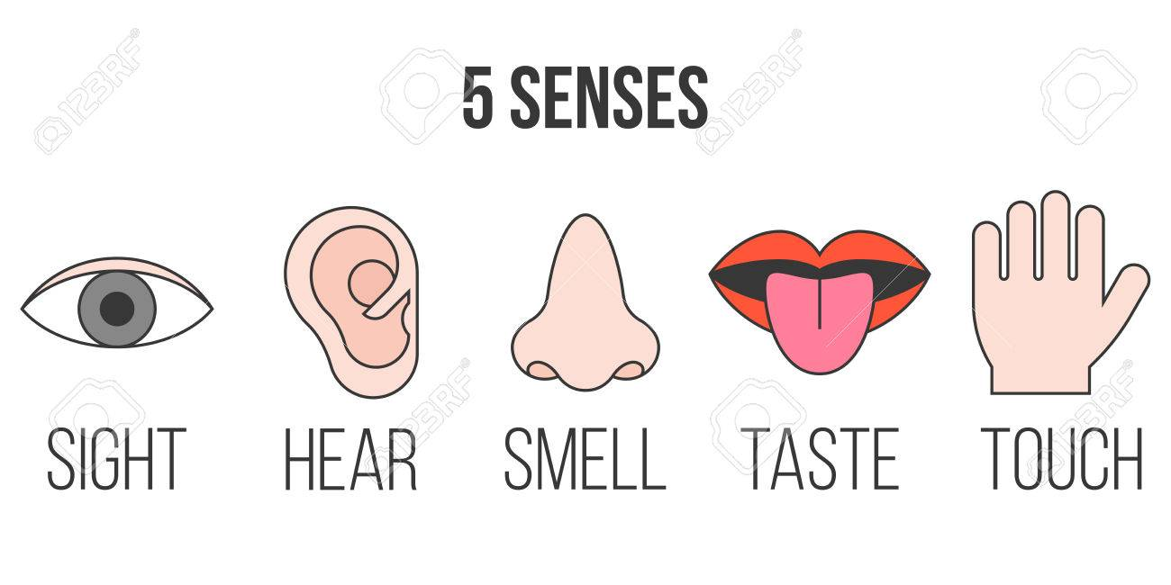

Our 5 Senses Week 3
P1/2 Super Science

Slide 2
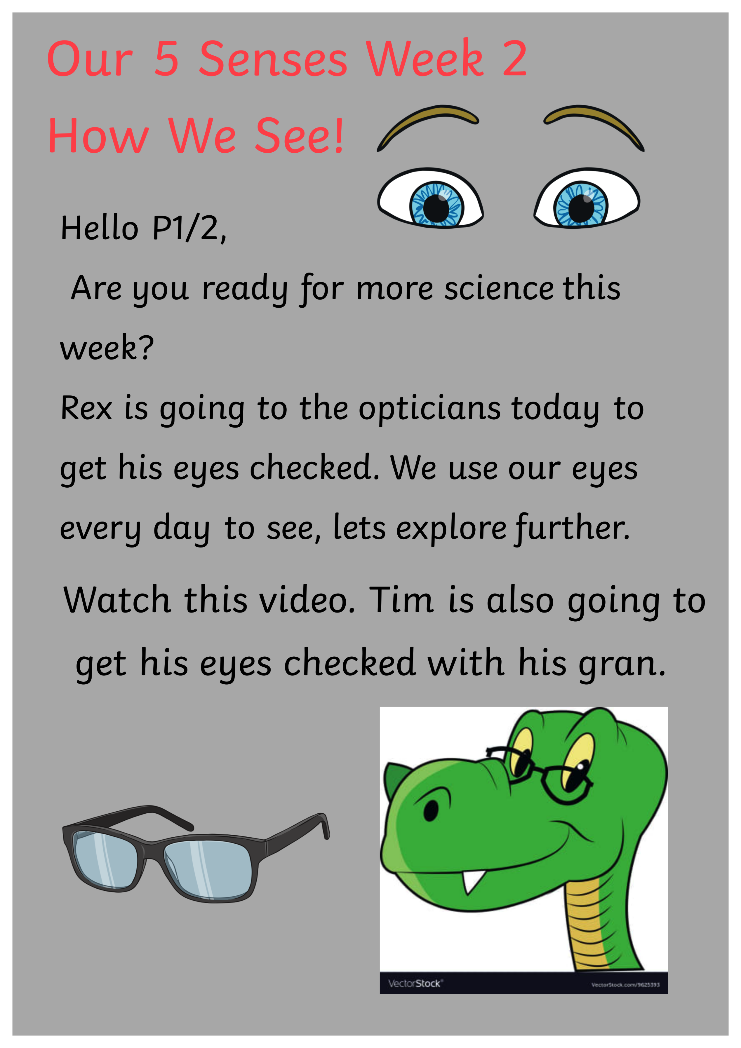

Slide 3
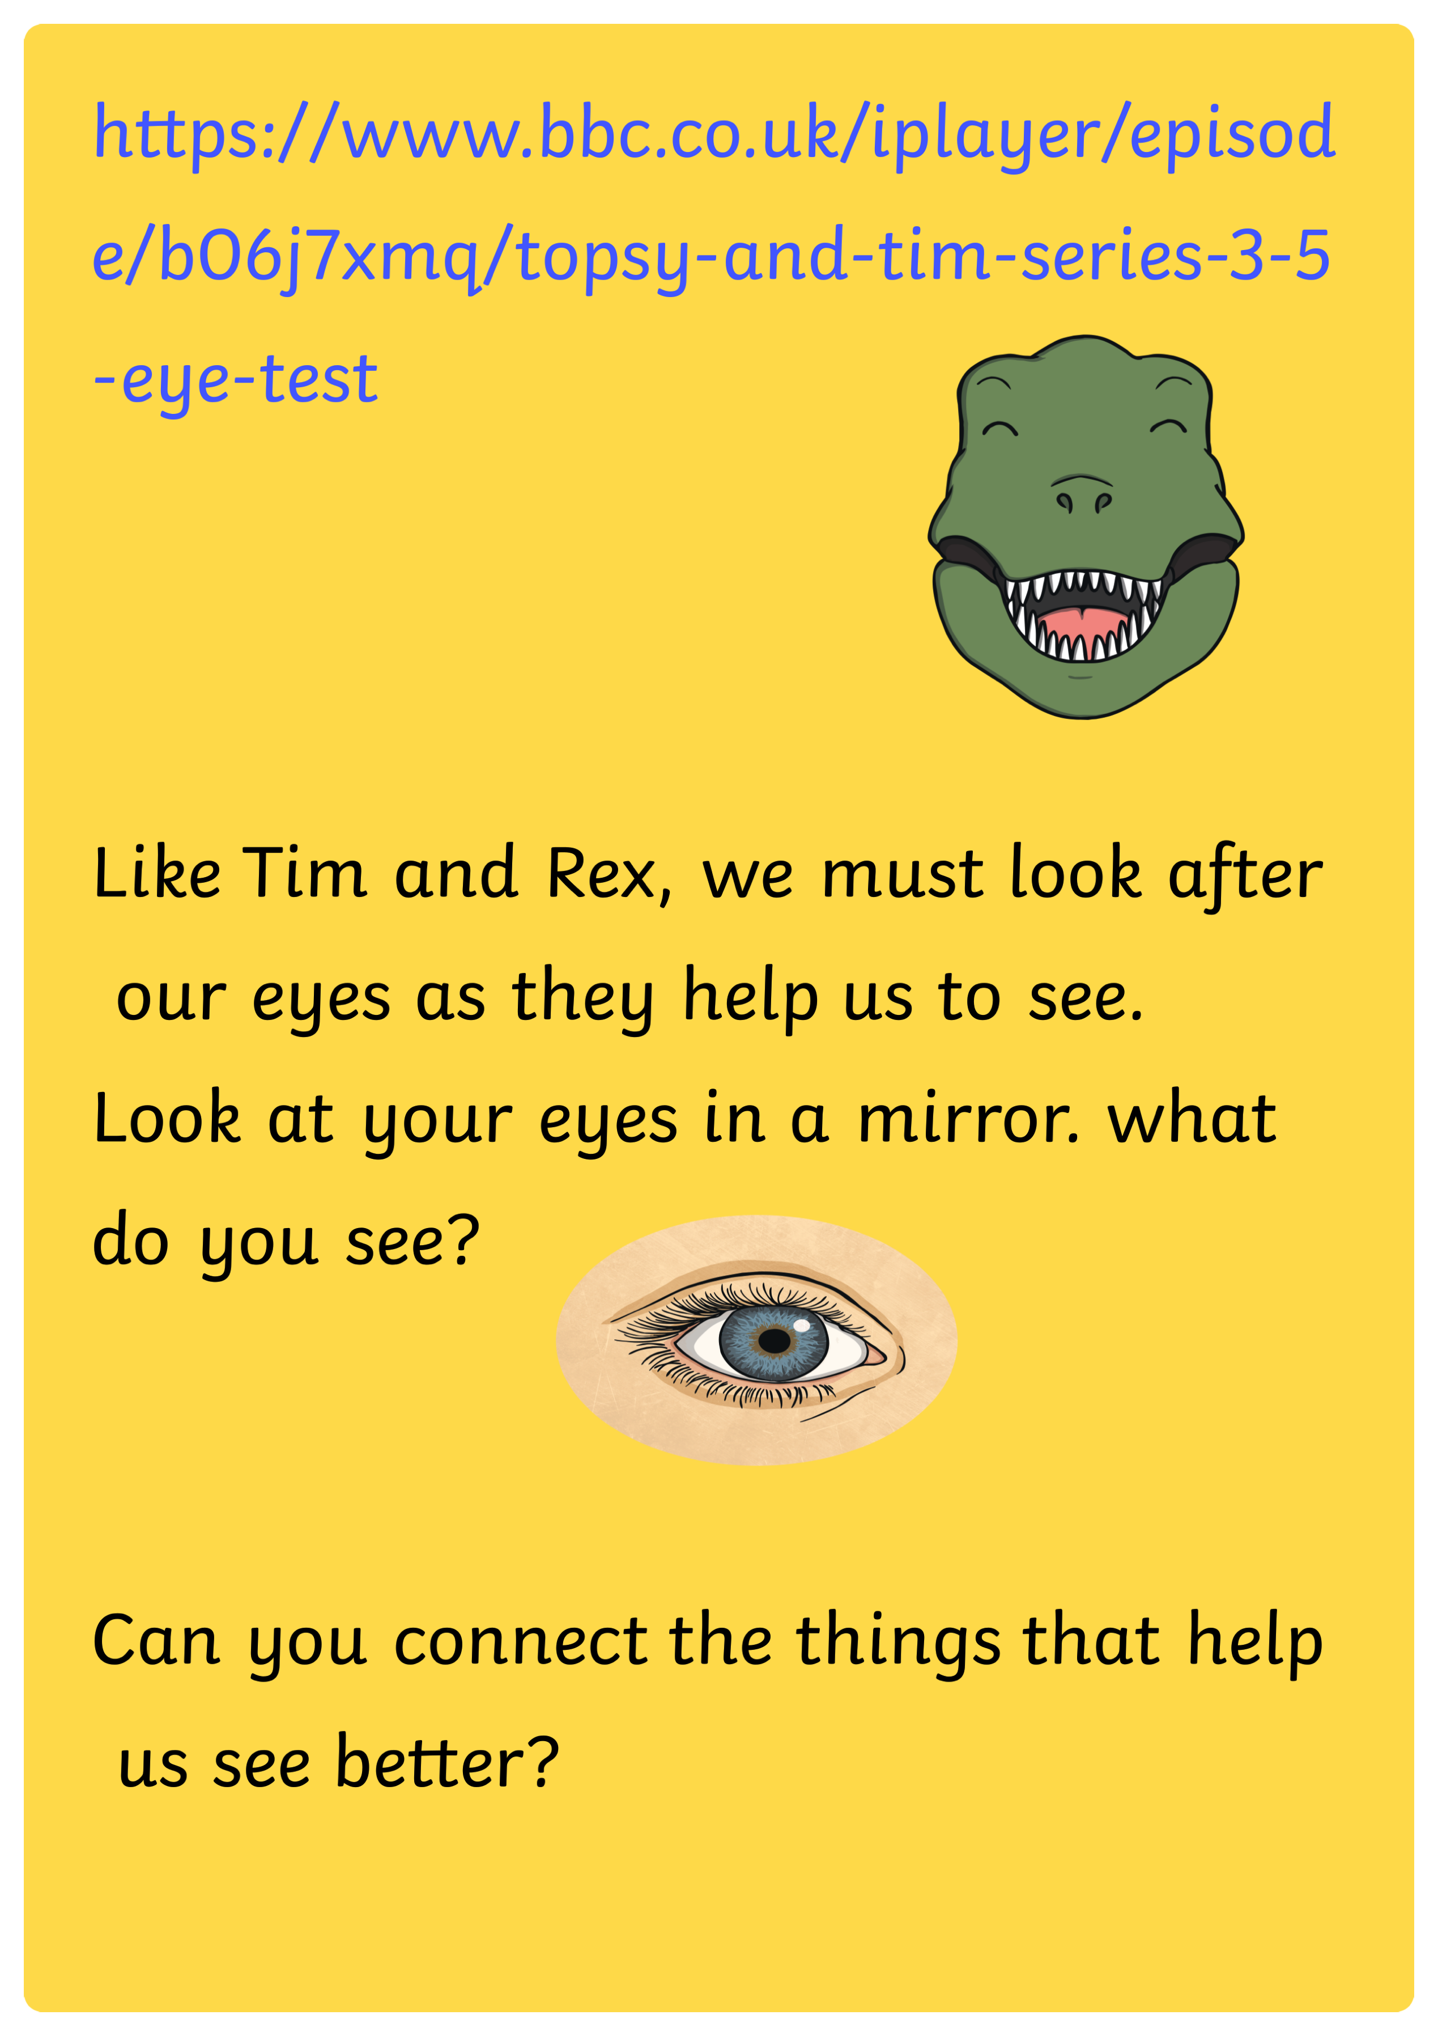
Topsy and Tim The Eye Test.

Slide 5
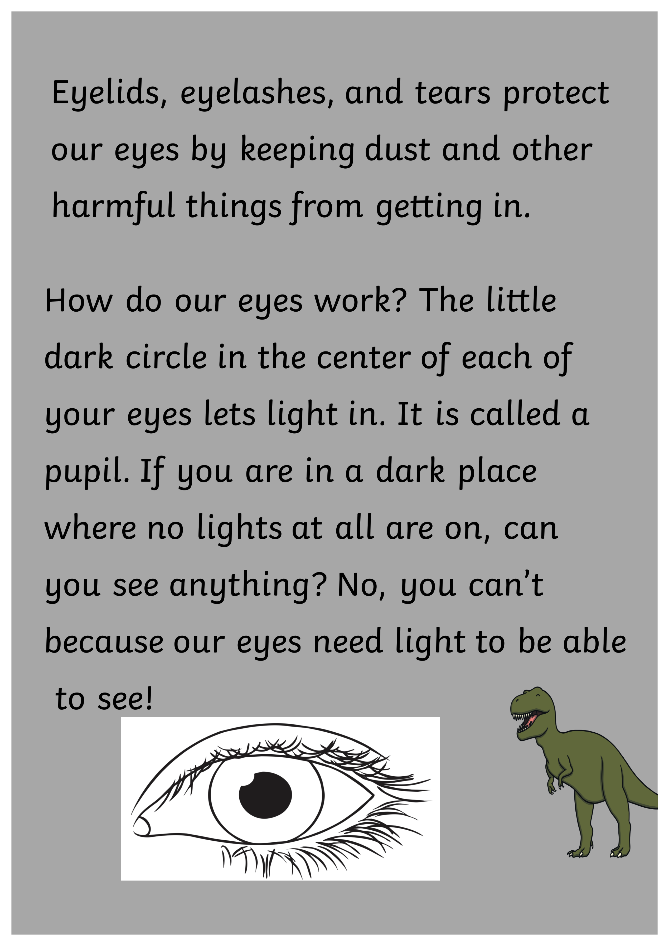

Slide 6
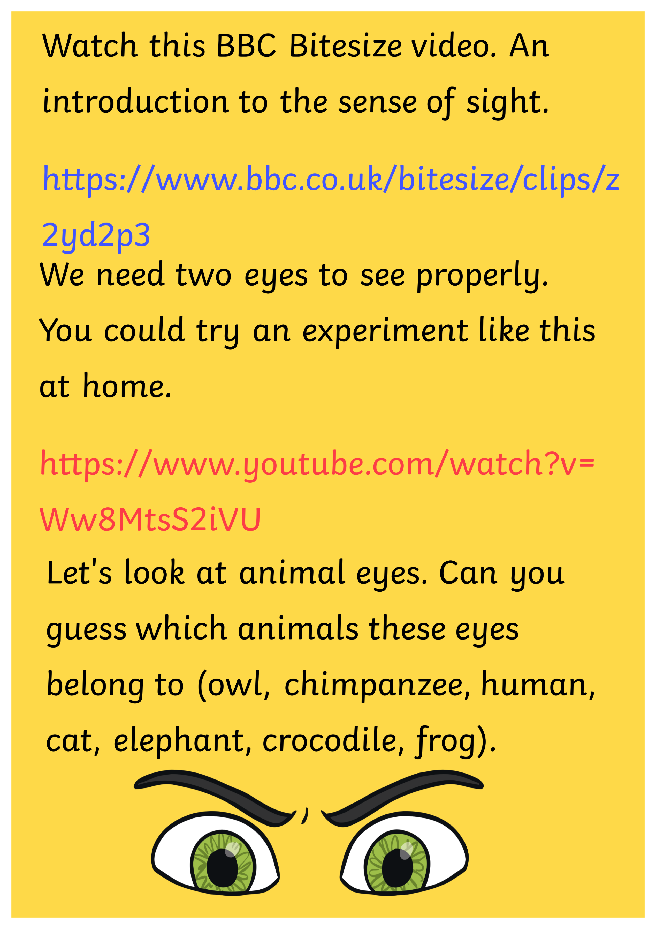
BBC Bitesize -Introduction to Sight.
One Closed Eye Experiment.

Slide 8
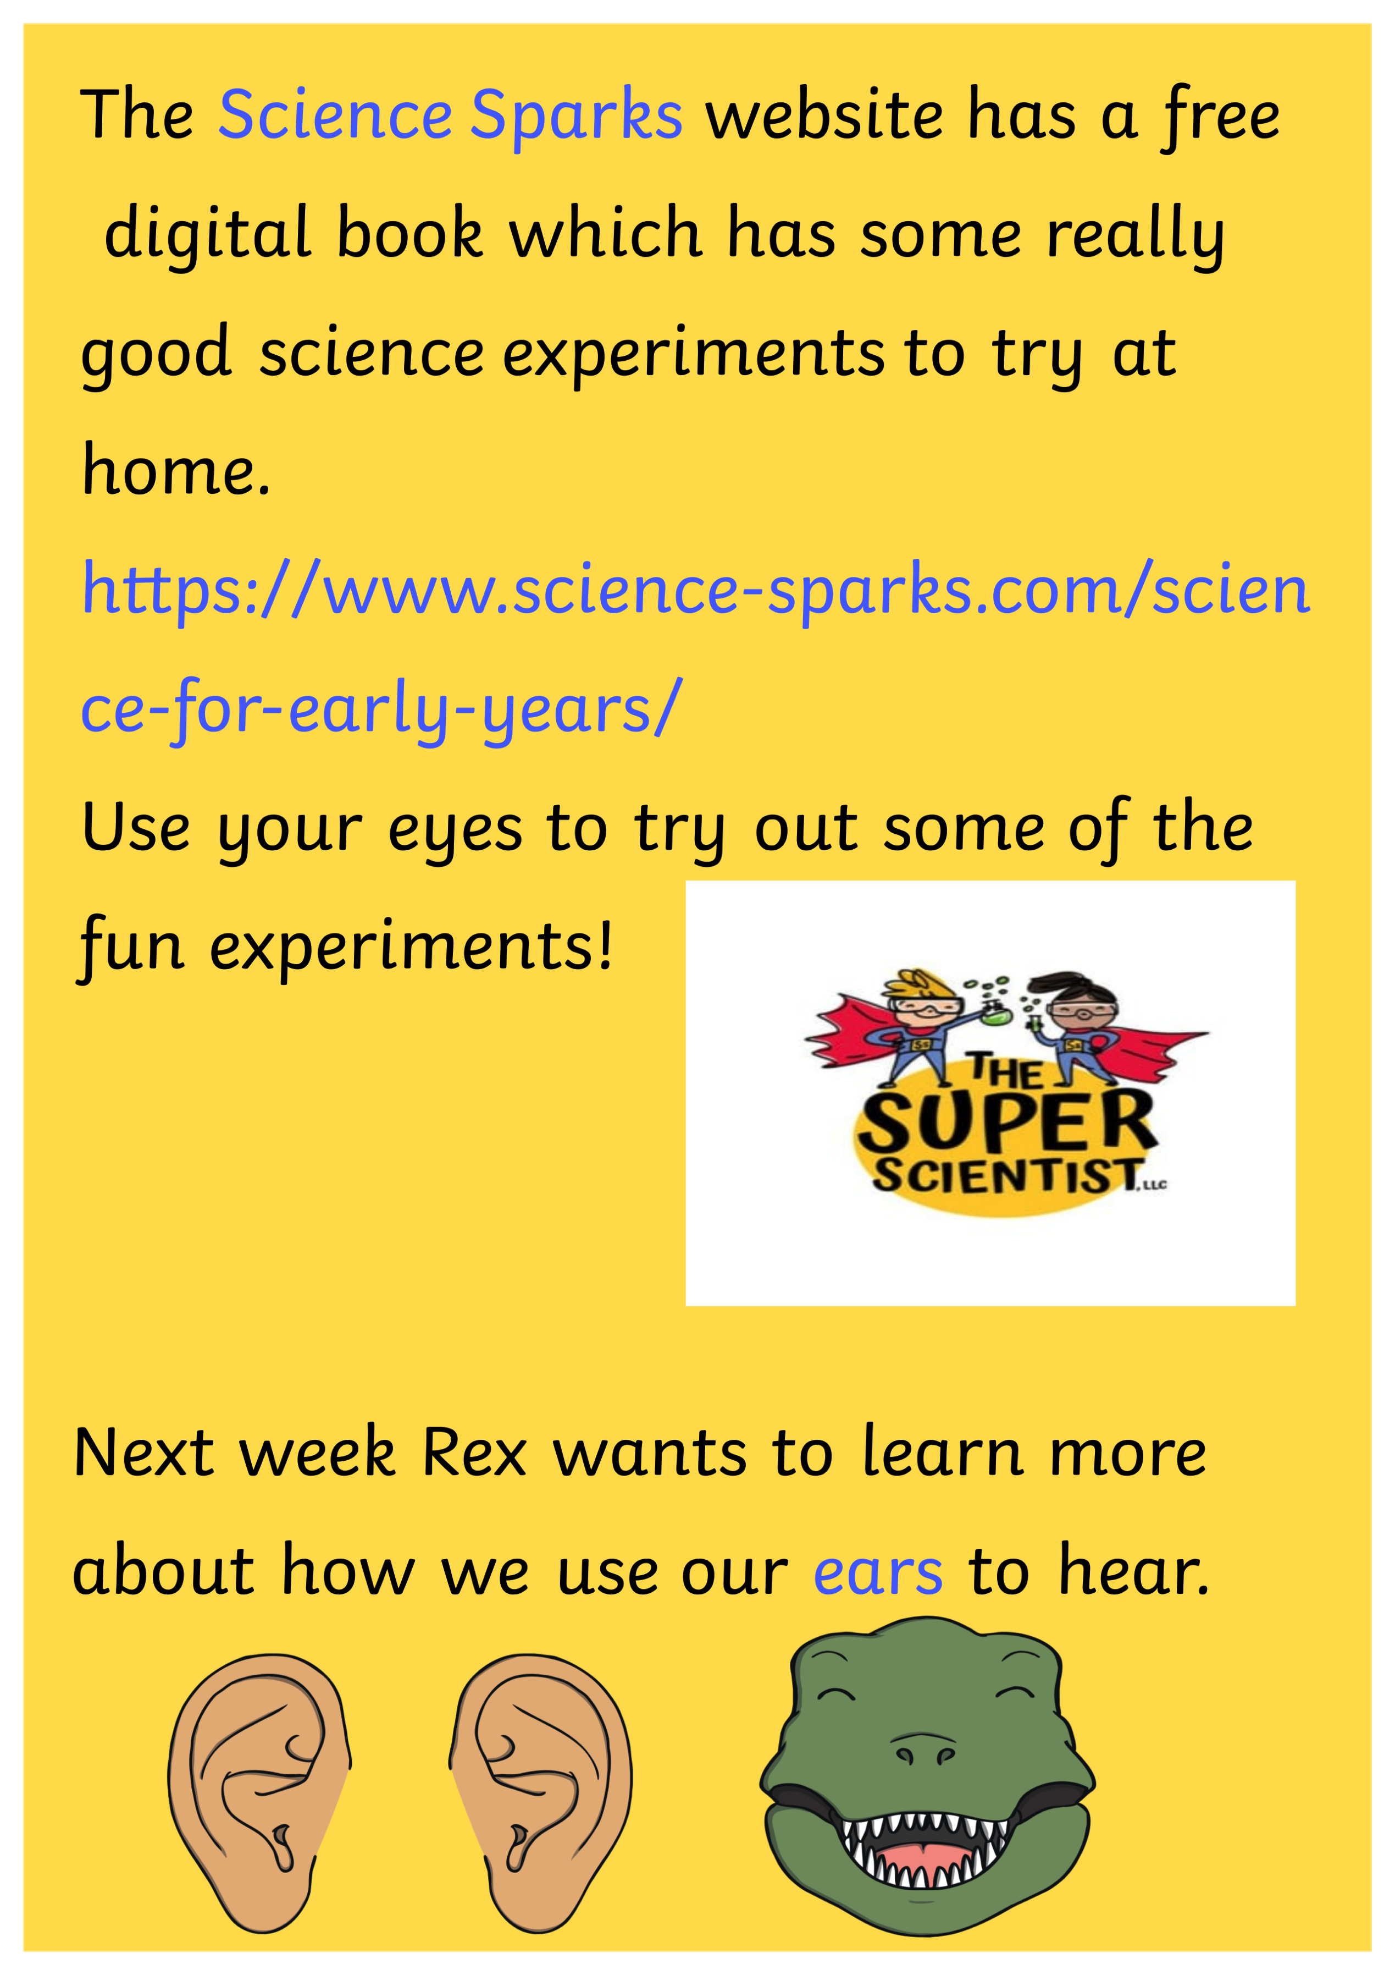
https://www.science-sparks.com/science-for-early-years/

