Slide 1
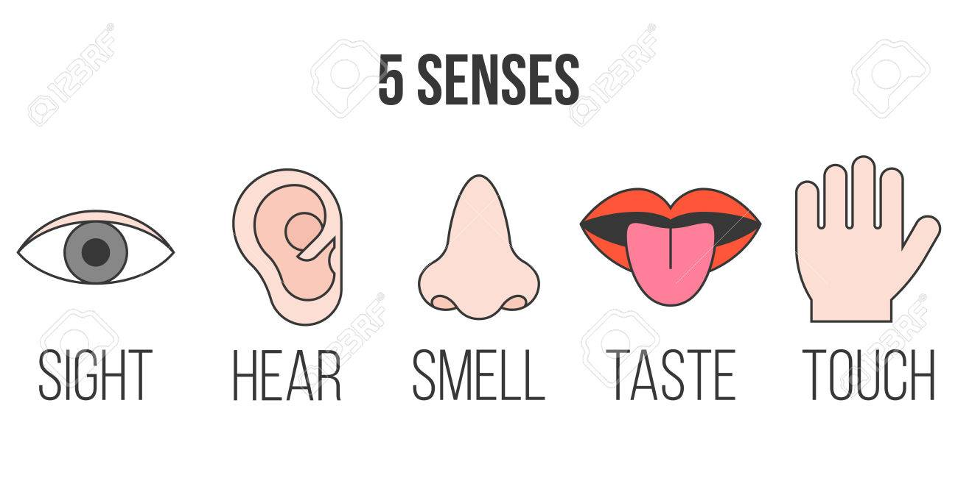
Our 5 Senses Week2
P1/2 Super Science

Slide 3
Smelling Activity/Experiment

Slide 4
Topsy and Tim- A Bad Smell

Slide 6
A sense of smell sing-a-long! Enjoy!

