Slide 1
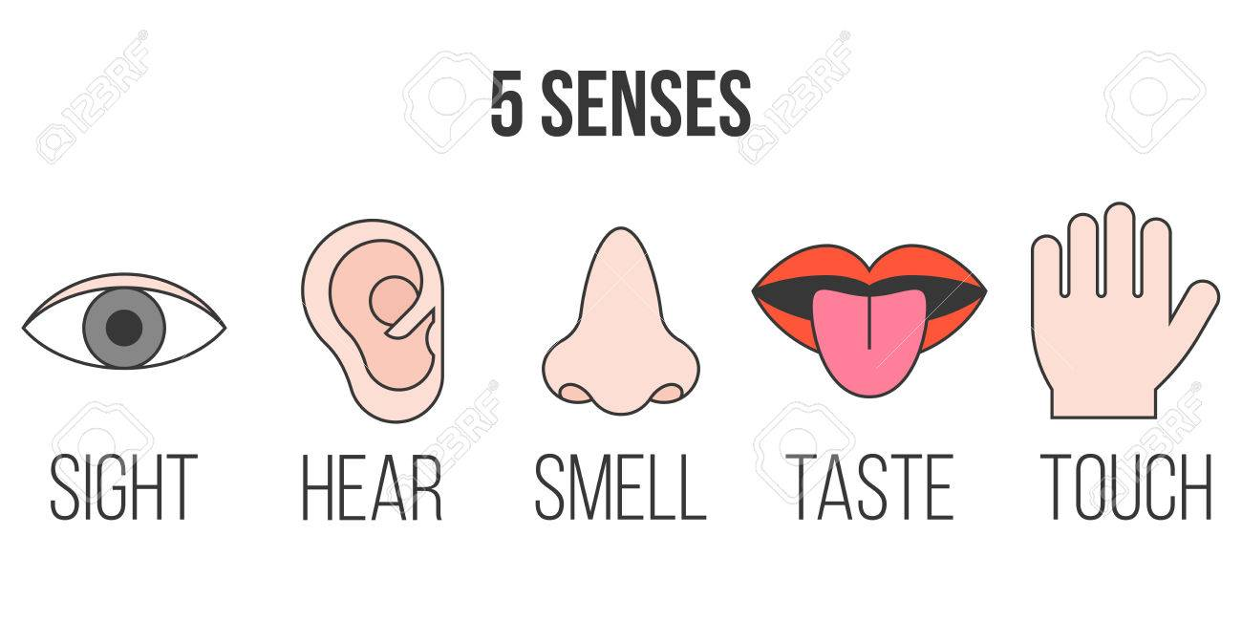
Our 5 Senses
P1/2 Super Science

Slide 2
https://www.abcya.com/games/five_senses

Slide 4
The Science of A String Telephone

