Slide 1
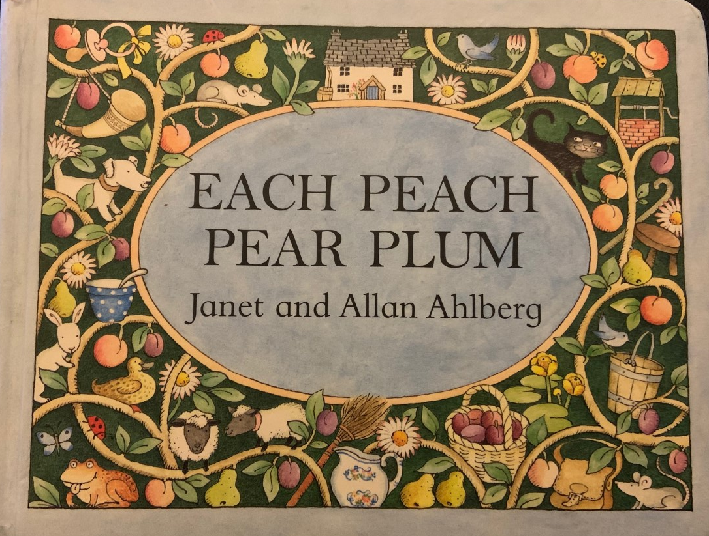
Each Peach Pear Plum
By Janet and Allan Ahlberg

Slide 3
Can you spy Tom?

Slide 5
Can you spy Mother Hubbard?

Slide 7
Where is Cinderella?

Slide 9
Can you see the bears?

Slide 11
Can you spy the baby?

Slide 13
Can you spy Bo Peep? She is wearing a large hat!

Slide 15
Jack and Jill are tumbling down?

Slide 17
Where is the Wicked Witch?

Slide 19
Can you spy Robin Hood?

Slide 21
Where are the bears?

Slide 27
How many people can you spy?

Slide 30
Activity Ideas
Some of the people we meet in Each Peach Pear Plum are also visited by the Jolly Postman, can you remember who?
Play I spy with your grownup… try and spot things with a ‘p’ or ‘i’ sound.
Reread Each Peach Pear Plum and try to find all of the words that rhyme.
Can you make up your own rhyme about one of the characters?

