Slide 2
Why is it important to know your times tables?
Learning your times tables is a useful skill in Numeracy.
Learning your times tables helps with mental maths calculations and allows you to solve more complicated problems as you develop a stronger recall of the facts.
Being able to recall number facts quickly is a skill and needs to be practised - everyone can get better at it!
Think about number bonds and how useful it is to be able to quickly answer questions to solve problems when adding and subtracting.
It’s the same with multiplication and division!

Slide 3
Ball and Beanbag
Individually throw a ball or beanbag into the air practising the answers of your chosen times table.
Work with a partner by standing two metres apart. Have them listen to you reciting the answers and check your accuracy.
Swap over but remember to use your own ball or beanbag.
Other ideas:
Bounce the ball off the ground.
Bounce the ball off a wall.
Recite the sum as you throw or bounce.

Slide 4
Test a Friend
Standing two metres apart, one person asks a question and the other person answers.
Other ideas:
Play “What is the question?” - One person gives an answer and the other person works out the question.
Increase the number of children, ask a question once you have answered and make your way through the group.

Slide 5
Buzz
Everyone stands in a circle, two metres apart. Choose a times table to practise the answers.
Start counting in turns from one and when you reach an answer from the times table you are working with, say “Buzz.” The next person continues the number sequence. See how high you can count. If a child gets an answer wrong, correct them.
Other ideas:
When you reach a station of the times table, say Buzz, then the sum.
Turn it into a game:
If a child gets the answer wrong, they can sit down. Last one standing is the winner.
See how quickly you can get the group to recall the sequence - if a child hesitates for too long, they are out and sit down.
Could you try more than one times table? Designate a new word to say for numbers that are part of the new times table (for example bing, boop, baa, etc).

Slide 6
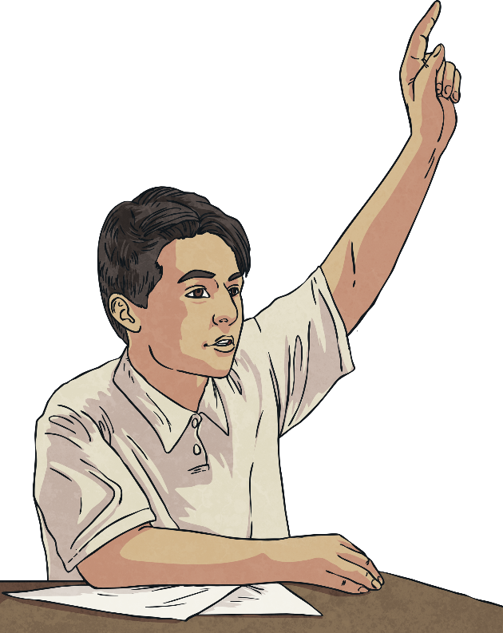
Hands Up Hands Down
Everyone stands in a space two metres apart.
Someone states a times table fact. If you think the answer is true, put your hands up and if you think the answer is false, put your hands down.
Choose someone to ask the next question.
Other ideas:
Turn it into a challenge or game; if you are wrong, sit down. Last one standing wins.
In pairs: How many you get right in a row before you swap over?

Slide 7
Quick Times Tables
For this game, you will need a clock with a second hand preferably on the wall.
In pairs, stand two metres apart.
Time each other reciting the times tables or answering a set number of questions. Time yourself or your partner.
Questions to consider:
Which times table are you most confident with? Why?
Which times table are you least confident with? Why?

Slide 8
The Answer Is the Same as...
In pairs, stand two metres apart. One person asks a question, for example 'What's another way of 6×2?'.
The person answers with a times table fact which equals the same number, for example 3×4 and then states the answer.
They then ask a new question.
Other ideas:
Choose a factor from the times tables. How many facts can you think of? Answer each question with a new question until you can’t think of any more. Then choose a new number.

Slide 9
10 Questions - Yes/No
In pairs, one person chooses a timetable sum but doesn’t tell the other person.
E.g. 5×4=20
Is this a sum in the 3 times table? No
Can the answer be divided by 4? Yes
Is the answer to the sum bigger than 10? Yes
Is it a number in the 10 times table? Yes
Is the answer 20? Yes (They still have to work out the question!)
Is the question from the 2 times table? No
Is the question from the 4 times table? Yes
Is the question 4×5? Yes
Once the partner has figured out the answer, the pair can swap roles with a new question in mind.
Within ten questions, the partner must try to work out the sum. They can only ask yes/no questions.
Check the example on the right for inspiration!

Slide 10
Odd One Out
Partner 1 gives a series of numbers.
Partner 2 needs to work out which is the odd one out and say why.
For example:
Partner 1 gives the numbers 7, 21, 36 and 56.
Partner 2 determines that 36 is the odd one out because the rest are in the 7 times tables.
Questions to think about:
Could you adapt it to have more players?
How could you make it more challenging?

