Slide 1
Supporting Families with Numeracy and Maths SL33
Robert McCallum
Quality Improvement Officer
20th February 2024

Slide 2
Outline
Free sources to support family learning
Types of activity
Why are these activities helpful?

Slide 3
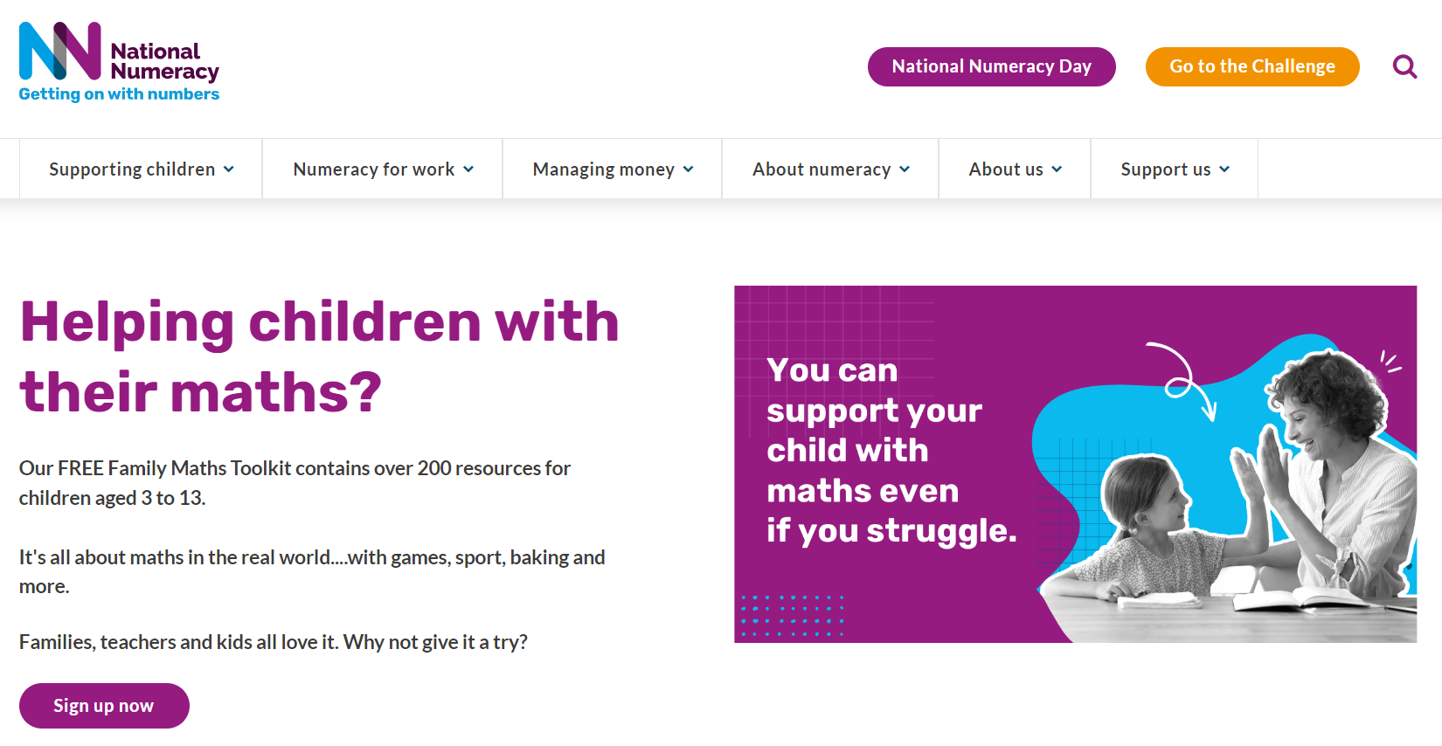
https://www.nationalnumeracy.org.uk/

Slide 4
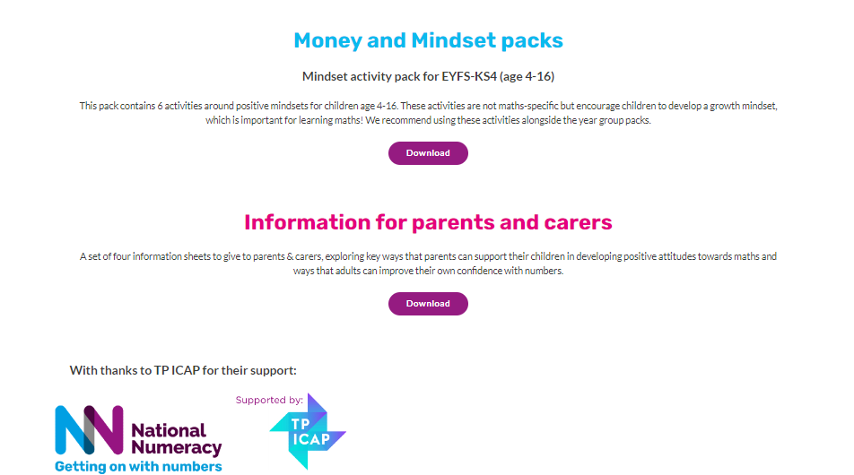

Slide 5
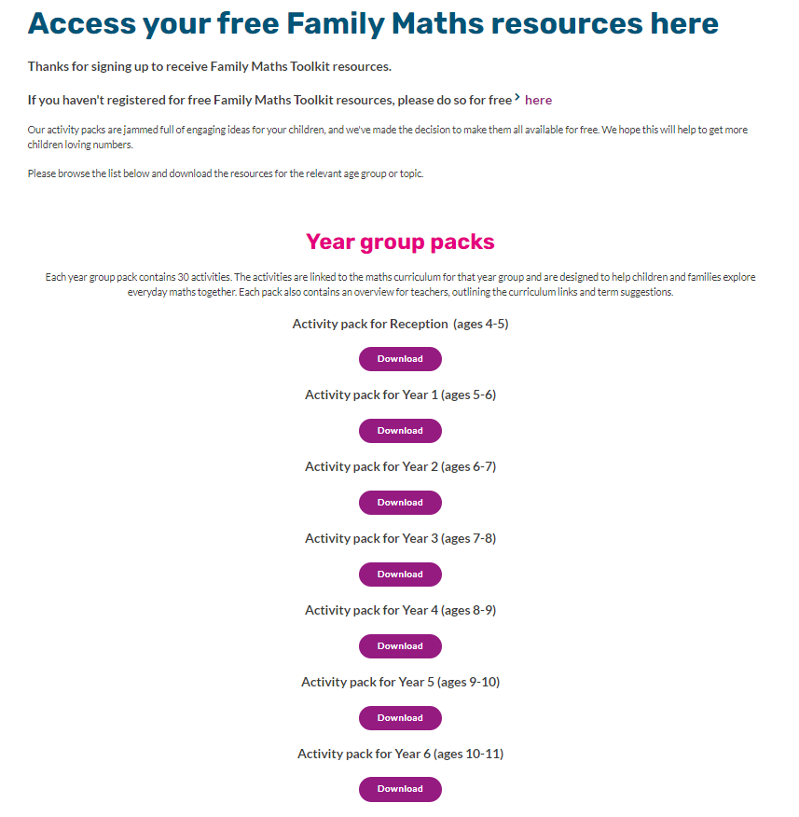

Slide 6
All of the Family Maths activities support the curriculum for excellence in Scotland. The resources have a strong focus on problem solving and reasoning. They are designed to encourage discussion between children and their parents or carers. They also link to cultural events and things around the home, helping children to see how maths connects to real life.

Slide 7
Problem Solving and Reasoning
Problem solving is the process of finding solutions to unfamiliar types of problems where the path is not obvious.
Problem solving is not only about answering word problems in maths. If a child has a readily available method to solve the problem, problem solving has not happened.
Reasoning is the action of thinking about something in a logical, sensible way.
Mathematical reasoning is the bridge between fluency and problem solving. It allows pupils to use the former to accurately carry out the latter

Slide 8
Managing Struggle!!
Building resilience
Not all problems are solved in 5 / 10/ 50 mins.
Aha moments.

Slide 9
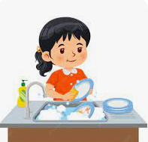
Low Floor, High Ceiling Tasks
Washing the Dishes
Go home tonight and offer to wash the dishes for a payment of 1p.
(Caution: There may be a reaction of surprise)
Then say
‘I’ll wash the dishes for 1p tonight and every night after this as long as my payment is doubled each night.’ (2p tomorrow night, 4p the night after)
How long would you need to wash the dishes to make this a worthwhile task?

Slide 10
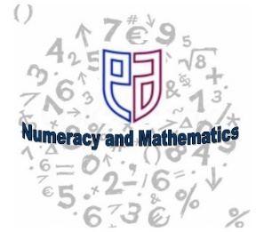
Thinking Mathematically strategic competence, adaptive reasoning, productive disposition
Integrating opportunities in daily practice for children to develop as mathematical thinkers. Key skills include:
• Visualising
• Working backwards
• Reasoning logically
• Conjecturing
• Working systematically
• Looking for patterns
• Trial and improvement.

Slide 11
Mathematical Talk
Talking mathematics should not be seen simply as a rehearsal in class of the vocabulary of mathematics,…It should extend to high-quality discussion that develops children’s logic, reasoning and deduction skills, and underpins all mathematical learning activity.
Sir Peter Williams (2008)

Slide 12
Families don’t need any special maths knowledge or equipment to enjoy the Family Maths activities. Children can draw pictures, write calculations, take photos or create diagrams in their answers. Creativity is encouraged!

Slide 13
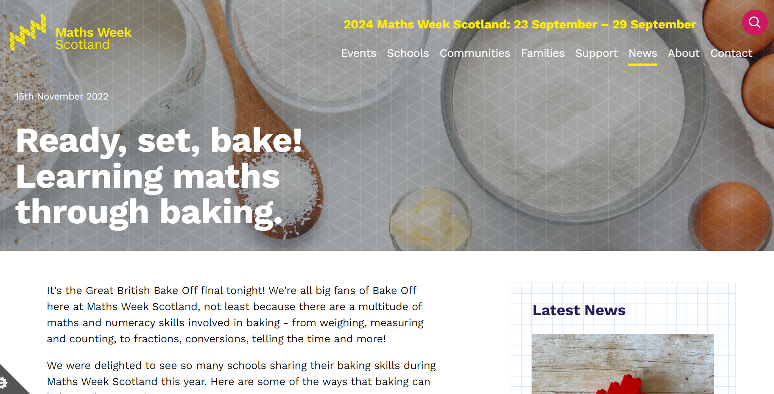
https://www.mathsweek.scot/news/learning-maths-through-baking

Slide 14
https://www.mathsweek.scot/news/diy-bead-string-puzzle

Slide 15
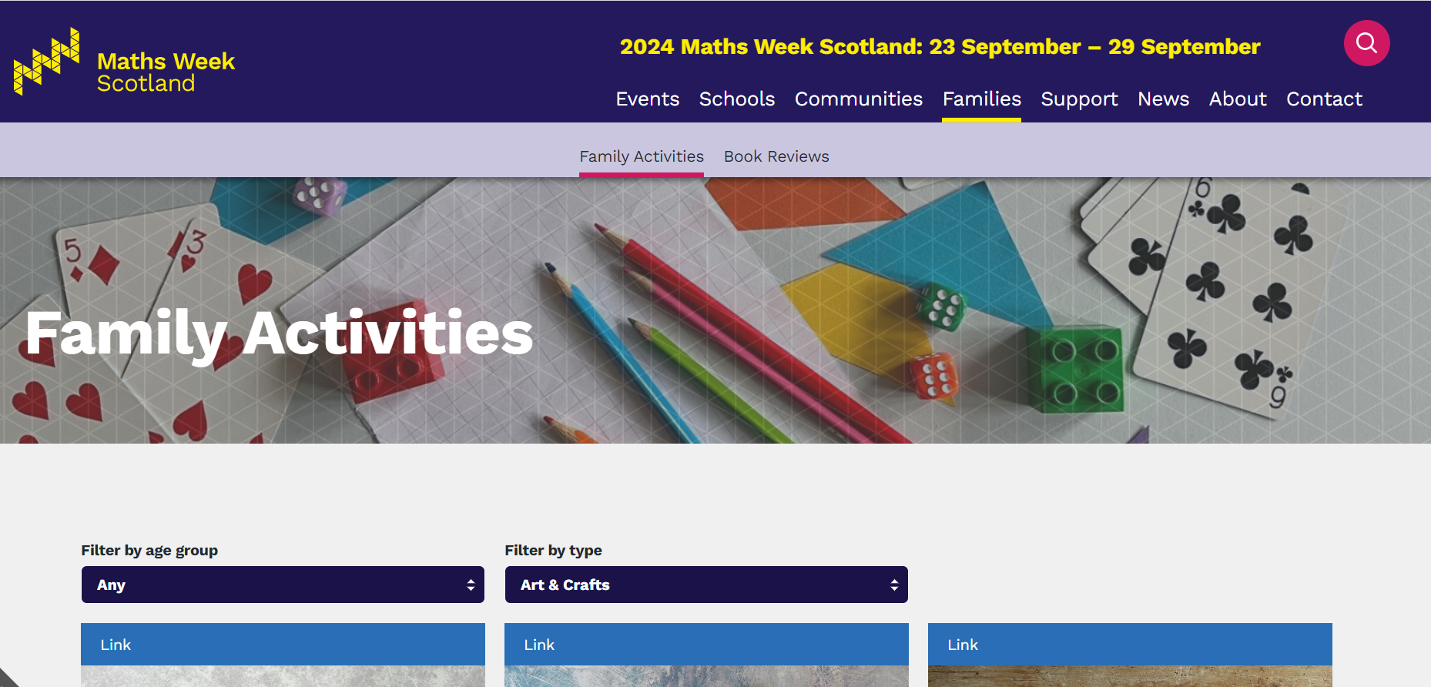
https://www.mathsweek.scot/families/activities?age=&type=crafts&page=1

Slide 16
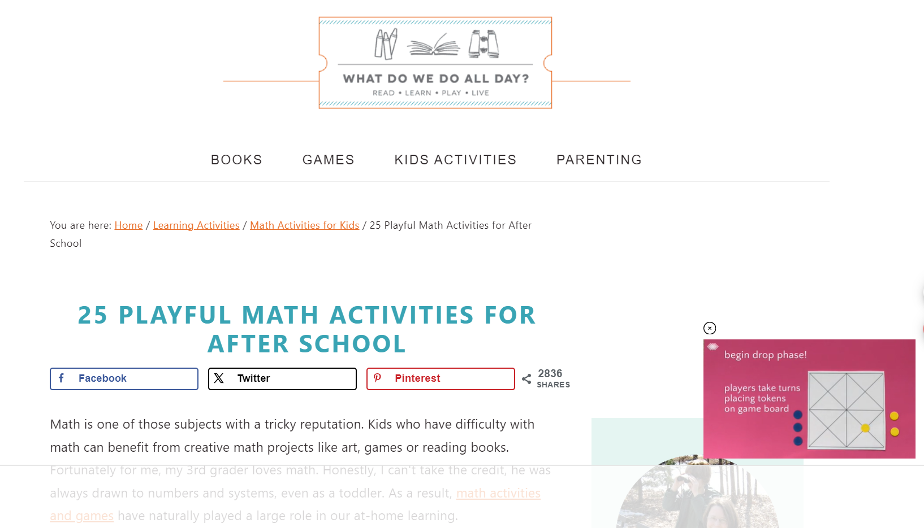
25 Playful Math Activities for After School (whatdowedoallday.com)

Slide 17
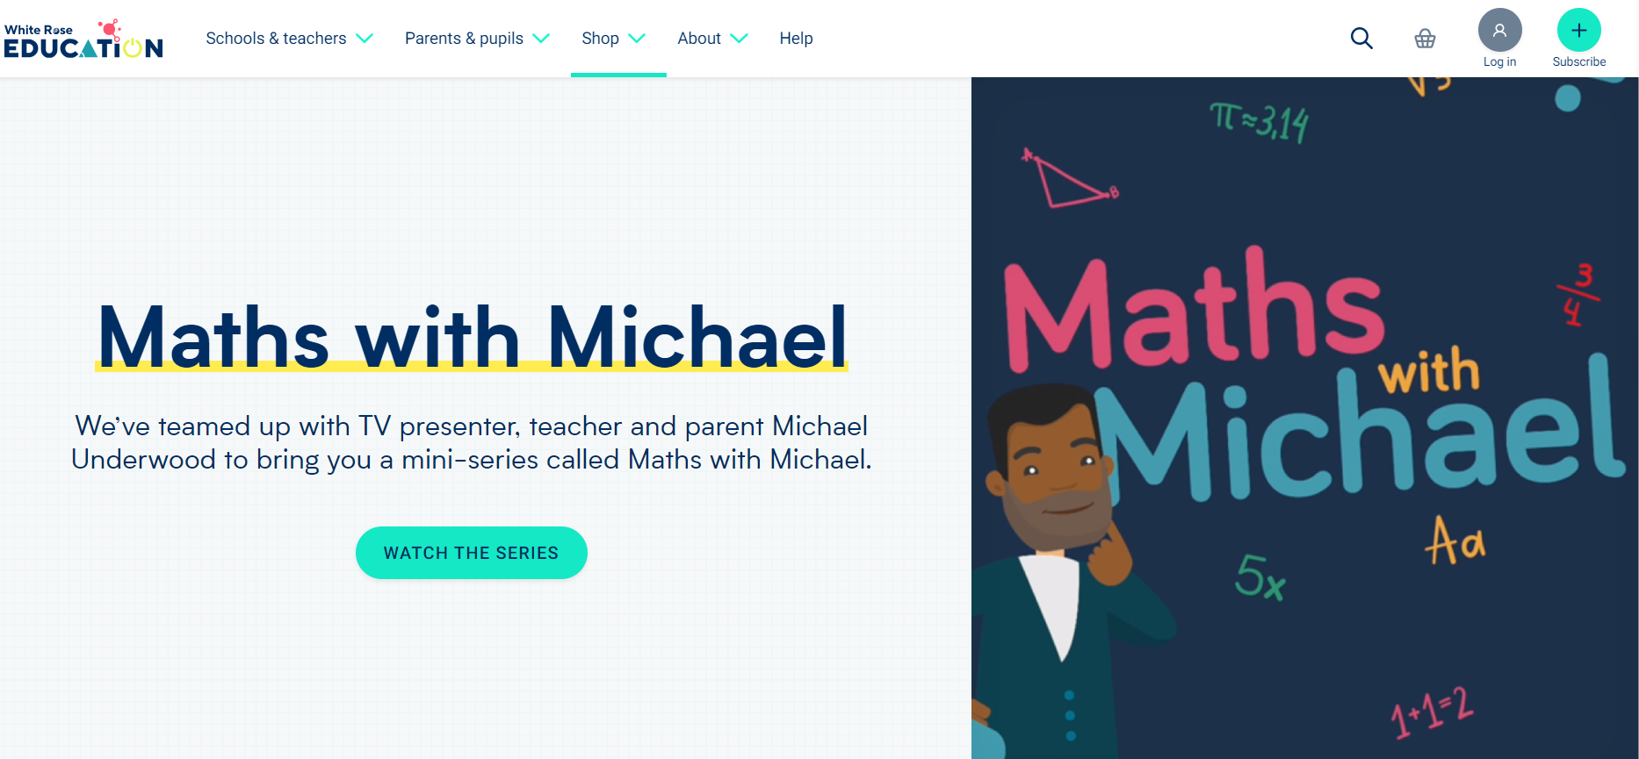
https://whiteroseeducation.com/parent-pupil-resources/maths/maths-with-michael

Slide 18
robert.mccallum@eastayrshire.org.uk

