Slide 1
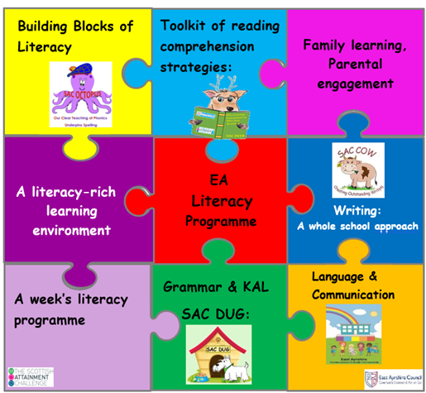
Home Link Workers Team
Literacy Ideas
20th February 2024

Slide 2
EA Literacy information for parents/carers

Slide 3
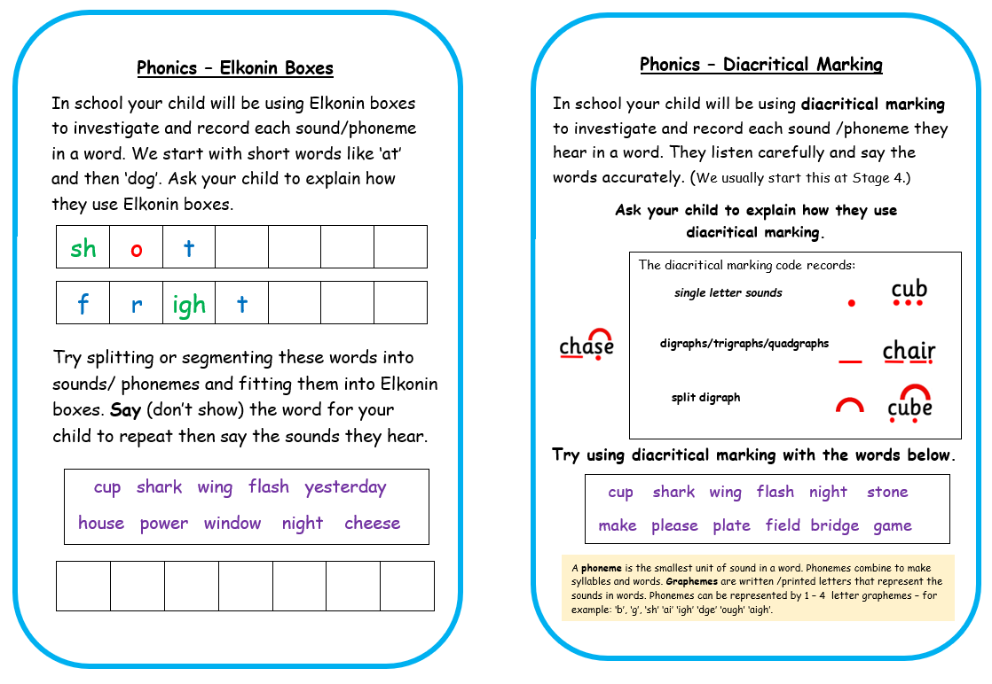

Slide 4
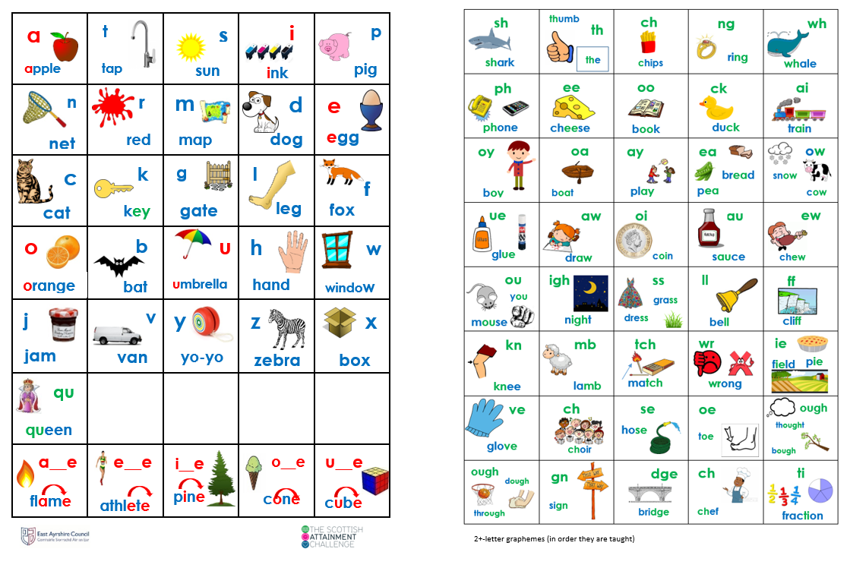

Slide 6
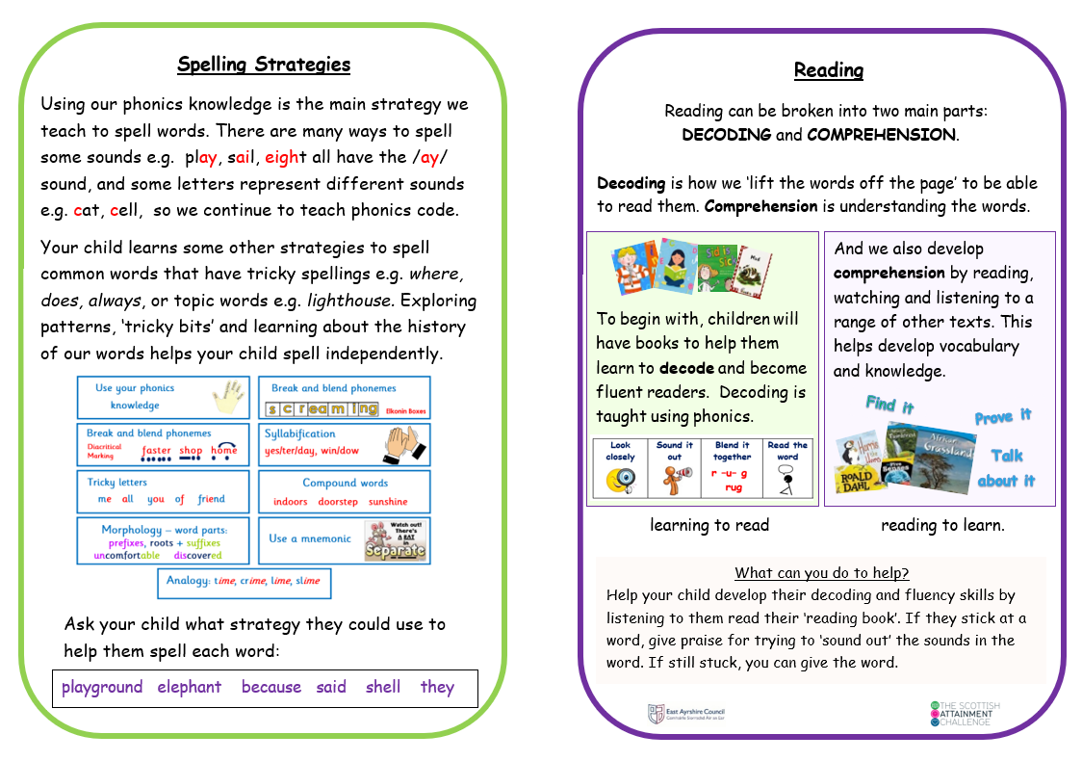

Slide 8
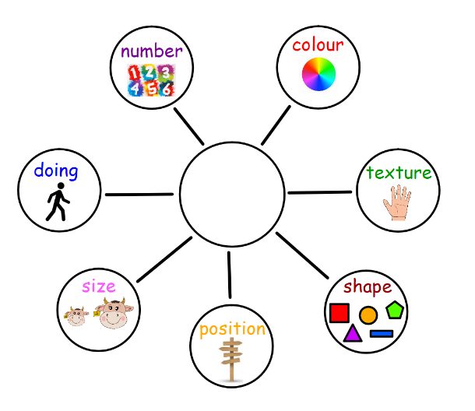
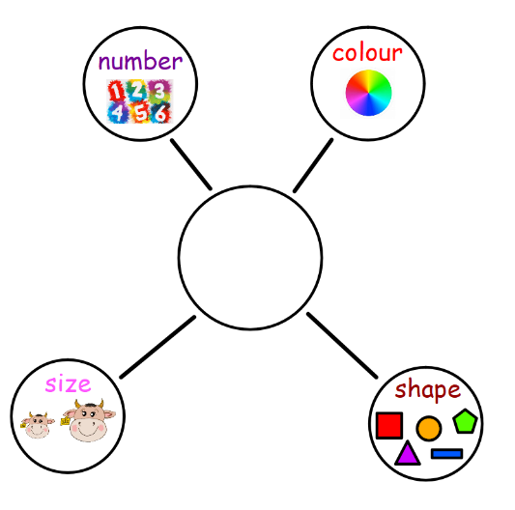
Description Bubbles

Slide 9
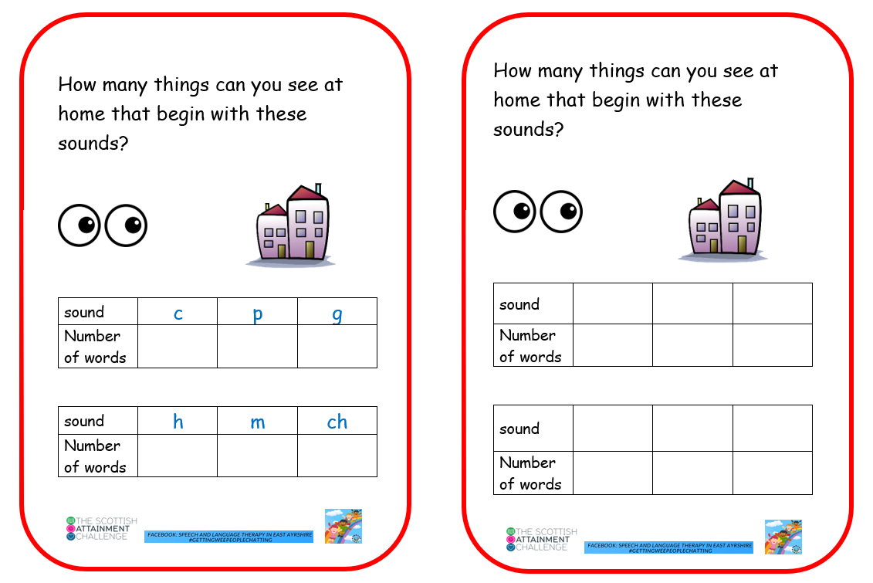
Language and Communication ideas for parents/carers

Slide 10
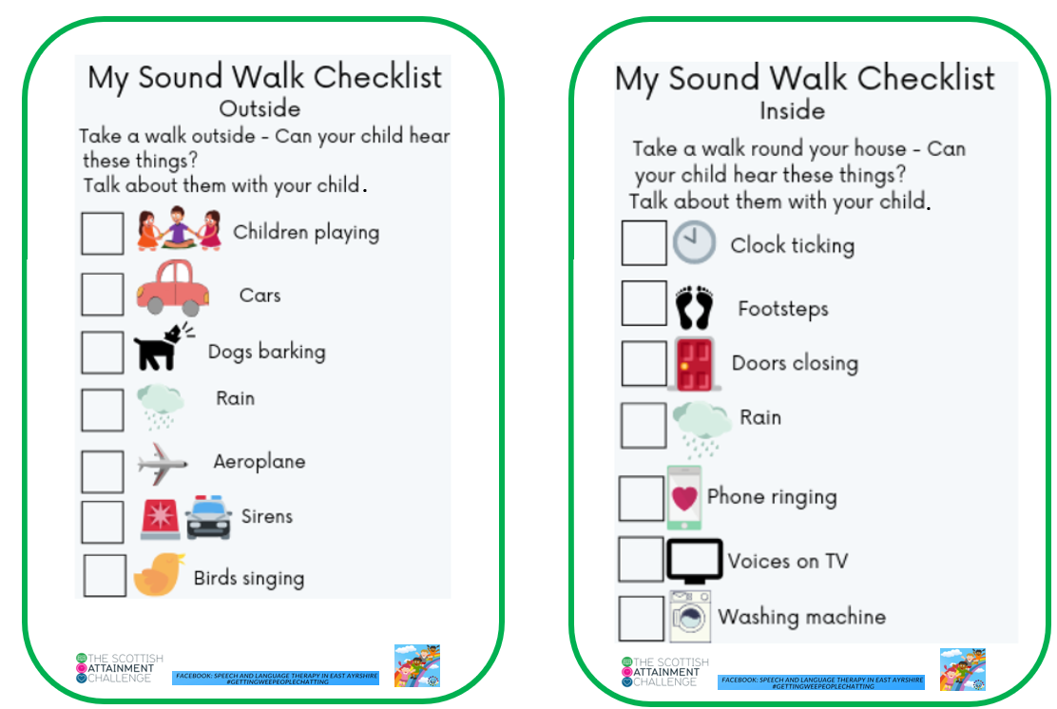

Slide 12
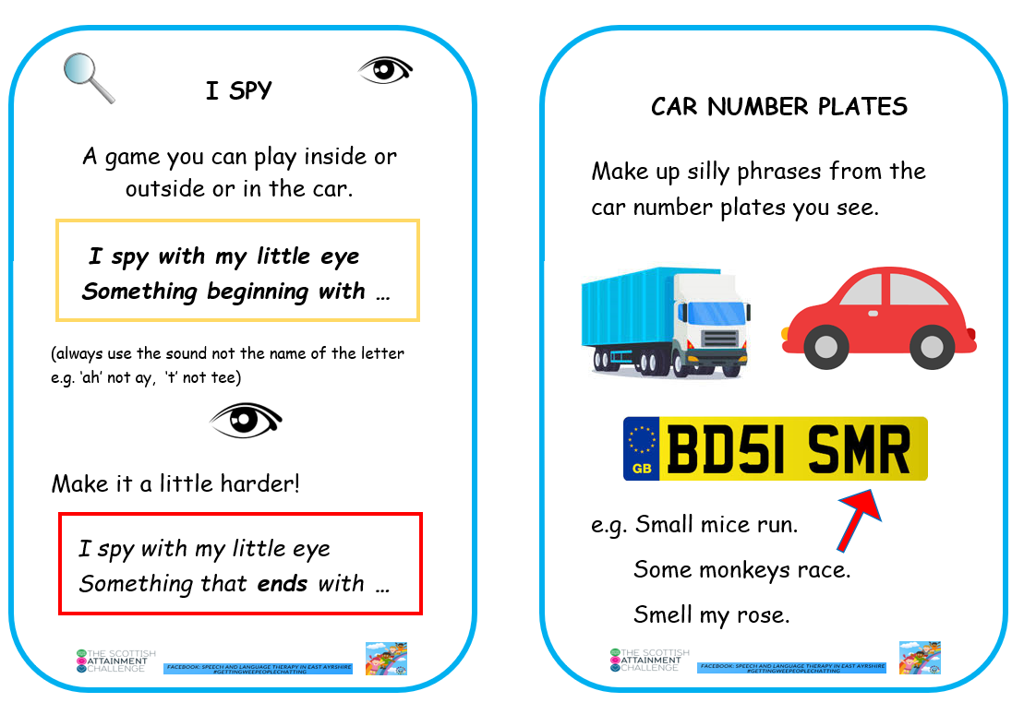

Slide 13
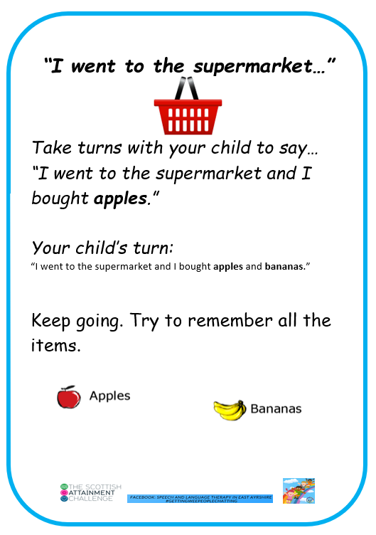
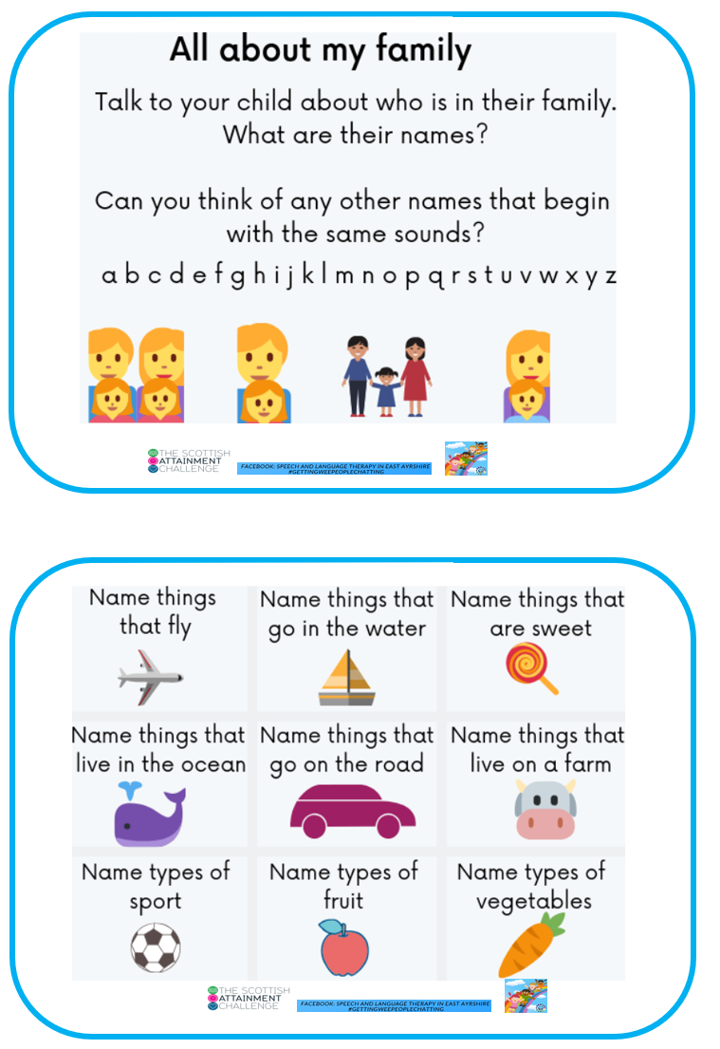

Slide 15
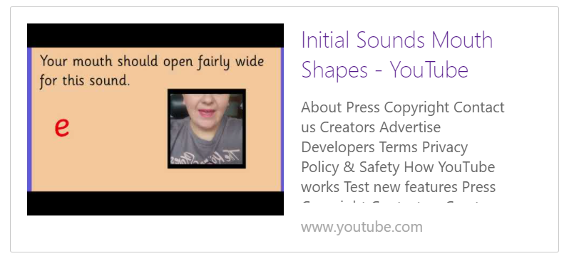
Click to play
Initial Sounds Mouth Shapes (youtube.com)

Slide 16
Key messages:
Use letter sounds, not names, for younger learners.
Letter formation – teach lower case letters.
Holding a pencil requires lots of practice and children need to develop their gross then fine motor skills.

Slide 17
Some links:
Bumps to Bairns (Highland)
Resource library for families - Speech and Language UK: Changing young lives
Bookbug for families - Scottish Book Trust
Play Scotland information leaflets Archives - Play Scotland
Play Ideas - Play Scotland

Slide 18
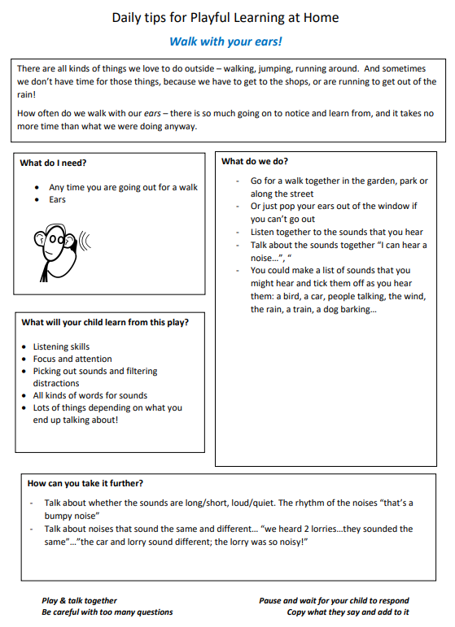
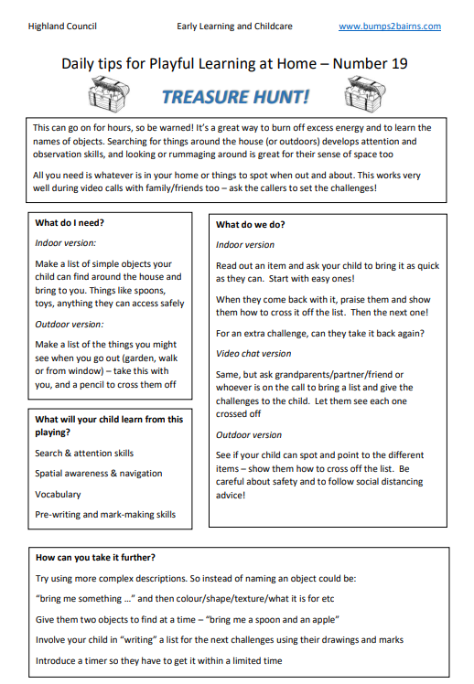
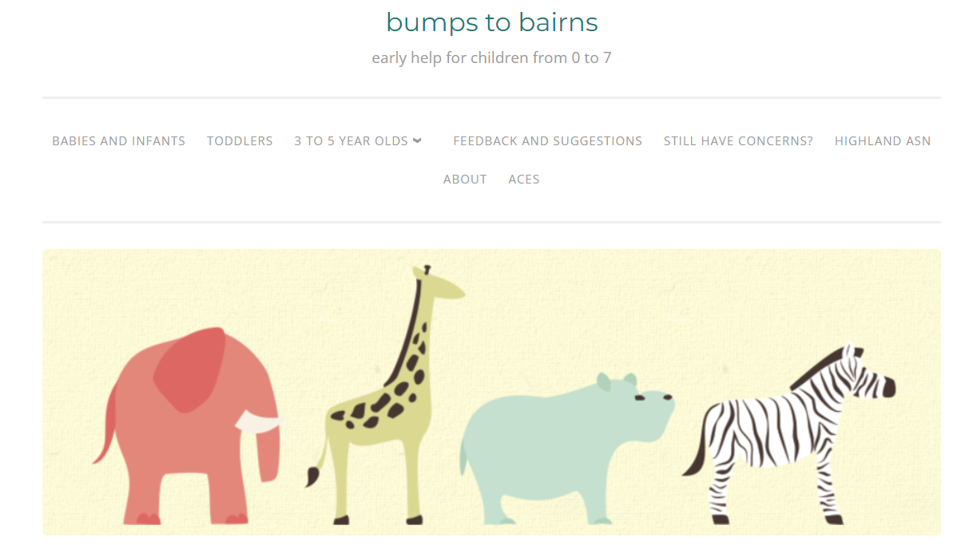
Bumps to Bairns (Highland)

Slide 19
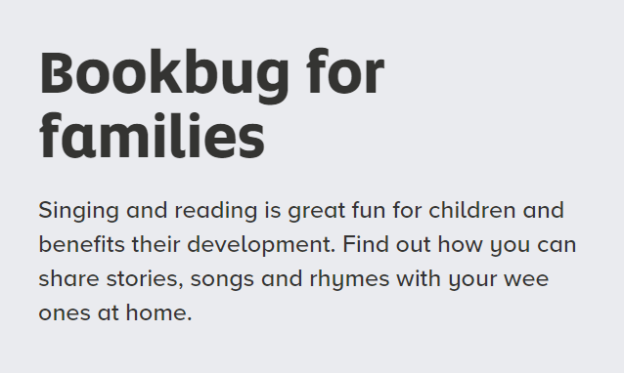
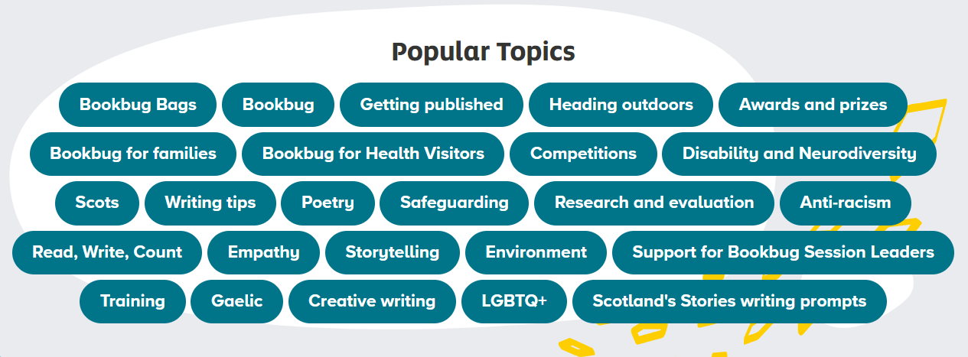

Slide 24
