Slide 1
Transition
Parental Empowerment

Slide 2
What is Transition?
Movement, passage or change from one position, state, stage, subject or concept to another change.

Slide 3
Examples of Transition
* Accidents or illness
* Buying a house / selling a house/ Moving house
* Divorce/ Getting married
* Having a baby
* Leaving for college
* Relocation
* Retirement
* Significant loss
* Starting a career or changing jobs
Notes:
* Accidents or illness
* Buying a house / selling a house/ Moving house
* Divorce/ Getting married
* Having a baby
* Leaving for college
* Relocation
* Retirement
* Significant loss (of a person, job, pet, or anything important)
* Starting a career or changing jobs

Slide 4
How does Transition make us feel?
* Excited
* Frightened
* Anxious
* Angry
* Happy
Notes:
Transition can make us feel very differently depending on the changes we are experiencing. Some of the emotions we might feel are ….

Slide 5
Reflect
* Think of a time in your life when you underwent a transition.
* Can you remember how you felt at the time?
* What emotions did you go through?
* Consider why you felt like that. How did you cope with these emotions?
* Think of all the people and resources you have that can help you cope with changes.
* What might you do differently in the future?
Notes:
* Think of a time in your life when you underwent a transition.
* Can you remember how you felt at the time?
* What emotions did you go through? Think about all of the positive and challenging emotions you had about it.
* Consider why you felt like that. How did you cope with these emotions?
* Think of all the people and resources you have that can help you cope with changes e.g. friends, family, doctor.
* What might you do differently in the future?

Slide 6
How do children express emotions?
* Behaviours
* Mood swings
* Tantrums
* Silence
* Withdrawn
* Hyperactivity
Notes:
Our emotions, how we think and how we behave (what we do) are all linked. We often notice how we feel (our emotion) before we notice what we are thinking or how we react (behave) to that feeling. This is no different for children. Children experience the same complex emotions that we do as adults. When a child can make the link between their thoughts, their emotions and their behaviour, they are less likely to struggle when difficult emotions occur.

Slide 7
Activity
Moving house | Facing a test or an exam
Loss of pet hamster | Lost or broken mobile phone
Divorce of parents | Isolation (illness eg COVID)
Change from Primary to secondary | Moving house
New baby sibling | Loss of grandparent
Notes:
Here are a range of Transitions a child might experience? Rate them on a scale of 1-10 in order of importance of event in their child’s lives. 1 being the most impactful, 10 being the least.
Allow them 10 minutes to rate.
Explain to group that there is no correct or incorrect order. Explain that the each Transition is personal to every individual be that adult or child and that Transitions are an inevitable part in everyone’s life journey.

Slide 8
How can we talk to our children?
How can we talk to our children that might encourage them to share their feelings?
What questions can we ask them?
Am I listening to them?
Here are some things to consider when talking to your children:
* Set aside time for talking and listening to each other.
* Talk about everyday things as you go through your day
* Be open to talking about all kinds of feelings, including anger, joy, frustration, fear and anxiety.
* Tune in to what your child’s body language is telling you, and try to respond to non-verbal messages too.
Notes:
Here are some ideas:
Set aside time for talking and listening to each other. Family meals can be a great time to do this.
Turn off phones, computers and televisions when you and your child are communicating. This shows that you’re completely focused on the interaction or conversation.
Talk about everyday things as you go through your day. If you and your child are used to communicating a lot, it can make it easier to talk when big or tricky issues come up.
Be open to talking about all kinds of feelings, including anger, joy, frustration, fear and anxiety. This helps your child develop a ‘feelings vocabulary’. But it’s best to wait until you’ve calmed down from strong emotions like anger before you talk about them.
Tune in to what your child’s body language is telling you, and try to respond to non-verbal messages too. For example, ‘You’re very quiet this afternoon. Did something happen at school?’
Involve your child in conversations – this could be as simple as asking, ‘What do you think about that?’

Slide 9
Active listening with children
Active listening is key to good communication and great for your relationship with your child. That’s because active listening shows your child that you care and are interested in them. It can also help you learn and understand more about what’s going on in your child’s life.
Here’s how active listening can be done with your child:
Use your body language to show you’re listening. For example, face your child and make eye contact. If your child likes to talk while doing activities, you can show you’re listening by turning to look at your child and getting close to them.
Watch your child’s facial expressions and body language. Listening isn’t just about hearing words, but also about trying to understand what’s behind those words.
Build on what your child is telling you and show your interest by saying things like ‘Tell me more about ...’, ‘Really!’ and ‘Go on ...’.
Repeat or rephrase what your child has said from time to time. This lets your child know you’re listening and helps you check what your child is saying.
Try not to jump in, cut your child off, or finish sentences – even when your child says something strange or is having trouble finding words.
Don’t rush into problem-solving. Your child might just want you to listen, and to feel that their feelings and point of view matter.
Prompt your child to tell you how they feel by describing what you think they’re feeling – for example, ‘It sounds like you felt left out when your friend wanted to play with those other kids at lunch’. Be prepared to get this wrong, and ask your child to help you understand.
Notes:
Active listening is key to good communication and great for your relationship with your child. That’s because active listening shows your child that you care and are interested in them. It can also help you learn and understand more about what’s going on in your child’s life.
Here’s how to do active listening with your child:
Use your body language to show you’re listening. For example, face your child and make eye contact. If your child likes to talk while doing activities, you can show you’re listening by turning to look at your child and getting close to them.
Watch your child’s facial expressions and body language. Listening isn’t just about hearing words, but also about trying to understand what’s behind those words.
Build on what your child is telling you and show your interest by saying things like ‘Tell me more about ...’, ‘Really!’ and ‘Go on ...’.
Repeat or rephrase what your child has said from time to time. This lets your child know you’re listening and helps you check what your child is saying.
Try not to jump in, cut your child off, or finish sentences – even when your child says something strange or is having trouble finding words.
Don’t rush into problem-solving. Your child might just want you to listen, and to feel that their feelings and point of view matter.
Prompt your child to tell you how they feel by describing what you think they’re feeling – for example, ‘It sounds like you felt left out when Felix wanted to play with those other kids at lunch’. Be prepared to get this wrong, and ask your child to help you understand.

Slide 10
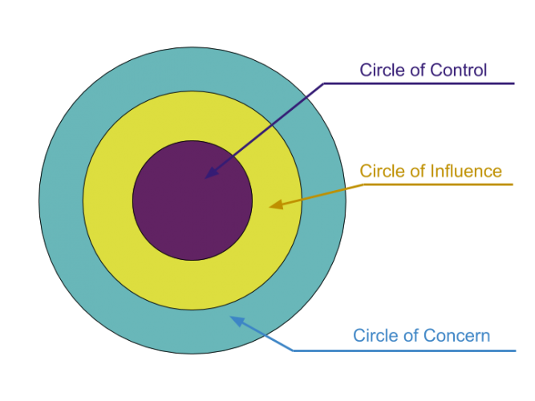
Activity
Notes:
On a large sheet of paper, draw 3 circles like the image shown.
Write your areas of concern in the outer circle. There might be lots of things that are of concern to you or are factors that could be affecting how you feel.
You might feel there aren’t many things that you can actively control. You may have a lot of stress and anxiety over the things you’ve written down and will feel you don’t have any control over them. Having no control can be alarming.
Think about the ways you could influence some of the things that are out of your control.
Maybe they can’t control them, but could you influence them? E.g. could you forge a better relationship with the person you are having issues with and get to the root cause of that?
When you explore these further, you think about them differently, you might find that some of the concerns can go straight into the centre Circle of Control.

Slide 11
Reflect
* Write down what you have achieved today
* Now write down what you want to achieve tomorrow and next week
* Check your notes in the morning to remind you what you want to achieve
* Reflect again at the end of the week. How have your plans changed?
* How could this method help you to achieve your aims?
Notes:
Reflecting on our successes helps us to cope better. Here is a method to help you to do that.
Write down what you have achieved today
Now write down what you want to achieve tomorrow and next week
Check your notes in the morning to remind you what you want to achieve
Reflect again at the end of the week. How have your plans changed?
How could this method help you to achieve your aims? You could use this to help choose new skills to learn, or groups you might like to join. How it will help you find out what those are?

Slide 12
You have now completed our Transition session.
Remember to keep your notes so that you can reflect upon the activities when you feel you need to.
You are now ready to move on.
Well Done!

