Slide 1


Problem Solving
Parental Empowerment

Slide 2
The Icebreaker
Notes:
You might remember a game show called catchphrase and this icebreaker is a similar idea. There are hidden phrases or sayings in the following images, your challenge is to work out what they are. (You can provide the answer to the first one to explain the idea.)

Slide 3

Notes:
Split Pea Soup

Slide 4

Notes:
What goes up must come down

Slide 5
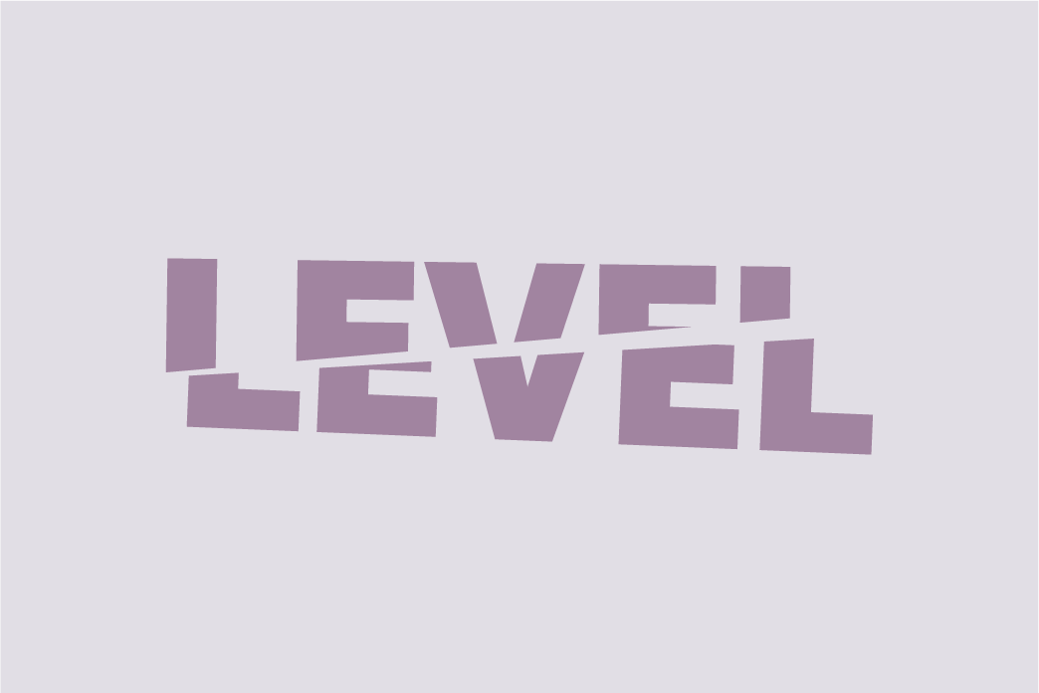
Notes:
Split level

Slide 6
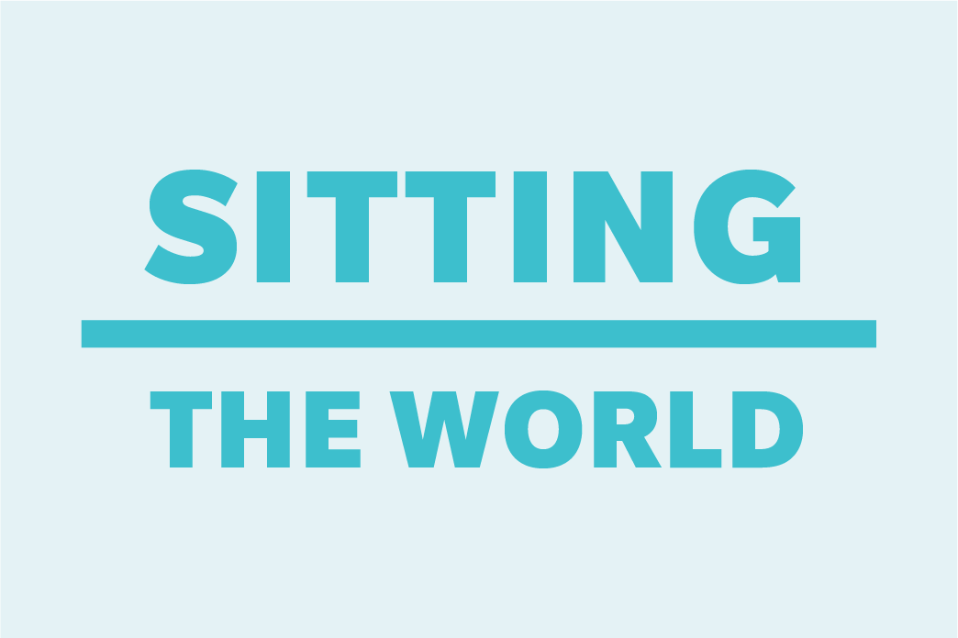
Notes:
Sitting on top of the world

Slide 7

Notes:
In between jobs

Slide 8
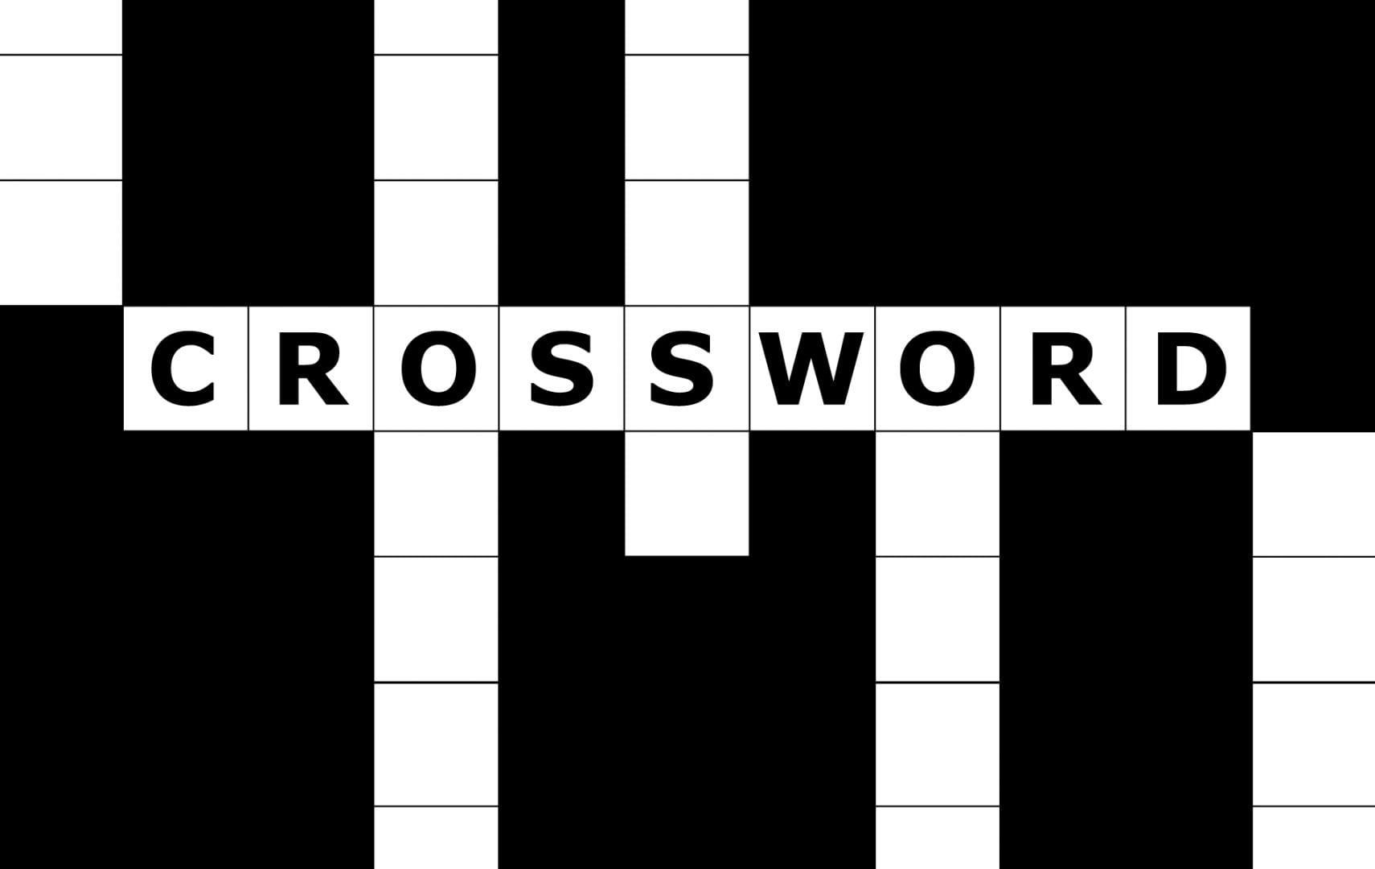
The novelty of brain teasers and puzzles helps us exercise thinking strategies that might be unfamiliar to us. And the best part? These creative problem-solving abilities transfer over into many different areas of our lives.
Brain puzzles come in all shapes and forms. Here are a few you might recognize:
•Crossword puzzles
•Sudoku
•Rebus puzzles
•Mechanical puzzles (e.g. Rubik’s Cube)
•Riddles
•Brain teasers
•Logic grids
Not only are brain puzzles fun to solve, but they also help you work on your lateral thinking skills — otherwise known as thinking outside the box.
And there’s nothing quite like the sense of satisfaction you get from sliding that final puzzle piece into place or nailing the answer to that befuddling riddle!

Slide 9
What is Problem solving?
NOUN
the process of finding solutions to difficult or complex issues.
"an expert at creative problem-solving" ·
"problem-solving skills"
Notes:
What is Problem Solving? Problem solving is the act of defining a problem; determining the cause of the problem; identifying, prioritising, and selecting alternatives for a solution; and then implementing a solution.

Slide 10

Problem-solving is a mental process that involves discovering, analysing and solving problems. The ultimate goal of problem-solving is to overcome obstacles and find a solution that best resolves the issue.
Problem solving is one of the most important skills children can develop as it prepares them to deal with issues they will face as they grow older. The earlier children begin solving problems, the more prepared they will be to deal with bigger challenges as they mature.
As a child we practice our Problem solving skills by
⭐Putting together puzzles
⭐Threading activities
⭐Stacking toys
⭐Imaginative play
⭐Matching games
⭐Building blocks
Notes:
Problem-solving is a mental process that involves discovering, analysing and solving problems. The ultimate goal of problem-solving is to overcome obstacles and find a solution that best resolves the issue.
Problem solving is one of the most important skills children can develop as it prepares them to deal with issues they will face as they grow older. The earlier children begin solving problems, the more prepared they will be to deal with bigger challenges as they mature.
As a child we practice our Problem solving skills by
⭐Putting together puzzles
⭐Threading activities
⭐Stacking toys
⭐Imaginative play
⭐Matching games
⭐Building blocks

Slide 11

Barriers of successful Problem Solving

Slide 12
A cognitive bias is a systematic error in thinking that occurs when people are processing and interpreting information in the world around them and affects the decisions and judgments that they make.
The human brain is powerful but subject to limitations.
Some of these biases are related to memory. The way you remember an event may be biased for a number of reasons and that, in turn, can lead to biased thinking and decision-making.
Other biases might be related to problems with attention. Since attention is a limited resource, people have to be selective about what they pay attention to in the world around them.
Because of this, subtle biases can creep in and influence the way you see and think about the world.
Notes:
A cognitive bias is a systematic error in thinking that occurs when people are processing and interpreting information in the world around them and affects the decisions and judgments that they make.
The human brain is powerful but subject to limitations. Cognitive biases are often a result of your brain's attempt to simplify information processing. Biases often work as rules of thumb that help you make sense of the world and reach decisions with relative speed.
Some of these biases are related to memory. The way you remember an event may be biased for a number of reasons and that, in turn, can lead to biased thinking and decision-making.
Other biases might be related to problems with attention. Since attention is a limited resource, people have to be selective about what they pay attention to in the world around them.
Because of this, subtle biases can creep in and influence the way you see and think about the world.

Slide 13

Here are some comments you might have heard or even say yourself.
“That’s the way we’ve always done it”
“That’s too disruptive”
“How do we know it would even work?”
“That idea is too crazy”
“I can’t think creatively”
“It’s already been done”
“I’m too busy to do that”
“We’ve already tried something like that”
“I’m not a creative person”
“I’m too logical a thinker for that”
“I would never be able to do that”
“ I knew that wouldn’t work”
Notes:
Here are some comments you might have heard or even say yourself.
“That’s the way we’ve always done it”
“That’s too disruptive”
“How do we know it would even work?”
“That idea is too crazy”
“I can’t think creatively”
“It’s already been done”
“I’m too busy to do that”
“We’ve already tried something like that”
“I’m not a creative person”
“I’m too logical a thinker for that”
“I would never be able to do that”
“ I knew that wouldn’t work”

Slide 14
Being aware of bias.
Consider how biases might influence your thinking.
Challenging your biases
Notes:
Consider how biases might influence your thinking.
Consider the different factors that influence your decisions. Are there factors such as lack of confidence, over confidence or self-interest at play? Thinking about the influences on your decisions may help you make better choices.
Challenging your biases
If you notice that there are factors influencing your choices, focus on actively challenging your biases. What are some factors you have missed? Are you giving too much weight to certain factors? Are you ignoring relevant information because it doesn't support your view? Thinking about these things and challenging your biases can make you a more critical thinker.

Slide 15
Benefits of successful
Problem Solving

Slide 16
Solving problems means making choices.
We develop problem-solving skills at different rates; nevertheless, it is important that we learn to tackle problems with grit and creativity, especially as we learn to cope with setbacks or resolve conflict. Problem solving is one of the most important skills children can develop, because it prepares them to face increasingly complex academic and interpersonal issues as they mature.
When children tackle problems on their own, or in a group, they become resilient. They learn to look at challenges from a fresh perspective.
Problem solving is important in child development because confident, capable children grow into confident, capable adults.
Children who learn how to solve problems when they are young tend to appreciate lifelong learning. They become curious and motivated learners.
Notes:
Solving problems means making choices. Typically, effective problem-solving skills result in happier, more confident and more independent individuals.
We develop problem-solving skills at different rates; nevertheless, it is important that we learn to tackle problems with grit and creativity, especially as we learn to cope with setbacks or resolve conflict. Problem solving is one of the most important skills children can develop, because it prepares them to face increasingly complex academic and interpersonal issues as they mature.
When children tackle problems on their own, or in a group, they become resilient. They learn to look at challenges from a fresh perspective.
Problem solving is important in child development because confident, capable children grow into confident, capable adults.
Children who learn how to solve problems when they are young tend to appreciate lifelong learning. They become curious and motivated learners.

Slide 17
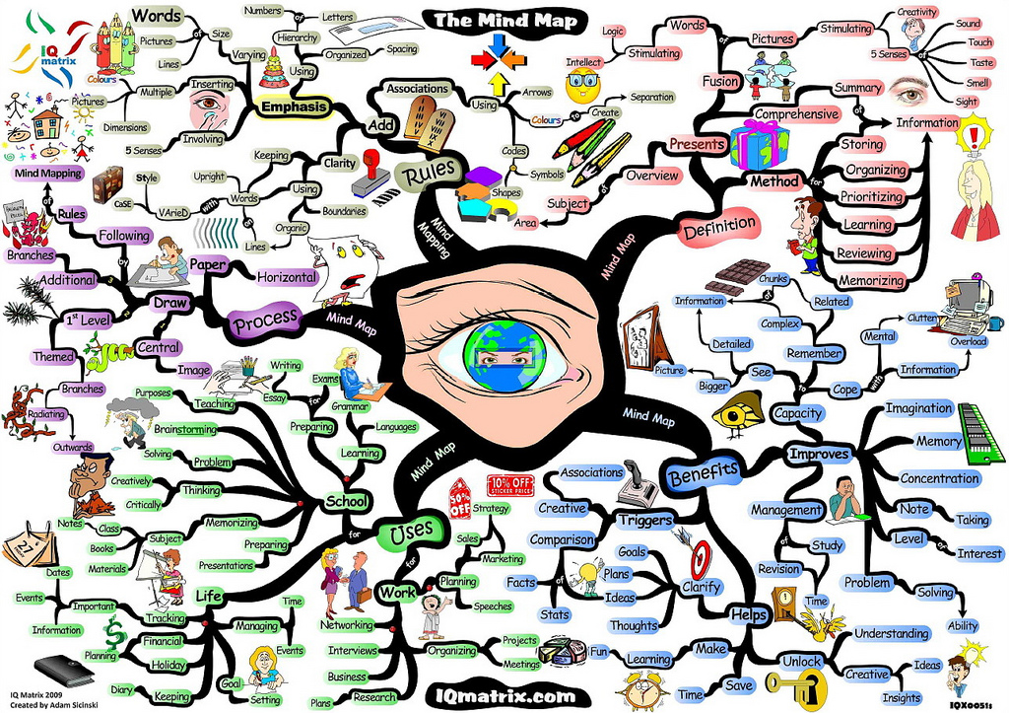
Mind Mapping

Slide 18
A great way to try and solve a problem is to Mind Map and this is how we can do it.
Identify the problem.
Develop possible solutions.
Identify the pros and cons of each solution.
Pick a solution.
Test it out.
Notes:
Identify the problem. Just stating the problem out loud can make a big difference if you are feeling stuck.
Develop possible solutions. Brainstorm possible ways to solve the problem. The solutions don't necessarily need to be good ideas (at least not at this point). Even a silly answer or far-fetched idea is a possible solution. The key is to see that with a little creativity, you can find many different potential solutions.
Identify the pros and cons of each solution. Identify potential positive and negative consequences for each potential solution identified.
Pick a solution. Once your have the possible positive and negative outcomes, pick a solution.
Test it out. Try a solution and see what happens. If it doesn't work out, you can always try another solution from the list that you developed in step two.

Slide 19
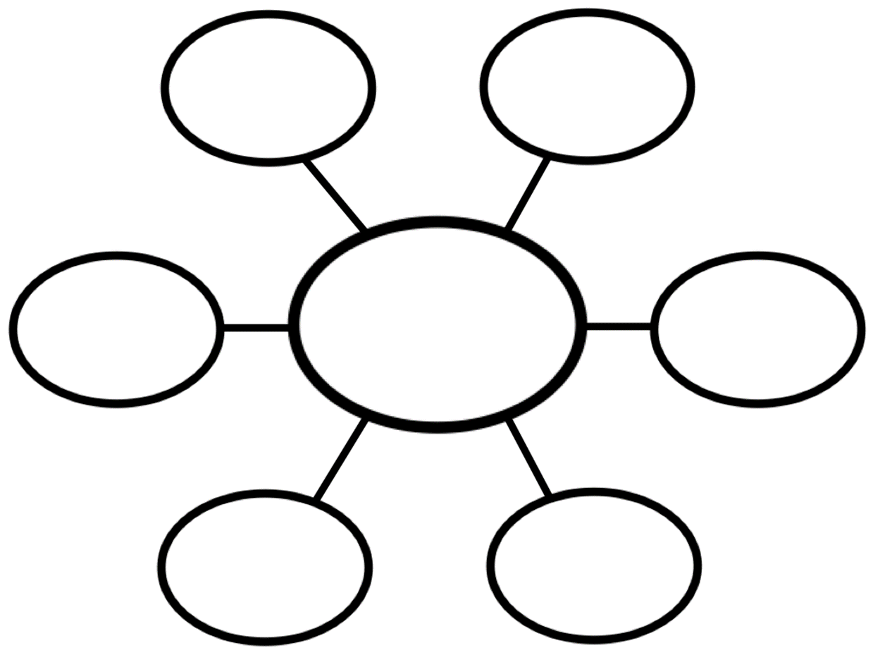
III
Notes:
Activity. I want you to think of a problem you are facing at the moment and write what that problem is in the centre oval on the diagram. Now I want you to consider possible solutions to your problem and write them in the outer ovals. Try to think of as many possible solutions as you can as silly or serious as you can imagine. For each of the solutions you have come up with, consider the pro’s and cons for each.

Slide 20

You have now completed our problem solving session.
Remember to keep your notes and your Mind Map so that you
can reflect upon your Problem Solving activity when you feel you need to.
You are now ready to move on.
Well Done!
You have now completed our problem solving session. Blah Blah Blah!

