Slide 1




Growth Mindset

Slide 2



What we’ll be looking at
Is intelligence fixed from birth?
Importance of Development
How to Develop a Growth Mindset
Changing the Angle
Embracing Challenges
Famous Failures

Slide 3
What is Growth and Fixed Mindset?
Growth Mindset: “In a growth mindset, people believe that their most basic abilities can be developed through dedication and hard work—brains and talent are just the starting point. This view creates a love of learning and a resilience that is essential for great accomplishment.” (Dweck, 2015)
A person may believe that they can improve their maths skills through studying hard, doing their homework and concentrating hard in class in order to overcome a difficult maths problem.
Fixed Mindset: “In a fixed mindset, people believe their basic qualities, like their intelligence or talent, are simply fixed traits. They spend their time documenting their intelligence or talent instead of developing them. They also believe that talent alone creates success—without effort.” (Dweck, 2015)
A person may believe they are as good as they can get at maths and give up easily on attempting to solve a maths equation.

Slide 4
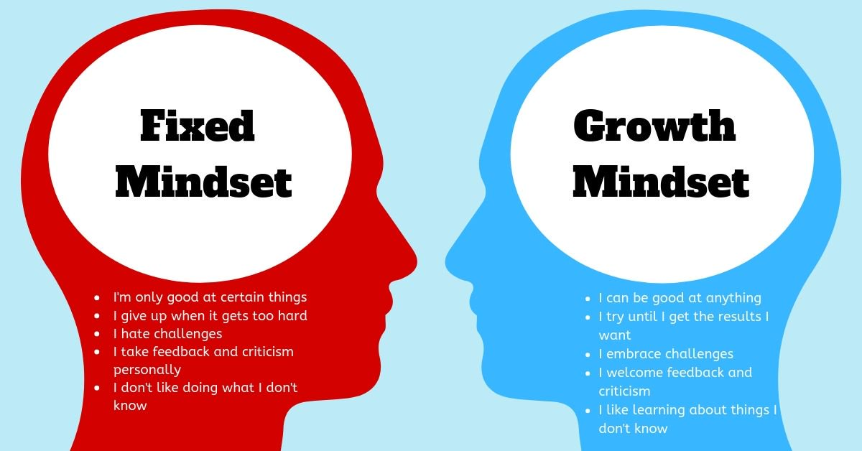




Slide 5

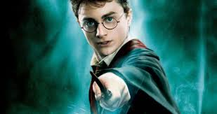
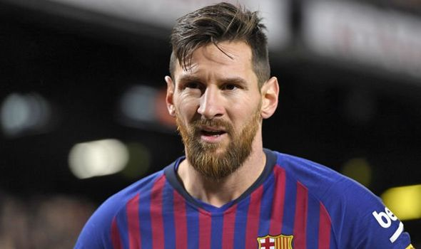




  Is Intelligence Fixed from Birth?
  Are we born…
  Good at maths?
        Good at acting?
  Good at sport?
        Good at music?
Or… do talents, abilities and intelligence itself grow from experience??

Slide 6
Importance of development
At birth, we can’t WALK or TALK
These abilities don’t pop up overnight….
….. they DEVELOP as we LEARN!!

Slide 7
Scenario
Scenario: A student enters a gymnastics competition, puts in her best effort, and doesn’t win. Her teacher was there observing her.
Task: What do you think the student could do in order to have a growth mindset?
Write down what you think and we will go over some information shortly after the task.

Slide 8
How to Develop a Growth Mindset (Scenario continued…)
Effort - By focusing on the processes and effort that allow people to be successful, you give them a template to replicate next time.
Ask for Feedback – view opportunities as a chance to learn, not a chance to compare.
Embrace Failure – failing is what makes some very successful people who they are today.
Notes:
2. Research was done and some students viewed an exam as a chance to test how much they have learnt. Others viewed it as an opportunity to compare themselves against their classmates. Those who focused more on comparison are said to have an ego-orientation, whereas those who focused on learning are task-orientated.

Slide 9
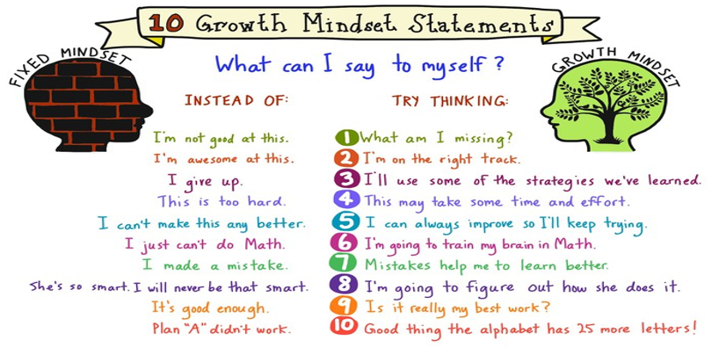
How to Develop a Growth Mindset (continued…)

Slide 10
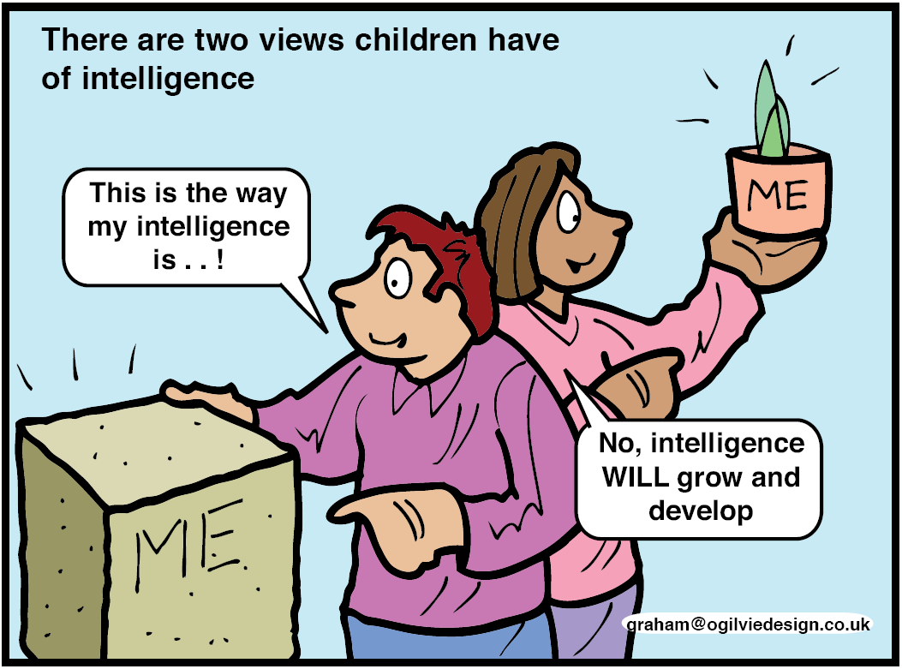



Two beliefs about intelligence

Slide 11



Changing the Angle
This picture below is real and everything in the picture is real. The rock is real, the trees are real, everything is real.
Flip it on its head…
More often than not, a situation has the potential to change depending on the mindset (fixed or growth) you choose to adopt!
People are not disturbed by an event, but by the way they interpret the event.

Slide 12



Embracing Challenges
Research suggests people who adopt a growth mindset are more likely to embrace challenges than people with a fixed mindset.
The earlier challenges are embraced the better – can cloud your mind leading to increased anxiety and stress
Give an example of when you have overcame a tough challenge
Give an example of a celebrity who has risen from having nothing to being a worldwide star

Slide 13
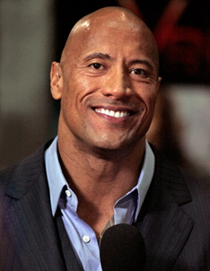
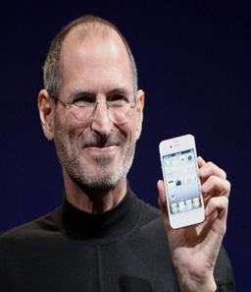



Famous Failures
Dwayne Johnston (aka The Rock)
After playing one American football game he was fired and only had $7 to his name.
Actor, producer, professional wrestler
Highest grossing actor in Hollywood
Estimated net worth - $280m
Steve Jobs
At the age of 30 he was devastated and depressed after being unceremoniously removed from the company he started.
Co-founder, Chairman, and CEO of Apple Inc.
Primary investor and Chairman of Pixar
Estimated worth (time of death 2011) - $10.2bn

Slide 14
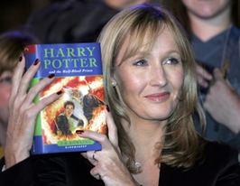
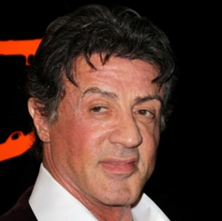
Famous Failures (continued…)
J.K. Rowling
Unemployed, divorced and raising a daughter and her first book was rejected 12 times by publishers.
Author, film producer, television producer,
screenwriter, philanthropist
Estimated net worth - $1bn
Sylvester Stallone
When he was 26, he was “totally broke, going nowhere pretty fast, owned two pairs of pants that barely fit, shoes that had holes in them.” He even sold his dog to a stranger for $40 because he couldn’t afford to care for the animal. (When he sold his first screenplay, he tracked down his dog and bought him back – for $15,000).
Actor, director, screenwriter, producer
Estimated net worth - $400m

Slide 15





Growth Mindset Video Clip
YouTube: Jay Shetty Famous Failures Part 2
<iframe width="695" height="391" src="https://www.youtube.com/embed/bAwXAFz6cmA" frameborder="0" allow="accelerometer; autoplay; clipboard-write; encrypted-media; gyroscope; picture-in-picture" allowfullscreen></iframe>

Slide 16



Thinking about mindset
OBSERVE the mindset you adopt
You can CHOOSE to adopt a growth mindset
When you meet challenges REMIND yourself about the growth mindset

Slide 17



F | First
A | Attempt
I | In
L | Learning

Slide 18




Slide 19
Contact Details for Further Information
Contact number: 07384211639
Email: adam.gibson2@east-ayrshire.gov.uk

