Slide 1
Tips for people supporting children experiencing
Change and Loss
Notes:
Adam - Thank you for undertaking this session and a very warm welcome to this Change and loss presentation.
Prior to starting I would advice you to have a pen and some paper handy.
This powerpoint has been created to provide information and support for anyone around the area of change and loss. It was created by our Health and Wellbeing team in collaboration with the educational psychology team. It is intended that people complete this powerpoint where possible.
During this session, grief and loss will be explored. For some people this may bring back memories and feelings related to both old and new losses. It is therefore important to consider whether this is the right time for you to engage with this learning activity. Self-care is always a solid foundation for our support for others!
It is also important to acknowledge that many adults may have their own anxieties about supporting a grieving child. Many of us worry that we are not appropriately “qualified” and we may say the wrong thing. Although this presentation aims to address some of these issues, it’s really important to remember that the key role adults have to play in supporting a child through a significant loss or change is through maintaining a positive, supportive, trusting relationship with the child and just being there to listen to them. Relationships really are fundamental in all that we do in schools.

Slide 2
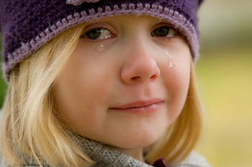
Aims:
To explore the different types of change and loss that children and young people can experience
To consider the potential impacts of change and loss on children and young people
To identify the correct language to be used when discussing change and loss in schools and life in general
To explore resources available to support people in the area of change and loss
Notes:
Adam - The aims of this presentation are:
Read slide

Slide 3
Notes:
Adam
If you are completing this session with other people, work in groups to answer the questions in the Quiz or alternatively jot down the answers on your own. There are 4 questions to complete and we will go through them just now. We will pause briefly for 15 seconds after each question to give you some time to consider your answer:
Q1 – How many children across Ayrshire do you think suffer a bereavement of someone close to them every year?
A - 1,700 – I don’t know about you but I was surprised by how high this figure is.
Q2 –How many children are bereaved of a parent every day in the UK?
A - 111- again I was shocked and saddened by this figure
Q3 - How many families are bereaved through suicide a year?
A - 4,500 – I feel this is a shockingly high figure and really shows why talking about Mental Health is important
Q4 – Why do you think as adults we struggle to talk about death? This was obviously a discussion point rather than a question but hopefully it generated some good talking points. Answers may have included because it generates negative emotions and memories, because it’s still a “taboo” subject, for fear of upsetting others, because it scares us.
Hopefully this gives you an indication of the number of bereavements that occur and why we feel its important that we prepare c&YP for the changes they will experience.

Slide 4
Bereavement
A parent of children under 18 dies every 22 minutes in the UK; around 23,600 a year. This equates to around 111 children being bereaved of a parent every day.
1 in 29 5-16 year olds has been bereaved of a parent or sibling - that's a child in every average class.
Estimated around 70 parents die each year in East Ayrshire leaving around 110 dependant children
Estimated that 290 children experience the loss of a parent across Ayrshire each year
www.childhoodbereavementnetwork.org.uk
Notes:
Laura
Please take a few moments to read the statistics given on the slide.
In almost every average class there will be a child who has suffered the bereavement of a parent or sibling. This highlights the importance of ensuring that adults feel confident in addressing the subject of grief and issues around it and that they feel supported to do so.
Hopefully after competing this session you will feel more confident around discussing the topic of change in loss.

Slide 5
Family Breakdowns
Epidemic proportions
42% of marriages end in divorce
Breakdowns in cohabiting relationships often not reported
Impact ranges from disruptive and sad to tragic
Children used as weapons in marital war
Useful Websites:
www.youngminds.org.uk
www.childline.org.uk
www.nspcc.org.uk
Notes:
Laura
Another example of a change and loss that we can experience is Family Breakdowns and these can be just as traumatising to children and young people as a death. More than half of UK children are affected by a family breakdown.
The Peak for splits is 4 – 8 yrs into a relationship when couples are likely to have young children. Breakdowns in cohabiting relationships of couples who are not married often go beneath the radar therefore the true extent of the effect of parental split on children is difficult to quantify. But some facts are that
25% of children live in single parent families ….92% of these are living with the mother and often the father is no longer sharing parental responsibilities. Around 70% of children are not well-informed about the split and this can have a devastating effect on children and young people of all ages.
Add to this is the fact that children can be used as a weapon and this can cause further trauma.
The sites shown on the slide have good resources to support schools to help a C & young person going through a family breakdown.

Slide 6
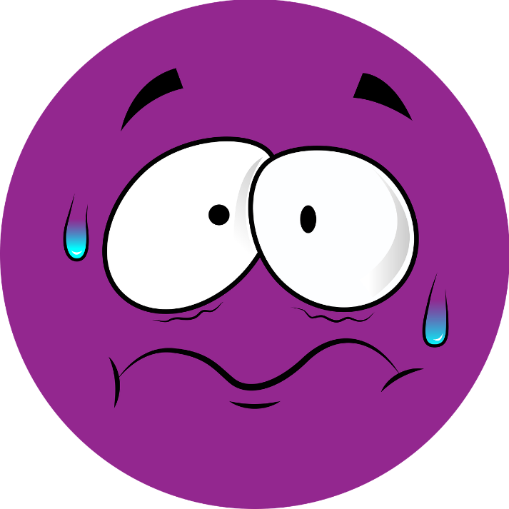
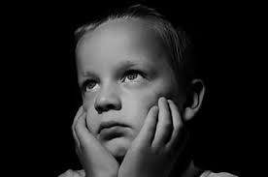
Suicide
In 2017 in the UK 5821 people died by suicide.
Addressing the stigma
Using the correct language
Importance of tacking gender based stereotypes
Importance of teaching resilience and emotional intelligence
Child bereavement UK
Scottish Mental Health first Aid training (SMHFA)
Asist Training
Notes:
Laura
Sadly, as we are only too aware of, suicide is a huge problem in Scotland. Scotland has one of the highest suicide rates in the world and young men in Scotland are more likely to die from suicide than from cancer or any other major illness. This obviously has a huge impact on local communities and schools.
Similarly to when we discuss death with children and young people, it is equally important to have open and honest conversations with children and young people about suicide if we are to attempt to address the stigma attached. Only when children and young people begin to see suicide as a less “taboo” subject will they have the confidence to talk to an adult about their feelings. For this reason it is really important that we use the correct language. When discussing suicide with young people either the words suicide or killed themselves should be used. If you require more support around this I would recommend the child bereavement UK website, or you can seek further training/information through using the contact details at the end of this presentation.
In terms of what we can all do in our own homes to address the national problem we have with suicide, teaching resilience and emotional intelligence is crucial as is teaching about gender stereotypes. It is really important for example that boys know it is good to talk about their feelings and that it is ok to cry.

Slide 7
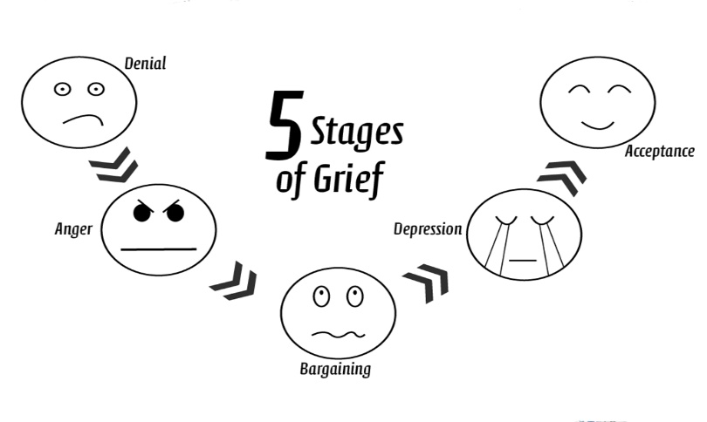
Word bank
We have included a vocabulary bank to help focus the discussion:
divorced separated living in different houses
moved away died not coming back
Try to refrain from using the term loss and where there has been a bereavement consult parent/carer as to what they have told their child. Please bear in mind that parent/carers may work away from home or may be incarcerated.
Notes:
Adam
One of the most important things to keep in mind when supporting a child who is dealing with a significant loss or change is to help the child to talk about it. Avoiding the subject may just further reinforce any feelings of guilt that the child is feeling. If they know they have someone to talk to they can start to address any negative feelings.
It is very important that you use the correct language when discussing death or any type of change with a child. It’s really important to use clear, unambiguous language so that the child understands exactly what you mean. I’m sure you have all heard different ways of death being described to children but this often leads to confusion. A colleague I worked with had a child in her class who got extremely upset about going on the bus on a school trip one day, on further discussion with the child it turned out the Mum had told him that “grandad went away on the bus” which was her way of saying he was dead. You can imagine the distress that caused the child. I’m sure many of you will know of other similar examples. It can seem daunting to say the words out loud sometimes but it’s really important that we use the correct terminology. Try to refrain from using the word “loss” for example “sorry for your loss” as this gives the impression that the person may come back

Slide 8
Trauma
“Any situation resulting in an overwhelming sense of vulnerability and/or lack of control.” (Soloman, 1996)
Sudden death
Accidents
Threat or loss of life
Serious illness hospital procedures
Abuse
Loss of home through fire or flood
Violent or serious assault
Notes:
Adam
Trauma has been defined as “any situation resulting in an overwhelming sense of vulnerability and/or lack of control.” Listed on the slide are just some of the traumas that children and young people may have experienced. Another very traumatic experience for children and young people is if a parent goes to prison. 27 000 children in the UK every year are affected by a family member in prison – this is the same numbers as divorce
Other major traumas that children and young people experience are:
Domestic violence - 1 in 5 children in Scotland are affected by this
Physical, emotional and sexual abuse
Abandonment (actual or perceived)
Becoming “Looked After”
Eviction
Major world events such as the recent Covid 19 pandemic
Evidence has shown that those children/young people who experienced trauma at a young age are more likely to develop Mental Health issues. As we know only too well Mental Health issues in children and young people have dramatically increased in recent years. In addition to Mental Health issues our young people are also experiencing new challenges that we did not face when we were growing up. 38% of young people have been affected by cyber-bullying, with text messages and comments on social media. These can be traumatic experiences for Young People and more and more are now also becoming victims to online grooming.
Evidence shows that experiencing trauma at a young age can entirely de-rail good attention, capacity to think well and concentration. When children are faced with trauma they revert to Primitive reactions: more commonly known as FIGHT/FLIGHT/FREEZE. Stressed out teenagers or children therefore function like threatened animals - unable to learn, attend, concentrate, enjoy friendships, play, problem solve. In relation Please also don’t underestimate the Importance of relationships.
As adults it’s very important that we are the responsive people they need, as often they do not have them at home.

Slide 9
QUIZ
Q1 How many children are bereaved of a parent every day in the UK?
Q2 In 2017 how many people died by suicide in the UK?
Q3 Estimated, how many parents die each year in East Ayrshire?
Q4 How many situations are listed under the Trauma slide?
Notes:
We are now going to go through a short quiz based on the information we have went through during this presentation until now. We will then go through the answer after the questions. 15 seconds will be given after each question to consider your answer:
Question 1 – How many children are bereaved of a parent every day in the UK? (answer = 111)
Question 2 – In 2017 how many people died by suicide in the UK? (answer = 5821)
Question 3 - Estimated, how many parents die each year in East Ayrshire? (answer = 70)
Question 4 - How many situations are listed under the Trauma slide? (answer = 7)

Slide 10
What day to day changes are our young people experiencing?
Body
Emotions
Relationships e.g. friends
Transitions
Life events
World events e.g. what is portrayed in the media
Notes:
Adam
We have previously discussed some of the major traumas that children and young people may face but it is also important to acknowledge the day to day changes that young people experience such as those shown on the slide. Some of these are difficult to cope with on their own but if you then throw into the mix a major change and loss then it is easy to see how Children &Young People struggle to cope.
Some of these may seem quite small to us but can often be a huge deal and cause of stress and anxiety for young people. It’s important to address these in day to day conversations within the home environment or in school.

Slide 11
What reactions to change and loss have you may seen in young people?
Shock
Denial
Sadness
Anger
Anxiety
Guilt
Acceptance
Loneliness
Notes:
Adam - Think about some of the reactions to change and loss you might see in children and young people. When dealing with GRIEF there is a conflict between the need to let go of what is lost and the wish to hold on to it, the pull between past and present – is the basis of all grief. The Significance of loss to a child is key to grief reaction. Some of the reactions you may have seen will include: SHOCK & DENIAL – older children may react in this way and feel quite numb…. They may not react with strong feelings immediately and this can confuse adults but is very normal…..what has happened needs to be taken in step by step, it’s a mechanism to prevent child being overwhelmed….Often - Older kids can blow up or fall apart at certain occasions such as summer holidays/Christmas etc.
SADNESS + loneliess
Everything from daily hugs, security from being with that person, to helping with homework, to driving to a club etc has been lost and that can result in the young person feeling very sad and lonely. Often the Young Person may have a preoccupation with memories. This can can help ease loss, and they may want to see pictures again and again, demand to hear stories, or carry round an object from the lost family member to keep them close or help with the pain. Sadness can appear in different ways – younger children have a shorter sadness span, they are not usually sad for long periods of time….sadness may also appear in different forms for example, a child may become withdrawn, or hide sadness so as not to make parents sad. When they cry, they may say they are crying for another reason.
ANGER
This is very Common – they may feel anger at the loss, at God, at adults ,others/themselves for causing/not preventing loss, they may feel anger towards the person who is gone for leaving them….temper tantrums can be very common.
ANXIETY
Anxiety is something that can be a real issue for may children and young people who have suffered a significant change or loss. There sense of security may have been shaken and this can lead to them feeling very insecure and uncertain about the future. Find out what is specifically worrying a bereaved child — try not to make assumptions. It is really important that this anxiety is taken seriously and that children are reminded that adults in both in the home and in school are there for them. Listen to any worries they may have. The most important thing is to be there for them- some children find it easier to share their worries with supportive adults at school rather than risk causing further upset at home.
GUILT
Often children think their thoughts, feelings or actions have caused what has happened. They may feel guilty about the last meeting with that person…can think about what they did not get to do…things they wish there had been time to do etc. They may feel SHAME for how they behaved or thought and sometimes adults (with the heated climate around loss) may say things that increase feelings of responsibility on children. Acceptance can happen – if dealt with properly, Grief is taken and folded in to the person and becomes an integral part of the person and often they become stronger, perhaps more sure of themselves and aware of frailty of life. However this takes TIME! Processing and re-processing may take place throughout the development of the child…even years after the original trauma, the child may revisit loss and struggle to understand from current development perspectives…. They may get intensity of emotional feelings on various anniversary dates following trauma. However, if symptoms of re-experiencing, avoidance, fearfulness ,sleep problems, nightmares persist beyond 3 months this should be addressed. If it goes beyond 6 months and is interfering with aspects of functioning then it is recommended that the child sees a professional.

Slide 12
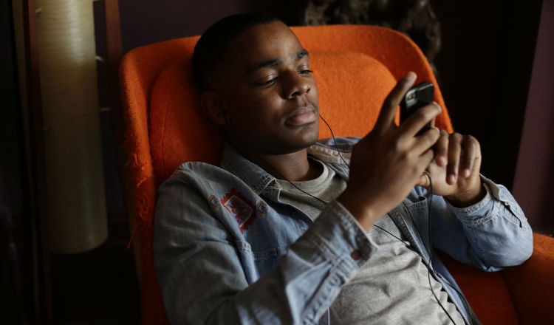
POTENTIAL BEHAVIOURS
Regression
Re-enactment
Sleep problems
Temper tantrums
Avoidance
Notes:
Adam
Some of the potential behaviours we often see after a significant change or loss are:
REGRESSION – the child may become more clingy and demanding. They may Want to be closer to care-givers, and react strongly to separations
They May exhibit some symptoms for years after especially if they have had reminder of the loss… they may become more impulsive, hyperactive, anxious and have sleep & mood problems. Temper tantrums are common as are other outbursts of aggression such as smashing windows etc. anti-social behaviour can be a way of forcing caregivers to focus on the needs of the child. Sadness and depression in children often result in increased activity – acting out behaviour is a way to keep sadness and depression at bay. SLEEP problems may be a potential behaviour after a change or loss. If the term “going to sleep” is used to describe death, they may be afraid of sleeping and be very alert when parents are sleeping. Bed-time can be a time to think about what has happened…they may have a fear of dreams that repeat themselves especially if no time is given to process a trauma during the day-time.
When it comes to dealing with a significant change or loss there can be Gender differences!
It is more common for boys to refrain from talking about loss and they have difficulty showing feelings. These differences are more pronounced as children progress through school-age, and are particularly pronounced in adolescence. There can often also be a difference in play and friendships between boys and girls. For example girls play in pairs, play more expressively, play centres on close human relationships whereas, boys play often involves learning their role in a group, sticking to rules, and not showing feelings. Boys are often unconsciously taught to suppress & deny feelings (except aggression) in many areas of life. And this results in a different way of dealing with loss. Males will often suppress events and look to the future, whilst females will confront feelings. Often support available is more tailored towards a girls way of thinking and this is something that needs to be considered.

Slide 13
Discussion Time
Notes:
Adam
I would now like you to pause the powerpoint and spend some time looking at the change and loss resources that are available. If you click on the Blog Resources link this will take you to the resources we have on our Blog or you may want to use a search engine to look for other resources.
Discuss the resources, or have a think to yourself if on your own, which are available to you as to which ones you feel are useful and you feel you could use in the future
Talk about/think about what you like about them, if anything is missing and any other resources you may need.
You should spend about 15 minutes on this, or take longer if need be.

Slide 14
IMPACT ON LEARNING
Difficulties in attention and concentration
Restless
Negative emotions = pessimistic outlook = diverts attention + intrusive thoughts around child’s well-being rather than learning.
Gaps in learning
Notes:
Dugy
Research shows that there is a strong link between loss and academic attainment. Attention & Concentration can be negatively affected.
Sadness and grief result in slower thinking, and a lack of energy and initiative. Children may appear inattentive or like they are finding learning difficult. It is important that adults at home and staff in schools are reactive to this and introduce a slower pace of learning and put supports in place to help the child or young person. The child or young person may appear as Restless. It is also common for dramatic events to show up in a child’s work. For example, Traumatic elements in drawings, stories etc.
NEGATIVE EMOTIONS
Unresolved loss leaves children vulnerable to new developmental tasks. For example, starting in a new school. Fear for personal survival, separation anxiety, sadness, anger, guilt, shame, depression, despair, and loss of self-esteem all impact upon a child’s motivation to learn.
Stress response, influences physiological reactivity. This results in hypervigilance and a lack of concentration which in turn impair willingness to explore, capacity to process new information and ability to focus long enough on new information to learn.
As a result of these impacts it is likely that GAPS in learning will emerge. This may be more prominent for Looked After and Accommodated children who have had to deal with many different changes in their lives already.
It is also really important that we as adults are aware of the length of the grief process. There is no time limit on bereavement and young people may feel upset and angry if it is suggested they “should be over it by now.” In time, children and young people may seem better but it is important for adults to remember that they will continue to grieve for the rest of their life. A nurturing home and school environment will help a bereaved child to feel supported, and able to share their feelings and ask questions.

Slide 15
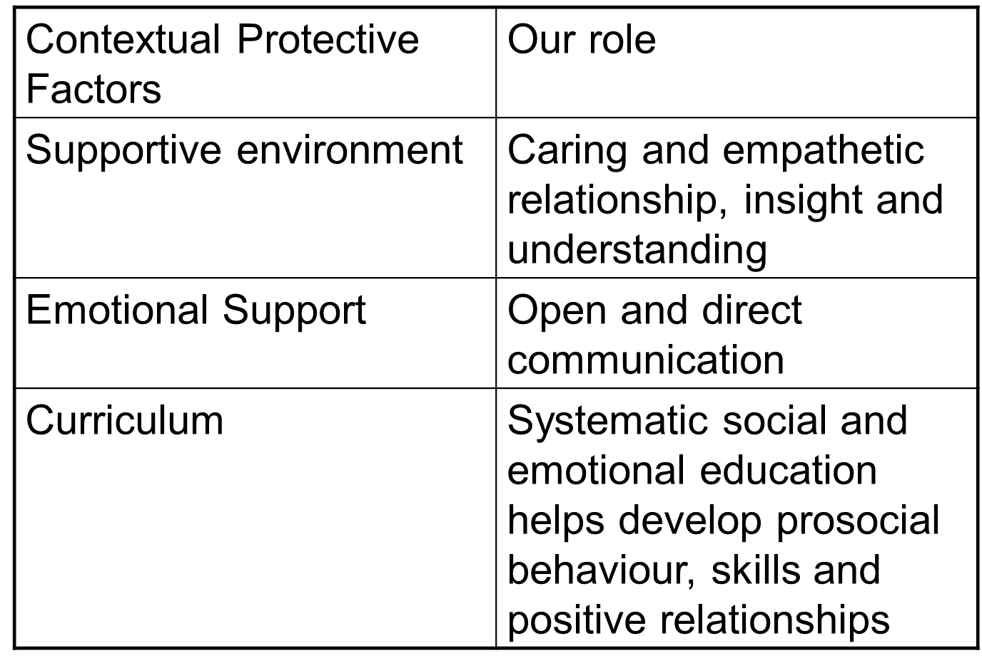
Notes:
Dugy
Children and young people are all impacted by loss but most children, with the right support, are not affected negatively on a long-term basis. Most children or young people do not need specialist input but can thrive when their grief is acknowledged and supported by the key adults in their lives. Normalising grief does not, however, mean that we are diminishing the pain that children and young people can experience.
It is important to be aware of children who may be more at risk of struggling following significant loss. For all children, an important protective factor is a key supportive adult in their lives. For those whose parents or carers struggle to be able to offer the support the child needs, the importance of a key adult becomes more pronounced. This key person may well be a teacher or youth worker who is able to acknowledge their loss and be there for them in addition to their family or friends. Peer relationships are also another key protective factor for children who have suffered a significant change or loss and teachers as well as parents play a crucial role in helping to facilitate these.
When children and young people learn about loss reactions, it can normalise this process and help them to feel less isolated. This feedback has been frequently encountered in children and young people who have taken part in Seasons for Growth.

Slide 16
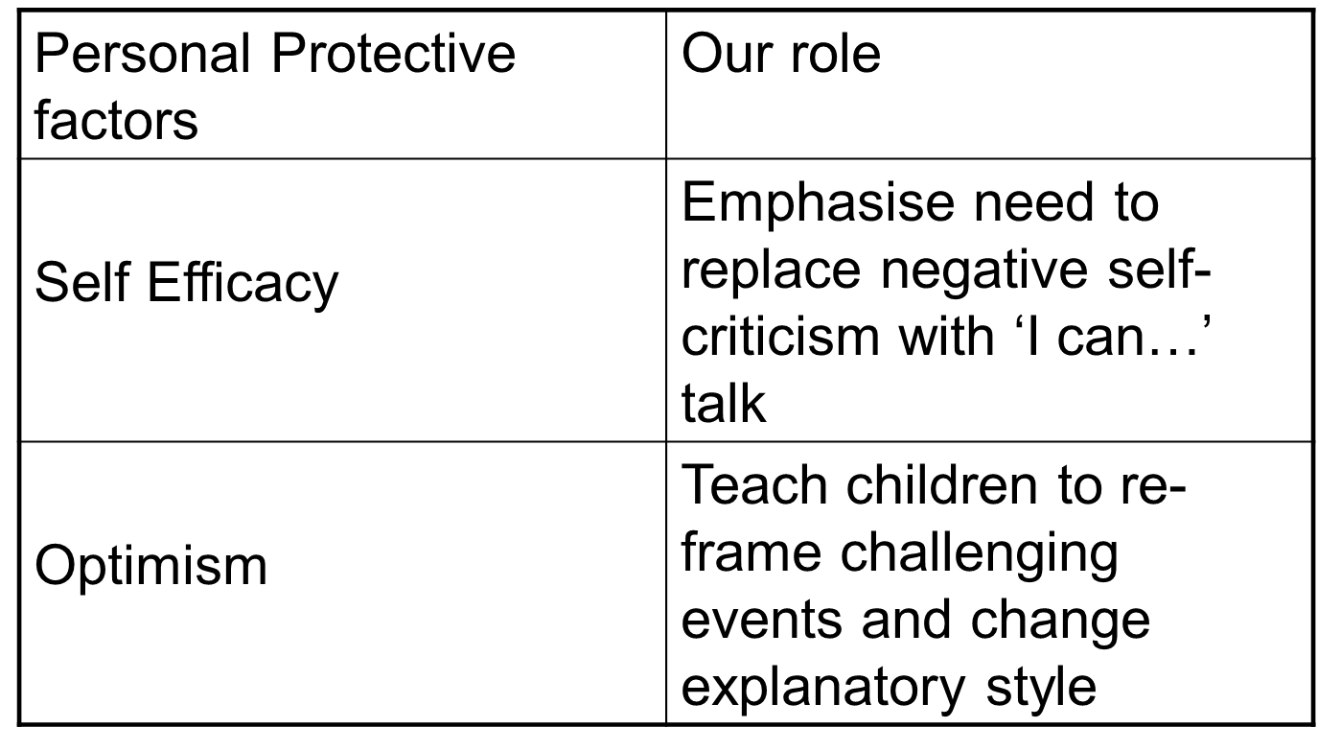
Notes:
Dugy
Children with high self efficacy and an optimistic outlook are thought to have more rapid recovery following bereavement than those with low self-esteem and a more negative outlook.
Optimism is linked to good mood, perseverance, achievement and physical health.
So what is our role….
Supporting children to set & achieve SMART targets and to celebrate their achievements will help them to boost their self-esteem. Rewards, certificates and celebration occasions for even the smallest of achievements can really help children.
Growth Mindset activities are great for working on positive mind set, self efficacy and optimism. There is information available on the Parental Empowerment blog for Growth Mindset under the Health and Wellbeing heading.
Also, try to encourage everyone to recognise and celebrate their child’s achievements, and upskilling on Growth Mindset will help to reinforce your message at home.

Slide 17
Reflections
Firstly think about a previous experience you may have had of supporting a person through change and loss. Think about the things that are already in place in your life to support a child. Remember these may not necessarily be specifically related to loss, it may be every day morning check-ins asking how they are feeling, conversations you have, or nurturing and caring as a family. Discuss in your group, or if on your own have a think about, the importance of these everyday supports in terms of supporting a child experiencing loss and change.
Notes:
Adam
It is discussion and reflection time. I would like you to either reflect or spend some time discussing in groups, or if by yourself have a think about, the scenario I am about to explain to you which is up on the slide for you to make reference to.
Firstly think about a previous experience you may have had of supporting a person through change and loss. Think about the things that are already in place in your life to support a child. Remember these may not necessarily be specifically related to loss, it may be every day morning check-ins asking how they are feeling, conversations you have, or nurturing and caring as a family. Discuss in your group, or if on your own have a think about, the importance of these everyday supports in terms of supporting a child experiencing loss and change.
You can now pause the presentation and have a think for 10 minutes about the scenario and reflect on it.

Slide 18
Helplines:
breathingspace.scot/
t: 0800 83 85 87
Samaritans
w: samaritans.org
t: 116 123 (Freephone)
Support Websites:
www.samh.org.uk
www.seemescotland.org
www.crusescotland.org.uk
Notes:
Adam
Thank you so much for undertaking this session and we hope you have found it helpful. If you require any further information please do not hesitate to contact a member of staff within your school.
If you would like to take part in further training our health and wellbeing team offer Change and Loss training. You can find out more information on this through the Blog link on the slide. It is an extended and more in depth version of the session you have just completed.
The NHS also offer SafeTalk and Asist training (these are both specifically focused on the issue of suicide) and please do not hesitate to contact a member of staff within your school or alternatively you can find out more through the links on the slide.
Finally, please make sure you look after yourselves. Many of the issues covered in this presentation can be upsetting and trigger unpleasant experiences or memories. If you require any further support please have a look on the SAMH. For support specifically around a bereavement please use the link for the cruse Scotland website.
Thank you very much for your time, stay safe and take care.

