Slide 1




An Introduction to Wellbeing
A Practical Approach for Parents & Carers
Adapted from Ahead for Health (NHS A&A)
Mentally Healthy Workplaces (NHS Health Scotland)
Mental health Improvement: A practical approach (NHS A&A)
Catrina O’Neil & Vicky McWilliam
EAC Health & Wellbeing Team

Slide 2



Course aim and objectives
AIM; To raise awareness of the importance of wellbeing and provide delegates with the knowledge, skills and tools required for mental health improvement.
OBJECTIVES;
Raise awareness of wellbeing
Provide information and self-help tools that are effective in promoting mental health improvement.
https://www.annafreud.org/scpc/

Slide 3
Mental Health Defined
Activity 1 – What is mental health?
What words come to mind when you think about the term “Mental Health”?
“Mental health influences how we think and feel about ourselves and others and how we interpret events. It affects our capacity to learn, to communicate and to form, sustain and end relationships. It also influences our ability to cope with change, transition and life events: having a baby, moving house, experiencing bereavement” (Friedli 2004)

Slide 4
Activity 2 - A Day In Your Life
Took the
dog a walk
Got loads done this morning and enjoyed a sunny lunchtime
Family time catching up on the day
Positive mental health
Woke up in an OK mood
Poor
mental health
Time to
sort argument
Off to bed reflecting on the day
Argument with family member

Slide 5
Learning points
Mental health and wellbeing is not static, moods can fluctuate over a year, a month or even a day! Mental health and wellbeing also fluctuates throughout the life cycle.
Day to day events can have an affect on our mental health and wellbeing, from small things like a puncture to life changing events like bereavement.
Each person has their own tolerance level, what affects one person may have no effect on another. Some people need more support than others.

Slide 6

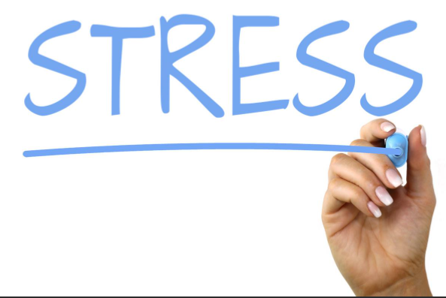
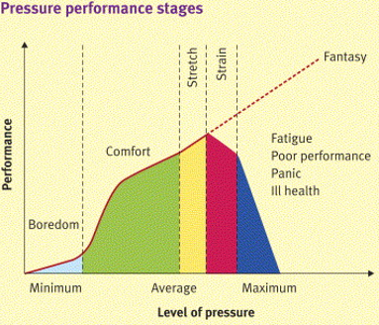
Stress is our mind and body's reaction to a situation that is overwhelming.
When we are stressed, our body thinks it is under attack and it goes into defence mode.
This is helpful when we are in situations where we need to act quickly.
Prolonged periods of stress are detrimental to our health
We can never completely remove stress from our lives but we can learn to manage our stress better by:
* managing external pressures
* developing our emotional resilience

Slide 7

What makes us stressed?
Stress can be caused by a variety of different common life events, many of which are difficult to avoid. For example:
Personal​
illness or injury​
pregnancy and becoming a parent​
bereavement​
long-term health problems​
organising a complicated event, like a group holiday​
everyday tasks such as travel or household chores.
Friends and family​
getting married or civil partnered​
going through a break-up or getting divorced​
difficult relationships with parents, siblings, friends or children​
being a carer for a friend or relative who needs lots of support.
Employment and study​
losing your job​
long-term unemployment​
retiring​
exams and deadlines​
difficult issues at work​
starting a new job.
Housing​
housing problems such as poor living conditions, lack of security or homelessness​
moving house​
problems with neighbours
Money
worries about money or benefits
poverty
debt.

Slide 8
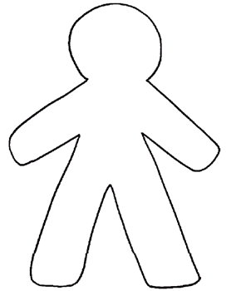
Activity 3 – Shaky Person part 1
Job
money

Slide 9


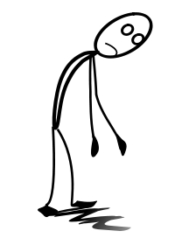

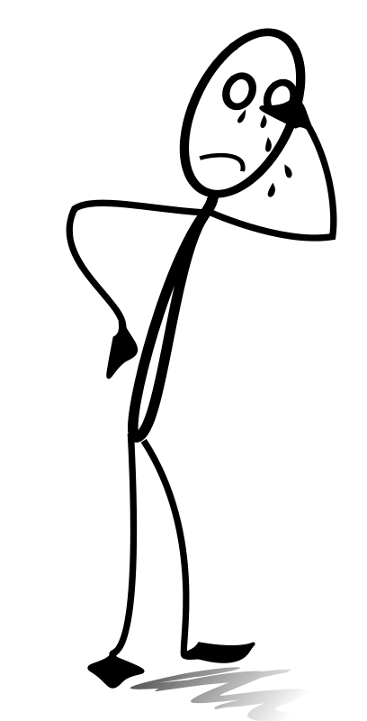

Emotions –
How do you feel?
Behaviour –
what do you do?
Mind – How is your mind working?
Physical – What happens
to your body?
Irritable
Aggressive
impatient
over-burdened
anxious, nervous or afraid
like your thoughts are racing and you can't switch off
unable to enjoy yourself
depressed
uninterested in life
like you've lost your sense of humour
a sense of dread
worried about your health
neglected
lonely.
find it hard to make decisions
constant worrying
avoiding situations that are troubling you
snapping at people
biting your nails
picking at your skin
unable to concentrate
eating too much or too little
smoking or drinking alcohol more than usual
restless, like you can't sit still
being tearful or crying
Poor judgements/ risky behaviours
finding it hard to make decisions
poor judgement
constantly worrying
forgetful and disorganised
avoiding situations that are troubling you
anxiety
catastrophising
being pessimistic or focusing on the negative
unable to concentrate/ focus
racing mind, unsettled, can't switch off
shallow breathing or hyperventilating
panic attacks
muscle tension
blurred eyesight/sore eyes
problems getting to sleep, staying asleep or having nightmares
sexual problems, such as losing interest in sex or being unable to enjoy sex
tired all the time
grinding your teeth or clenching your jaw
headaches
chest pains
high blood pressure
indigestion/ heartburn
constipation/ diarrhoea
feeling sick, dizzy or fainting.

Slide 10
Activity 3 – Shaky Person part 2
Job
Irritable
can't eat
Unsettled sleep
money

Slide 11
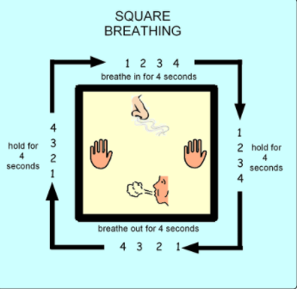
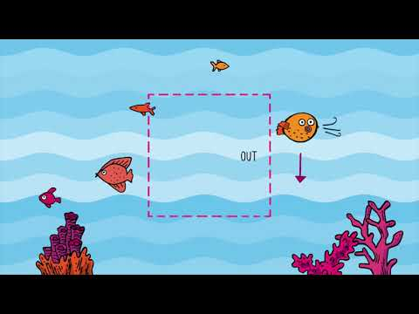
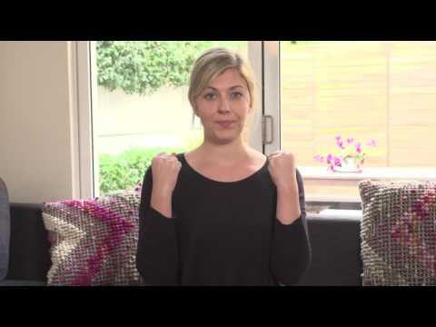
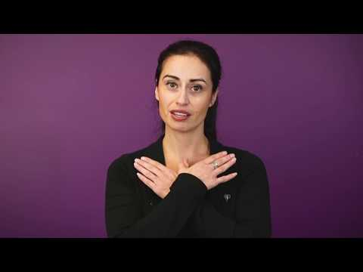
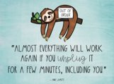
Practical techniques and tools
Breathing (counting breath, square breathing)
Progressive Muscle Relaxation
Butterfly tapping/hug
Mindfulness colour/
object spotting

Slide 12

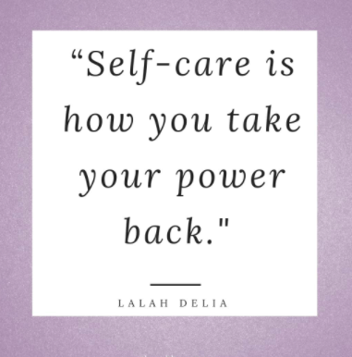
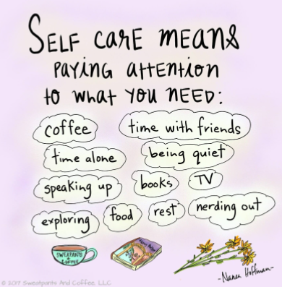
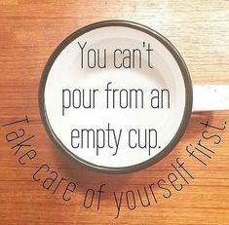
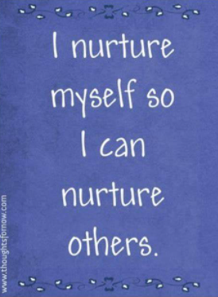
Self care – It is necessary!!

Slide 13
Learning points
Stress affects health in many ways and symptoms can vary from mild to severe
We should try to prevent stress in the first place but if people start to experience symptoms, it’s important to act early
Self Care is necessary – You cannot pour from an empty cup!

Slide 14

Activity 4 - Steps for Stress
Research shows that writing about three things that went well and thinking about why each good thing happened can increase our mood and help us to feel more optimistic. Try doing this once a week before you go to bed and see if it makes you feel better.
Think back over the past week and fill in your Three Good Things activity sheet.

Slide 15
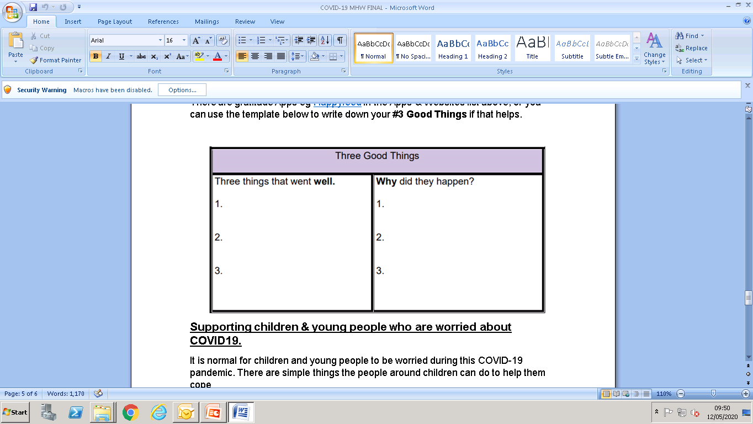
3 Good Things

Slide 16
Learning points
It is common for us to focus on the negative aspects of life and this is not good for maintaining positive mental health and wellbeing
When things get too much, self help tools like mindful problem solving can help you re-focus and work through problems step by step

Slide 17
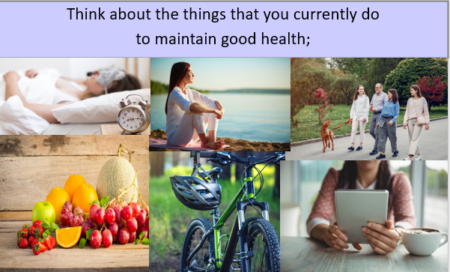
Activity 5 – What do you do to keep well?

Slide 18
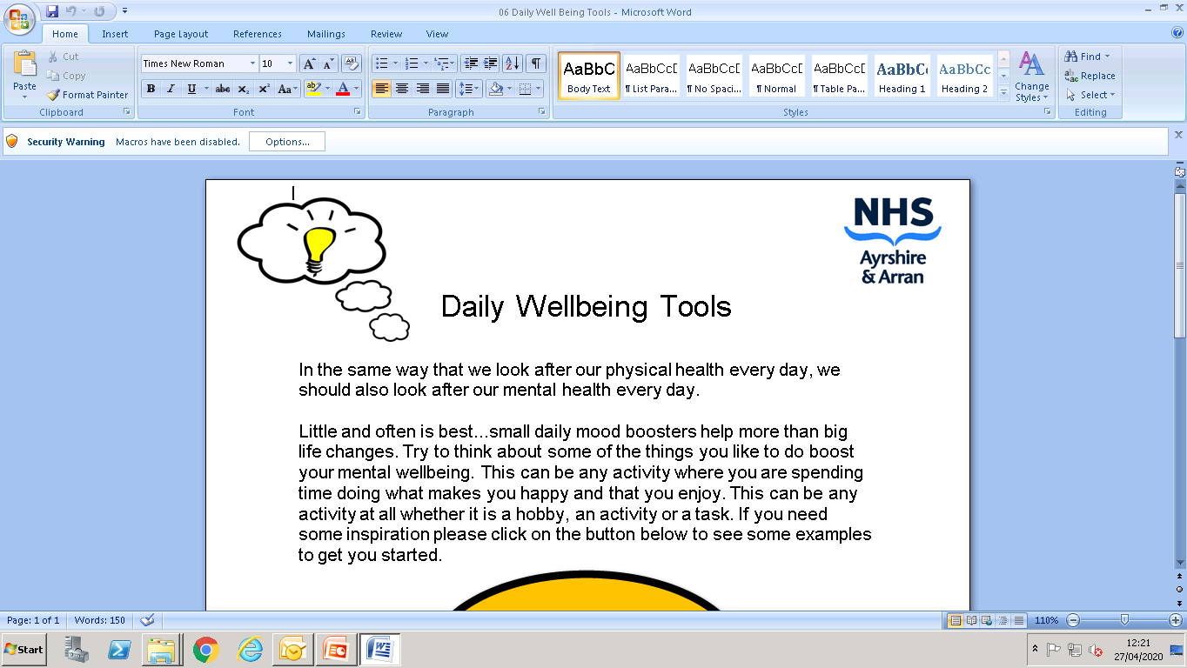
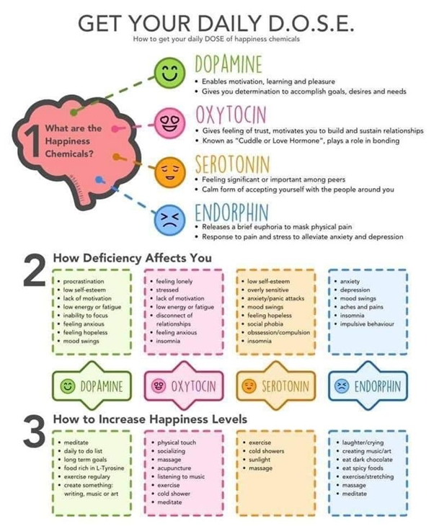
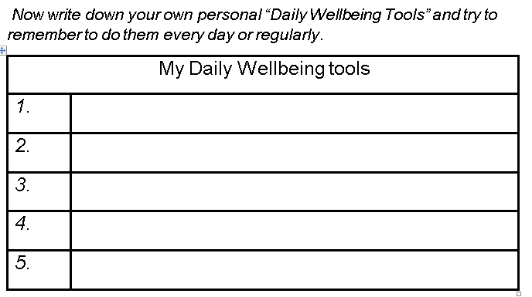

Slide 19

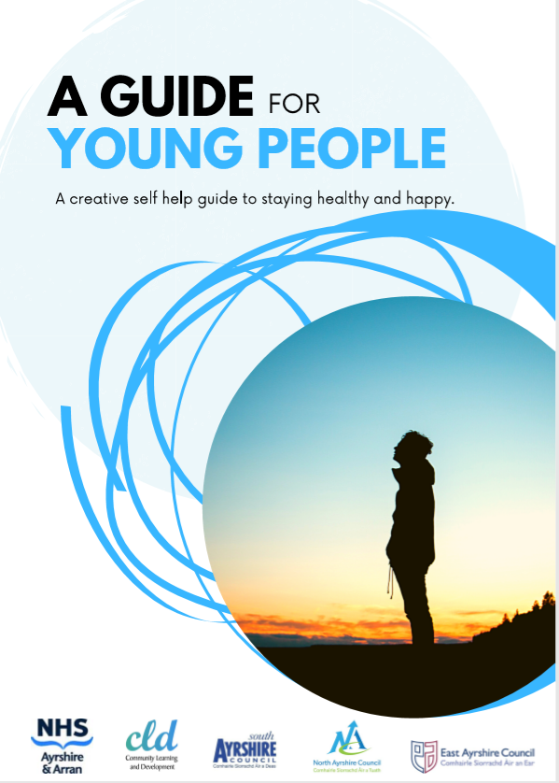
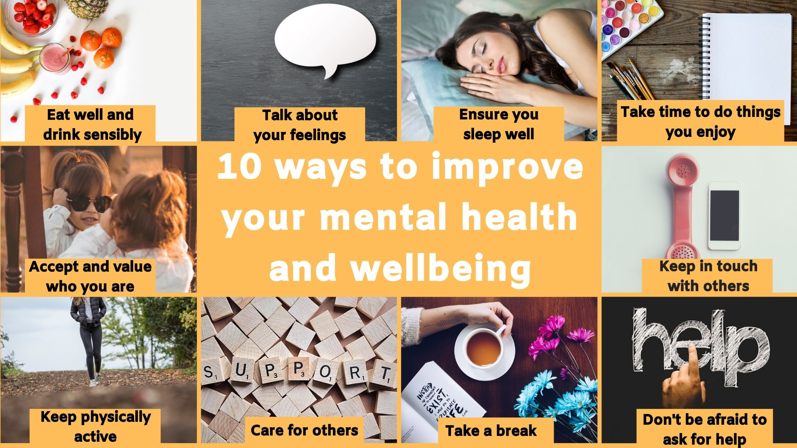
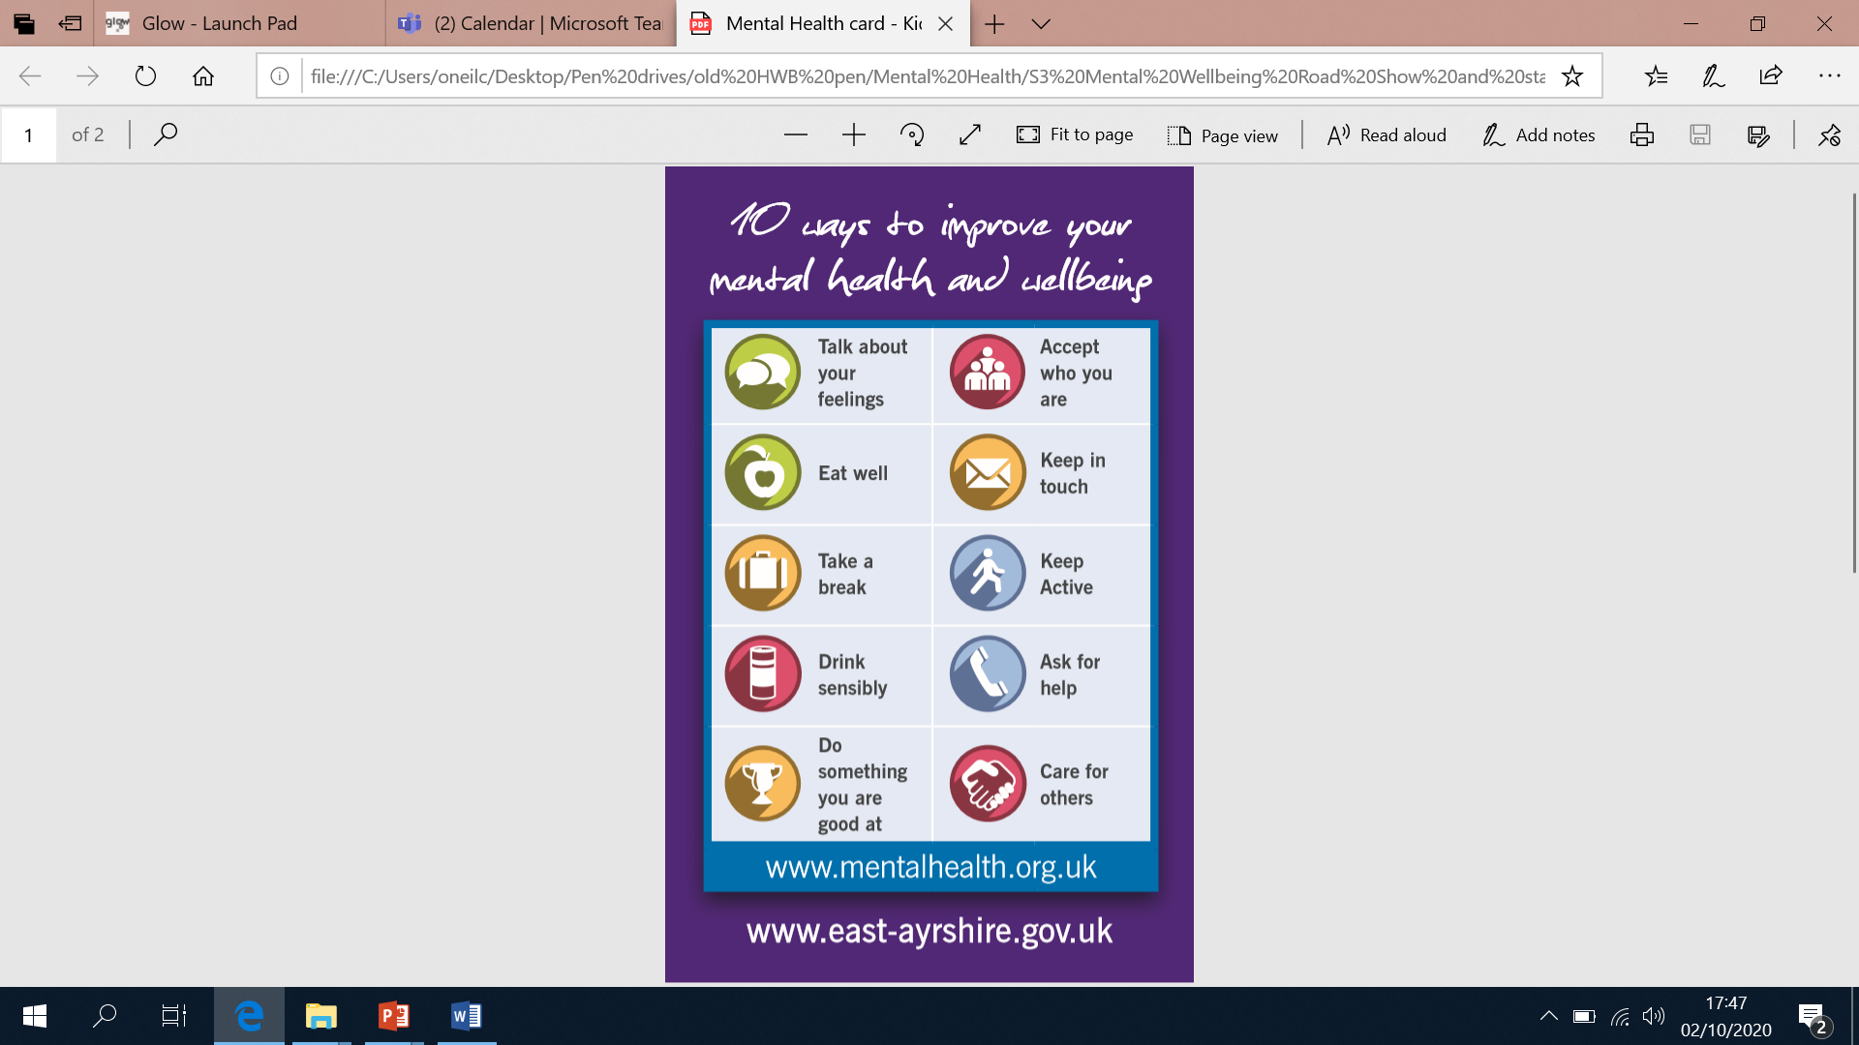
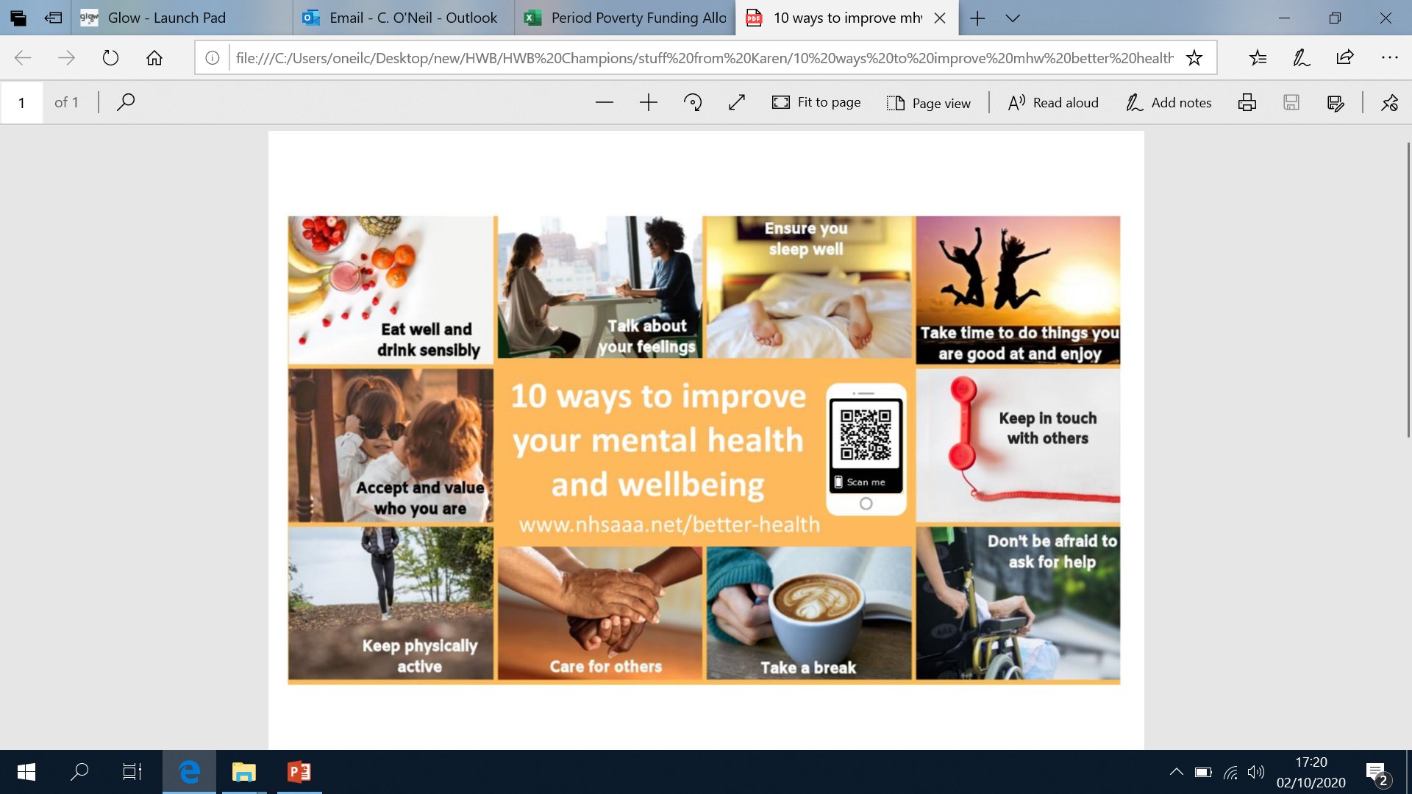
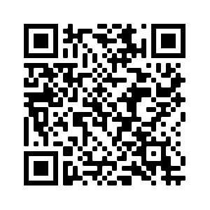

Slide 20
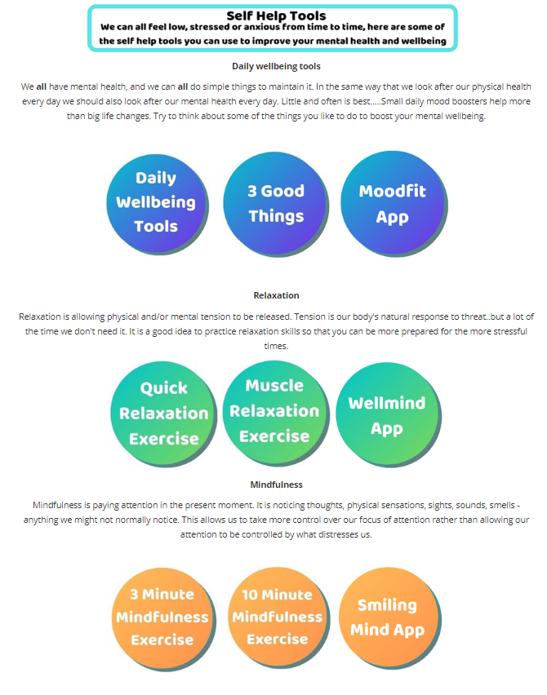

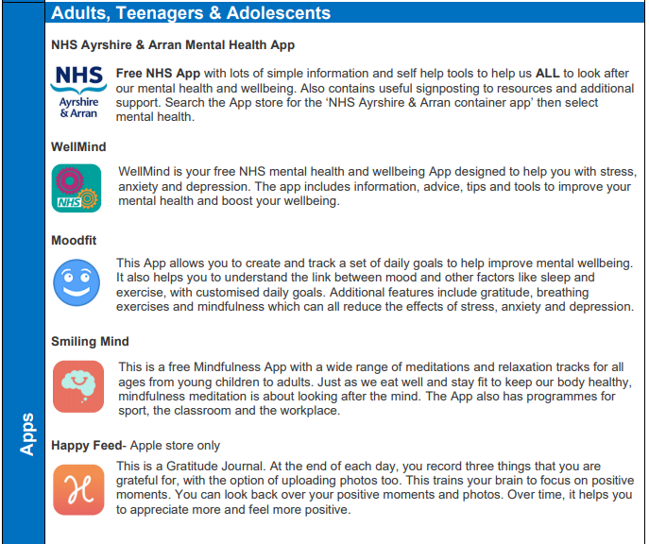
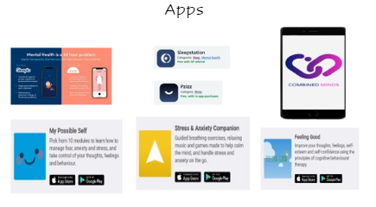

Slide 21

Activity 6 – What’s next?
Spend the next few minutes thinking about what you are going to take away from the course to promote your positive mental health and wellbeing. For example;
What could you do?
Set time aside for myself to find out more about mindfulness
EAC Parental
Awareness Blog

Slide 22
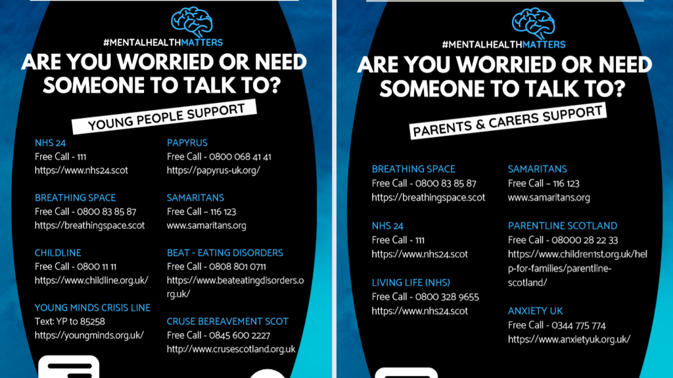

Slide 23


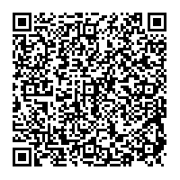
https://forms.office.com/Pages/DesignPage.aspx?auth_pvr=OrgId&auth_upn=EAcatrina.oneil%40glowmail.org.uk&lang=en-GB&origin=OfficeDotCom&route=Start#FormId=oyzTzM4Wj0KVQTctawUZKZSt4Qcv03lAtN3TR371vfhUQ1I5Vkg5Qk9SUjY1MzlUQ04wQlg5VVBCRS4u

Slide 24
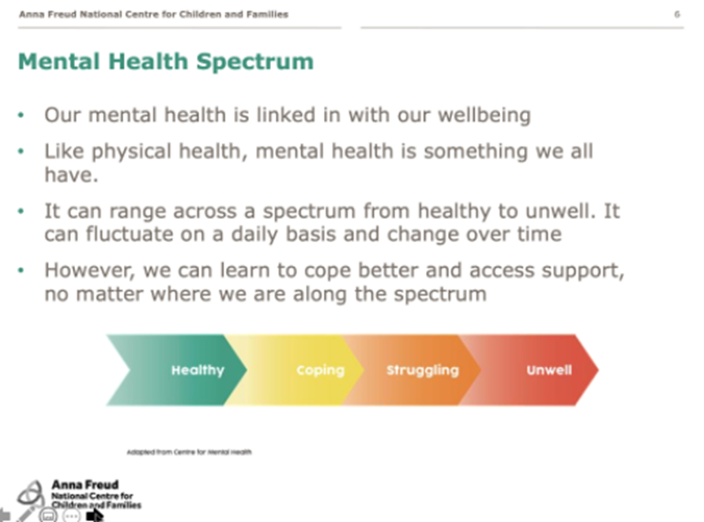

Slide 25
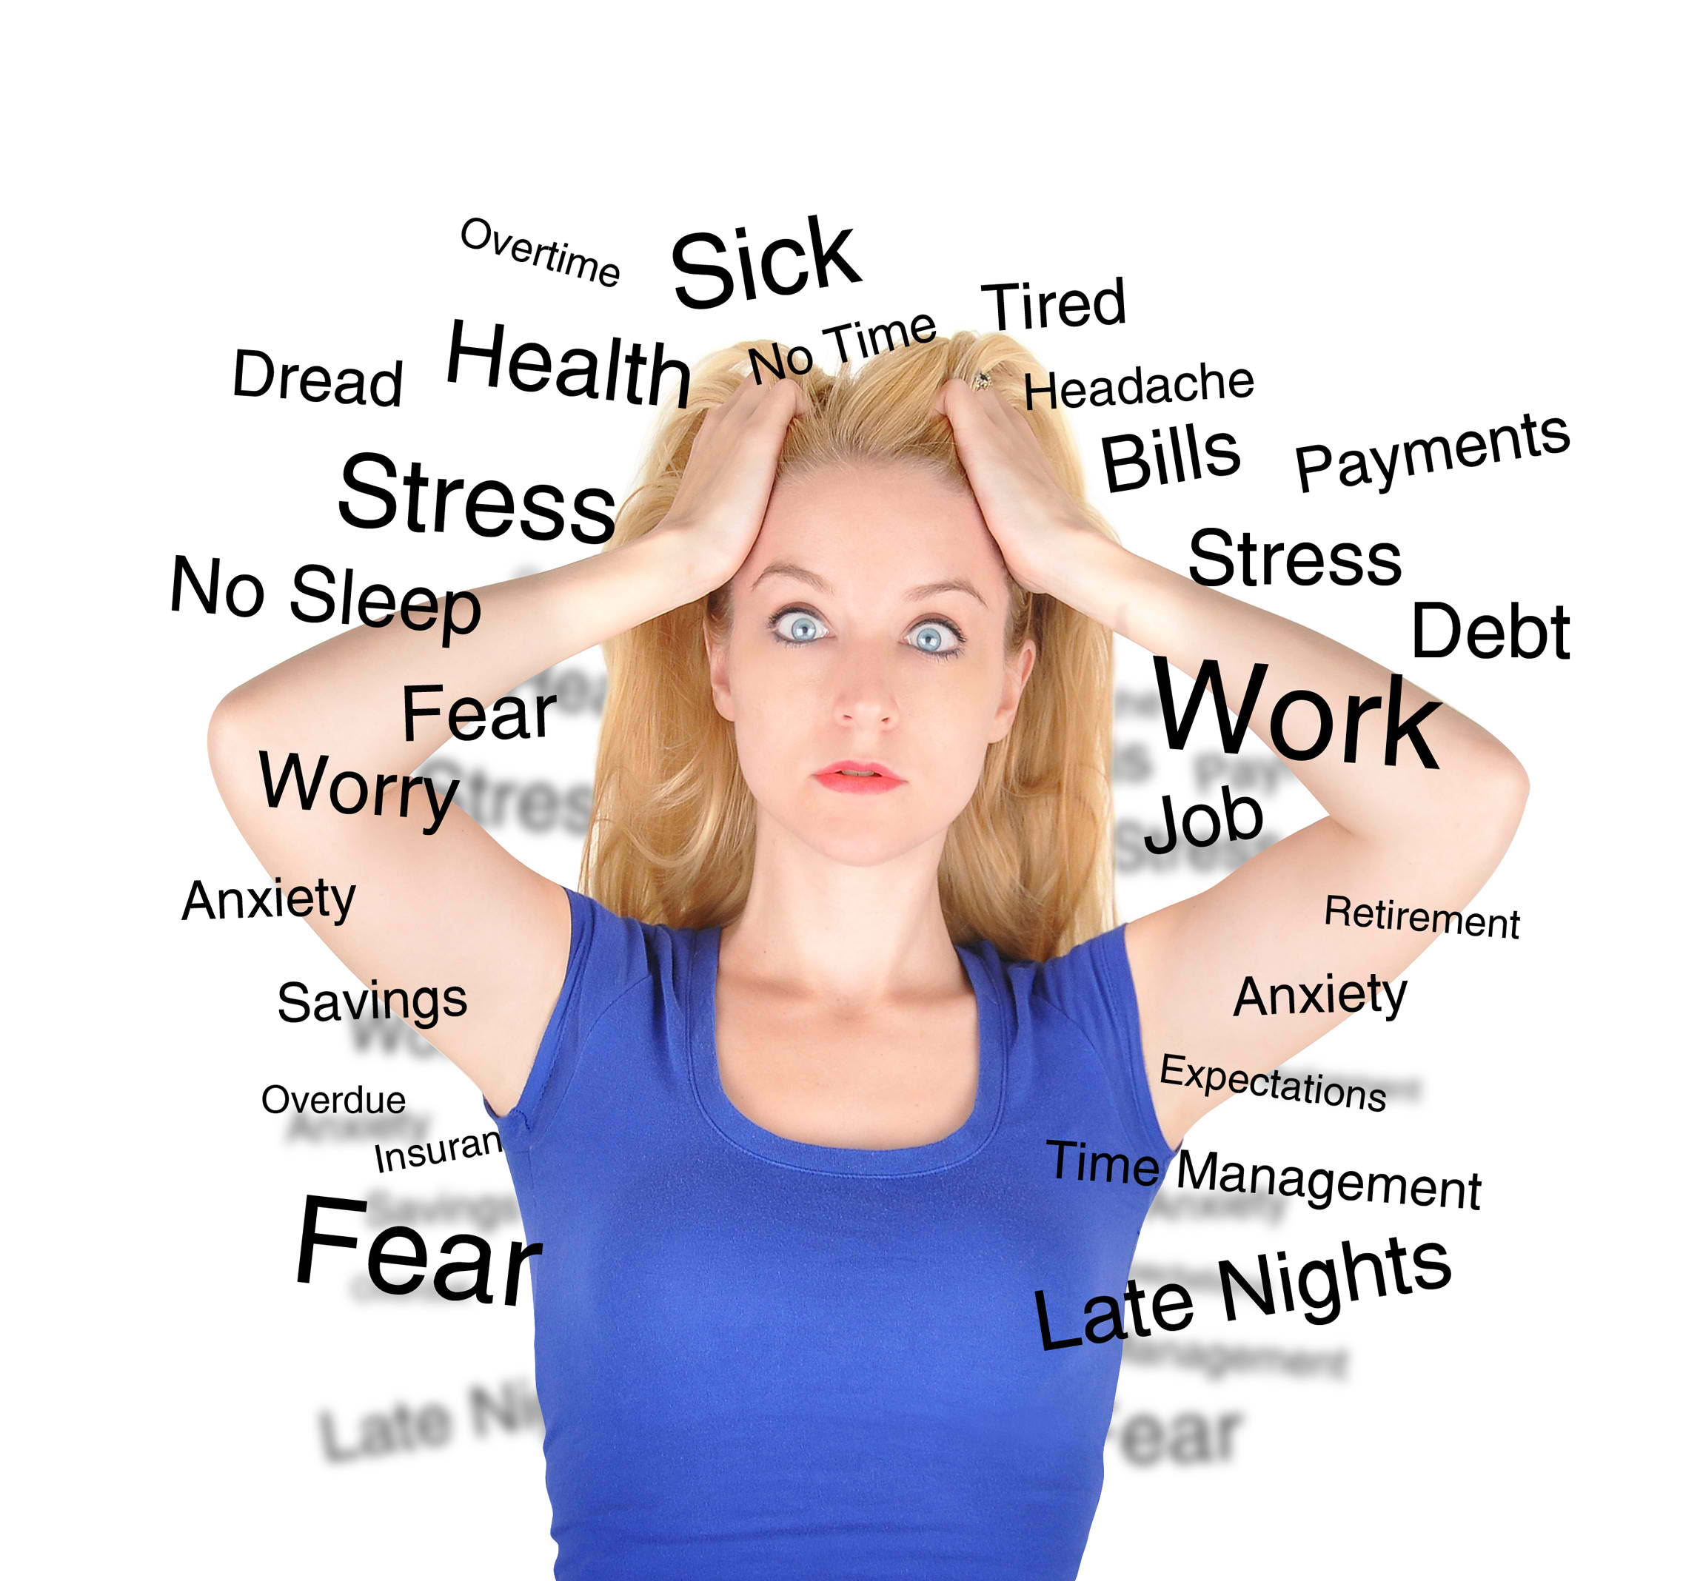
What makes us stressed?
Feelings of stress are normally triggered by things happening in your life which involve:
being under lots of pressure
facing big changes
worrying about something
not having much or any control over the outcome of a situation
having responsibilities that you're finding overwhelming
not having enough work, activities or change in your life
times of uncertainty.

Slide 26

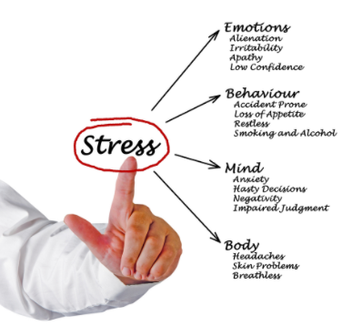
The effects of Stress
Signs or symptoms can fall under the following categories:
Emotions – How do you feel?
Behaviour – what do you do?
Mind – How is your mind working?
Physical – What happens to your body?

Slide 27
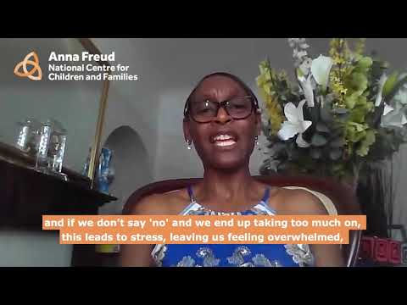
What is self-care and why is it important?

Slide 28
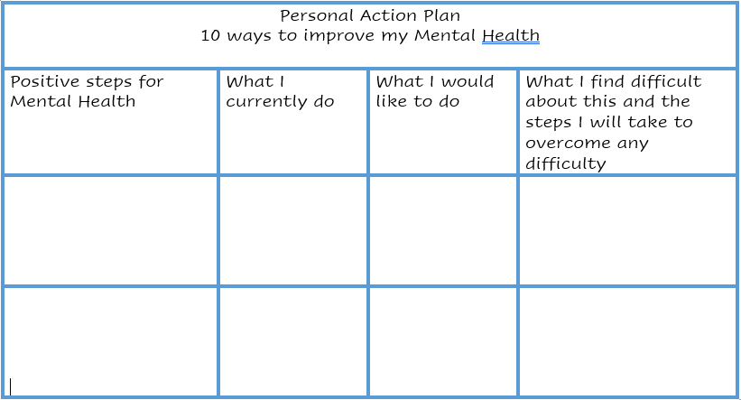
Create a ‘Personal Wellbeing Action Plan’
Identify the top two areas you think you could work on.
You are working towards building RESILIENCE.
…..take the time to regularly revisit your action plan in the future.

Slide 29
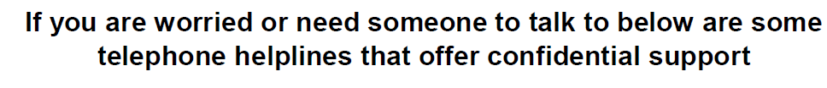

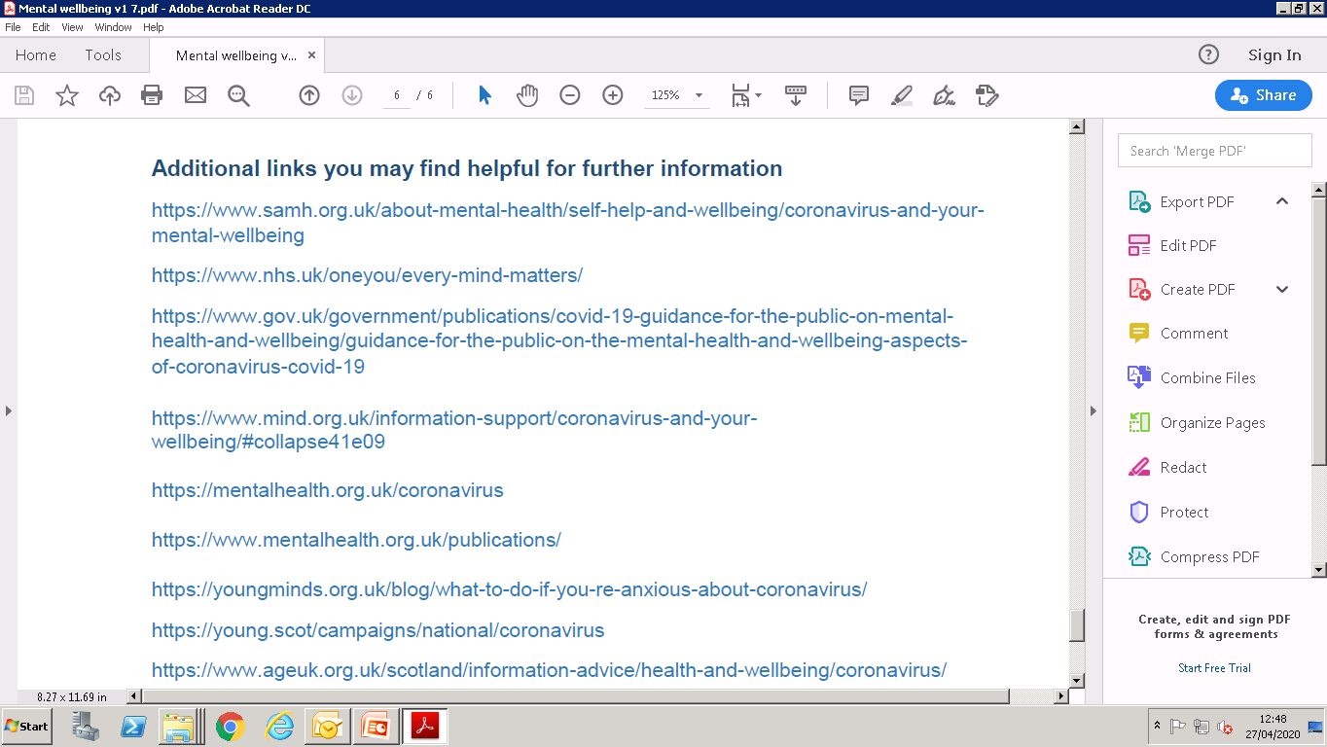
Support
www.nhsaaa.net/better-health/

