Slide 1
Parents & Carers Workshop
Notes:
Adam
Firstly thank you all for coming along today to our respectme workshop for parents and carers. My name is… and I have been working with respectme
Scotland’s anti-bullying service to bring this information to parents and carers across East Ayrshire.
respectme research has shown that 30% of children and young people in Scotland have experienced bullying. Having positive relationships is important for all of our wellbeing and this is the same for our children. It is important therefore as parents and carers that we know how to help our children if they are affected by or involved with bullying behaviour.
If a child is being bullied or is involved with bullying others it can be an anxious time for them and for parents/carers too. Parents report feeling unsure if they are supporting their children in the right way and it is not always clear where to go to get help. This workshop is all about helping you to feel more confident to offer support and to how to get further help if you need it.
Bullying is a children’s right’s issue- Every child growing up deserves to feel safe and protected and that means online and offline.
Bullying is never acceptable and we all have a vital role to play in ensuring that children get an effective and consistent response when it comes to bullying behaviour.

Slide 2
Aims
What is bullying?
How to respond to children affected by bullying?
What can we do to prevent bullying?
Where can we get further help ?
Notes:
This workshop aims to help you recognise bullying behaviour, undersdtand how best to respond to it, what you can do as a parent to help to prevent your child from bullying others and how to get further help.
Talking about bullying can sometimes make people feel angry, upset and frustrated especially if they’ve had an experience of being bullied themselves or known someone that has.
Whilst we do want you to join in with the discussions today please be careful not to share any specific information about children and note that we won’t be able to explore any personal situations due to the need to protect child confidentiality. If you need help to support yourself or a child affected by bullying we will show you how and where to get help at the end. We want this workshop to be a safe space to learn but if you feel yourself getting upset it’s important to look after yourself and you are free to leave at any point.
If you’re not sure of something there will be an opportunity at the end to ask questions and we will be sharing this presentation at the end.
Before we get started though there are some quick housekeeping reminders: Toilets, mobile phones, fire exits, assembly point
If delivering online remind participants to put their audio on mute and if they would prefer not to be seen turn off their video camera. Comments and questions can be put into the chatbox and will be answered.
So let’s get started!

Slide 3
Section 1-
Recognising Bullying

Slide 4
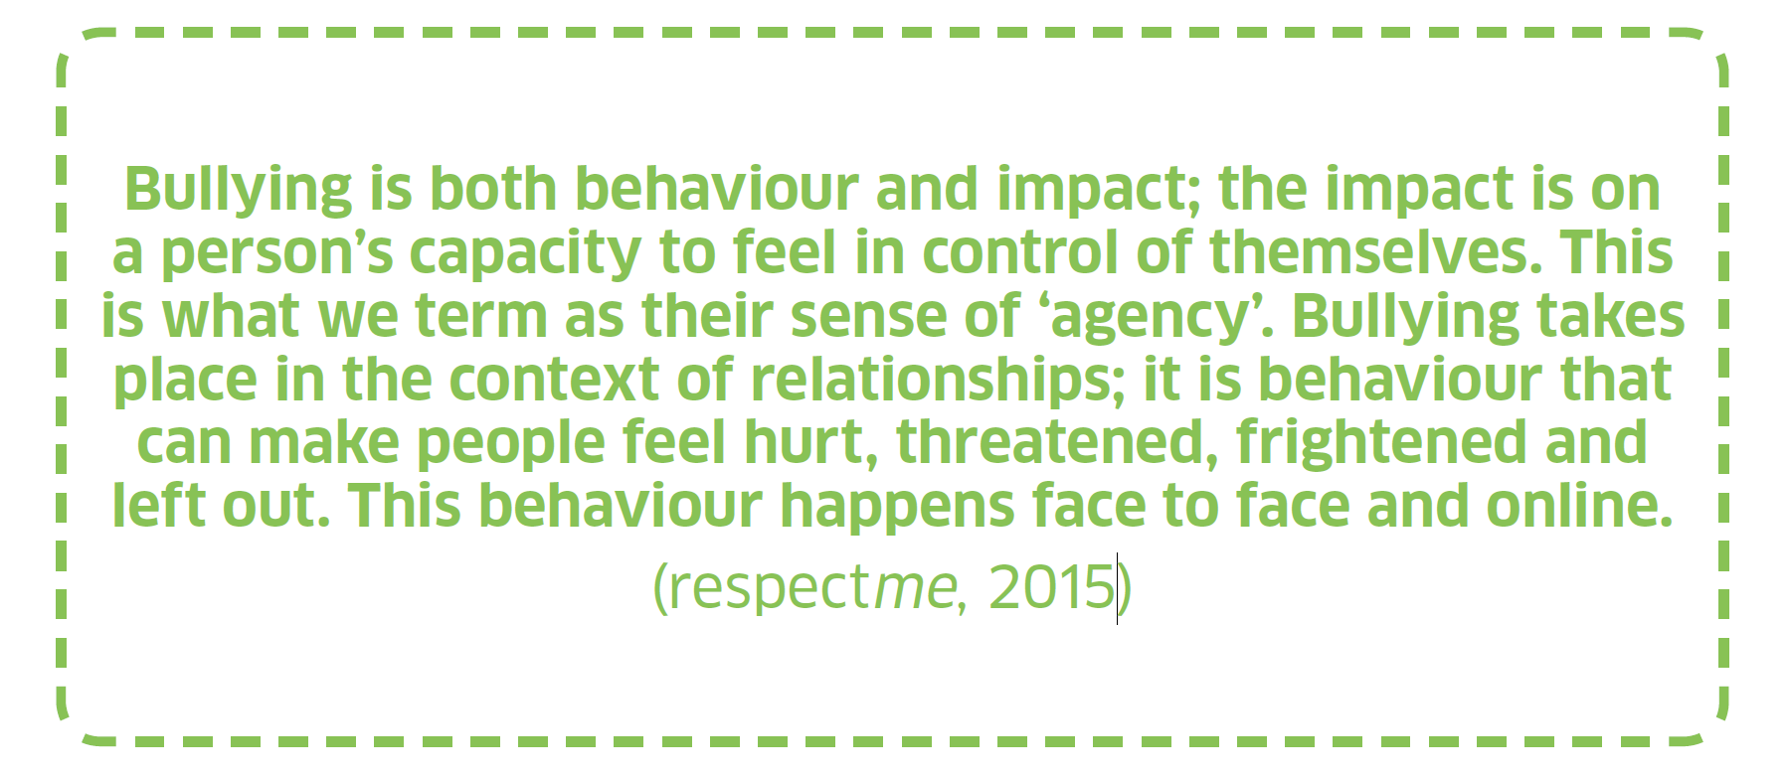
What is Bullying?
We have an agreed definition in Scotland of what bullying is and a National Approach, “Respect for All”
Notes:
In Scotland we have a National Approach to dealing with bullying behaviour. Called “Respect for All” it sets out an agreed definition of what we meaning by bullying
Trainer reads out the definition from the slide
If parents, teachers, youth workers are all on the same page when it comes to how we define and deal with bullying behaviour it helps to ensure that children get consistent and effective response.
It’s good for us as parents to know a bit about what this National Approach because this is what our local authority, teachers in our schools and in fact anyone working with our children and young people will be guided by.

Slide 5
Key Points about the Scottish Approach to Bullying
Bullying behaviour isn’t always intended to cause harm
Bullying behaviour isn’t always persistent-can be a one off
Labelling children as “Bullies” does not help to change behaviour
Bullying can be caused by prejudice towards differences
Notes:
The most common definitions of bullying include terms such as repeated, deliberate behaviour intended to cause harm. They may also use labelling language such as “Bullies” In Scotland our Approach, which is regarded globally as being very progressive, is a little bit different from this. Here’s how.
For example: does bullying behaviour need to be intentional? (The answer is No)
Many definitions of bullying contain an element of “It’s only bullying if the person meant to do it” But this is not particularly useful when it comes to trying to decide if it’s bullying or not. It’s easy to say “I didn’t mean to do it.”
Also, whilst some bullying is intended to cause harm, some children could be copying behaviour they have seen elsewhere and not understand its impact. Intent to bully might not be present but the impact is still there. Keeping the focus on the behaviour that’s happening and the impacts it’s having on the child is more important than trying to work out if it was intentional.
Does bullying behaviour need to be persistent? (The answer is No)
Although bullying is usually persistent, a single incident can have a significant impact for some children and young people, as the fear of it happening again remains.
Also waiting to see if a pattern emerges before taking supportive action is not helpful to a child that is already being affected by bullying.
Labelling children as either ‘a bully’ or a ‘victim of bullying’ is stigmatising. Labels do not change behaviour or support recovery from the impact of bullying.

Slide 6
Bullying Behaviours
Unwanted physical contact-Hitting, being tripped, pushed, kicked, hair pulling
Name calling / being teased, being threatened
Having belongings taken or damaged
Being ignored, left out
Rumours, gossip, lies spread about you
Being sent abusive messages/images
Being targeted because of who you are/seen to be
These happen online and offline
Notes:
Here are some of the ways that bullying can happen.
Some of these are obvious behaviours that can be seen easily. Others are not so obvious- sometimes a certain way of looking at someone for example can feel threatening although perhaps it didn’t last very long but if you were on the receiving end of it felt threatening.
Sometimes it can be hard for children to describe the behaviour that is happening that is upsetting them.

Slide 7
Harmful Impacts of Bullying
Mental & physical health- e.g. anxiety, depression, bed wetting, eating/sleep disorders, self harm, suicidal thoughts, suicide
Attainment e.g. lowered confidence and aspirations
School Attendance- not wanting to go to school
Reactive behaviours e.g. withdrawn, aggressive
All children have a right to be safe and protected from harm
Notes:
Bullying can effect different children in different ways. It depends on the child.
Here are some of the ways that bullying can harm children.
Talk through the list. Ask if they can think of any other impacts?
These can also all be signs that bullying might be happening.
Providing an effective early response can help to reduce these long term impacts of bullying.

Slide 8
Bullying is not…
Physical assault, sexual assault, hate crime
Differences of opinion, wanting to do different things, “falling out” with each other.
Notes:
Also it is important to understand when behaviours become unlawful such as in the case of physical or sexual assault. For example if I punch someone in the face and cause injury this is not bullying this is a physical assault. This kind of behaviour carries legal consequences.
Sometimes as children are learning about relationships they may describe things that are happening in their relationships as bullying when actually it is not. It may be that it’s simply that someone disagrees with them or doesn’t want to do the same things as them. Or maybe they didn’t feel like playing together today. As parents we can help our children understand when what’s happening in a relationship is bullying and when it is not.

Slide 9
Section 2-
Responding to Bullying

Slide 10
Attitudes to Bullying
Notes:
Sometimes some of the attitudes that we’ve grown up with might get in the way of us giving our child a good response
What do you think of this statement?
Why might this attitude not be helpful for a child seeking support?
Bullying may be relatively common but it is not acceptable and should never be seen as a normal part of growing up. Adults don’t expect to be verbally or physically abused by colleagues or friends, and children and young people have the same right to be free from bullying and to feel safe in their environments.
Comments from adults such as; ‘It happened to me and I turned out alright’; and ‘It will toughen you up, it’s character building’; can dismiss how a child feels about bullying and do nothing to help the situation that they find themselves in.
What about bullying building resilience?
Children are all different and have different levels of resilience – a child may be more affected by bullying behaviour than others. Bullying itself does not build resilience. It might be possible that if a child gets effective support and are helped to recover that they could come through an experience of bullying with minimal lasting impact but often bullying can actually reduce a child’s level of resilience and the impacts can last right into adulthood.

Slide 11
Before you give advice get some
Notes:
We are now going to watch a couple of short films that will help us explore how we can best support children.
Play film “Before you Give Advice Get Some”
Ask delegates: what do you think of the messages in this film?
We are not trying to make the Dad the villain of the piece in this video. Hearing that your child is being bullied brings out an understandably emotional response.
Sometimes the advice we give children and young people at this time isn’t necessarily the best advice. Children and young people report that being told to ‘hit someone back’ if they are being bullied is a common response. We know it exists as an option to use but we know, by and large, it’s not necessarily the best or safest option to take, so there always has to be an alternative.
We encourage all adults to get advice before you give advice because of the potential negative consequences for young people.

Slide 12
Notes:
As parents/carers we can help a child explore their options in order to deal with and cope with the bullying and this helps them get back their feeling of being in control again. Children can feel helpless when they don’t feel/see that there are any options. This can lead to mental health problems and unhealthy coping strategies. Exploring options also helps to build a sense of hope that there are things that can be done to deal with the bullying.
PLAY FILM
Summarise as a group discussion:
Every child is different. What might work for one child may not be right for another.
Every options has pros and cons depending on the person/people involved and the situation. We can help them weigh up their options or understand what options are available.
Telling an adult is the safest option and remains the option most children prefer. Hitting back is the most risky option.
They may have to try a few things to find out what’s going to work for them.

Slide 13
Responding to Bullying
✔ What’s been happening/has happened?) (Behaviour)
✔ How has it made you feel?) (Impact)
✔ What would you like to happen next?
✔ What would you like me to do to help you?
✔ What attitudes, prejudices or other factors have influenced the behaviour?
Notes:
Every bullying incident should be treated individually – there is no single response that will work in every situation, but these 5 simple questions will guide us to have helpful conversations.
By avoiding the often natural urge to jump in and “fix” a situation we can help a young person restore their sense of being in control by asking them what they think would help, what they want to happen and having their voice as much as possible lead what you do next.
Find out what behaviour has taken place and how this has made them feel. You might need to ask probing questions to find out who and what has been involved
Remember too that the way you respond is vitally important.
-Listen and give them your full attention
-Encourage them to talk, show empathy and understanding and reassure them that they have done the right thing in talking about it and you’ll do your best to help.

Slide 14
What should I do if my child is bullying others?
Understand the causes of the bullying behaviour
Describe for them the behaviour that needs to change
Explain the impact their behaviour is having
Avoid labelling them as a “bully”
Challenge any prejudice
Find out what they need to help them change their behaviour
How can you help them to do that?
Explore other ways of coping with difficult feelings
Notes:
It can be distressing to find out that your child has been involved with bullying behaviour. However all behaviour communicates feelings and we need to try to understand what lies underneath the behaviour. It’s not to excuse the bullying behaviour but the child may well need help to manage their emotions or difficult feeling in more positive and helpful ways if they are to avoid patterns of negative behaviour repeating possibly into adulthood.
Children and young people who are bullying will need help and support to:
• Identify the feelings that cause them to act this way
• Develop alternative ways of responding to these feelings
• Repair relationships
Do not label the individual or group as a ‘bully or bullies’. Name the behaviour and the consequences should it continue. For example, “When you call people names it is upsetting for others and hurts their feelings. If you act like that people may not want to play with you.”
It can be hard for parents to empathise children that are displaying bullying behaviour towards others. However we should try to remember that all behaviour is communication and the child displaying bullying behaviour will need the support of adults in his/her life to help them to learn about positive relationships, how their behaviour impacts others and how they can help to repair relationships.

Slide 15
Section 3-
Preventing Bullying
& Further Help
Notes:
Adam
The third and final section of this presentation is about preventing bullying and where to get further help should you ever need it.

Slide 16
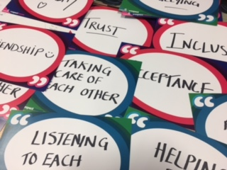
Preventing Bullying
Focus on positive, respectful relationships
Create kind, inclusive communities
Role model fairness, respect, equality and inclusion yourself
We all have a part to play
Notes:
Adam
The best way to address bullying is by preventing it from happening in the first place and encouraging positive, respectful relationships is an important part of what we do as parents and carers. We all want our children and young people to grow up to enjoy happy, respectful relationships. Talking about relationships and how to be a good friend is important so that children can learn what it takes to build healthy relationships. These are important life skills.
Respect is a commonly used word but how would you explain and talk to our children about it? (Gather responses from the audience)
Respect means different things to different people but the common underlying themes are of kindness, listening to each other’s views, accepting difference, empathy, valuing each other and treating others equally.
Role modelling respectful relationships in our families is crucial to creating positive environments. Children look to us to learn lessons on how to resolve conflict, how we disagree in a respectful way, how we deal with differences and treat others that are different from ourselves. We all need to lead by example. If we boss, judge and criticise, children and young people will think this behaviour is acceptable and will follow our lead. Show children respect and they are more likely to respect others.
Let children know that you don’t have to like each other , you don’t have to agree with each other but you do have to respect each other.

Slide 17
Getting Help from School Checklist
✔Find out what information your child wants you to share with the school
✔Find out who is best to speak to in school
✔Read the Anti-bullying/Positive Relationships policy
✔Arrange a meeting/telephone appointment
✔Keep calm & focus on finding a solution
✔Agree next steps & time to review the situation
Notes:
Adam
Incidents of bullying tend to be best resolved at school level. Finding the right person in school to help you and being familiar with the school anti-bullying policy will help to reduce the stress you might be feeling so that you can focus on the best way for you and your child to get the support they need either to cope with the bullying behaviour or to get the behaviour to stop.
Emotions can run high if our child is being bullied or has been involved with bullying behaviour. As parents it is natural to feel protective over our children.
Sometimes however our emotions can get in the way of finding a solution and positive steps forward. Trying to stay calm for our children is important as it helps them to feel safe.
Once you’ve met/spoken to school keep in contact with school to review your child’s wellbeing and progress. For reasons of confidentiality you won’t be told details of what’s happening with other children involved but you do have a right to be kept informed that action is being taken to get the behaviour to stop and that your child is getting support to keep them safe.
In East Ayrshire our anti-bullying policy is called Respectful Relationships. You will find it on the council website. Schools will also have a copy of it and their own statement about the school’s approach to dealing with bullying.

Slide 18
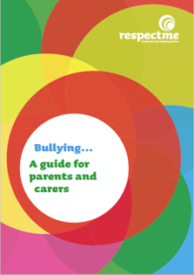
Further Help
Notes:
I would like to Thank you for attending today’s workshop and hope it has given you a better understanding. Obviously there’s only so much we can cover here today.
Here are some of the organisations that can help you and to get more information.
respectme have lots of resources for parents such as videos and a Parent Guide. There’s also information about dealing with bullying when it’s happening online.
Some children may want to speak to someone else about bullying apart from parents and carers. Childline and Breathing Space both offer helplines and instant messaging services.
As parents we might need some emotional support for ourselves. Children 1st operate Parentline for all parents across Scotland.
If you want more information about online bullying the NSPCC run Net Aware for parents with lots of information about social media apps and gaming and how we can deal with bullying when it’s happening online.
Also don’t forget that school is always there to support you with any concerns about bullying and you can read up about East Ayrshire updated Respectful Relationships policy on the authority website.

