Slide 1
Conversation Matters

Slide 2
Objectives
Building the skills and confidence to make a positive impact
The need for a plan and structure
The need for flexibility & to expect the unexpected
The need for clarity & a safe environment during conversation
Notes:
“Here are a list of objectives which we will be looking at throughout this short presentation. And we will be looking to help you complete such objectives by the end of this session. So we have…..(read through objectives on the slide)

Slide 3
Your experiences
A potentially challenging conversation that had a good outcome
A conversation that didn’t work well/ go to plan – what happened?
Why it is important to tackle issues early and not let them escalate?
What are the conversations some of us dread or put off and why is that?
Notes:
“Here are some examples of situations which we would kindly ask you to discuss. Think of…(then read through slide)
“I would now ask that you pause for 5 minutes and reflect on your own experiences, and give an example of when you have found yourself in a difficult conversation, or even a conversation that began negatively and ended positively. You can feel free to work in pairs/groups for this discussion.”
Facilitator then to summarise everyone’s views

Slide 4
Some example situations
Addressing poor behaviour or conduct
Dealing with personal problems or stress related issues
Providing comfort or reassurance e.g if your child has had a bad day at school
Tackling personality clashes
Bullying at school/out with school
Finding school work difficult
Notes:
“In relation to the previous slide, some of you may have mentioned the following situations…(read off slide)
Ask if any other situations participants have come across
Highlight OD clinics here

Slide 5
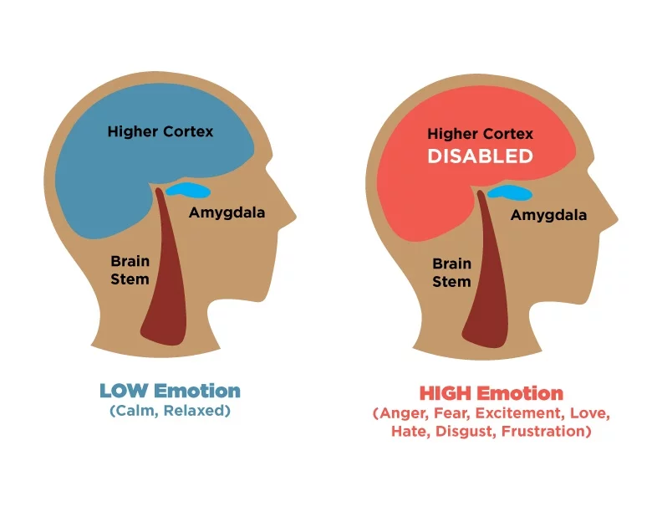
Handling Emotions
Notes:
5
Now that we have covered some examples of situations where difficult conversations may arise, we will now go through the potential reasoning behind some conversations along with how we can help improve the situation of some conversations.
When we are in situations that cause us to become defensive or trigger situations, or emotions become heightened, it activates our flight fight or freeze response
essentially we stop being able to think clearly and calmly and rationally with our higher prefrontal cortex and we react rather then respond.
Reacting is helpful when there is a real immediate danger, otherwise responding is much more useful.
Ask for example where people may have reacted when it was not helpful
Example trigger words
Eg I want to see you in my office now
You had better
You must
How does these words make you feel?

Slide 6
Notes:
Here we have an example of 5 levels of listening. (then read through the slide top to bottom)
Listening for the gist is ok sometimes but not useful in Conversations that matter.
In addition the 5 levels, listen with a…
Open mind – no preconceived ideas
Open heart - listening for the emotion that is there( Level 4)
Open will - listening for what might be trying to emerge
And that we become aware of our “voices”
Voice of cynicism
Voice of Judgement
Voice of Fear
Practice suggestion
Choose some situations in your lives and practice listening with open mind open heart and open will, and be aware of when the voices of cynicism, judgement and fear kick in as they may do.

Slide 7
High quality inquiry
Do you understand what I am saying?” | “Tell me what this means for you ?”
“Don’t you agree?” “Don’t you think it would be better if…?” | ‘‘What is your view on this’’
Did you do that because of X or Y? | “What happened?’’ ‘’Tell me a bit more about it’’
“Why can’t you do X?” | “What support do you need to do X?”
“Why didn’t you just tell me?” | ‘’What got in the way of you speaking up?”
Notes:
The way you ask questions contributes to the shared pool of meaning, and the way you listen to the answers will create the safe environment where you can have a high quality conversation
Now, you can see on the screen that there are two columns of questions in the table. The one on the left hand side is very different from the right hand side. Take 5 minutes to pause here and have a look at both sets of questions and discuss or have a think about what you believe the difference may be, or if you believe there even is a difference.
Hopefully you can notice that the right hand side may be the preferred option when engaged in a conversation. The right hand sided questions is showing you are interested in what they have to say, and they are not as direct as the left hand sided questions. For example, the second question on the left hand side is almost as if you are putting words in their mouth and providing an answer for them, when really we should be asking “What is your view on this?”

Slide 8
Fun Quiz
Q1 How many levels of listening are there?
Q2 It is important to address poor behaviour or conduct as soon as possible? True/False
Q3 In the High Quality Inquiry slide, which column in the table is the preferred way of conversation? Left or right?
Notes:
We are now going to go through a short fun quiz. Feel free to pause the presentation after each question to allow for some additional thinking time however, 15 seconds will be given in between questions.
Question 1 – How many levels of listening are there? (answer = 5)
Question 2 – It is important to address poor behaviour or conduct as soon as possible? (answer = true)
Question 3 – In the High Quality Inquiry slide, which column in the table is the preferred way of conversation? (answer = right)
That is not the end of the quiz and we will now go through the answers. (repeat question 1, 2, and 3 except include the answers this time)

Slide 9
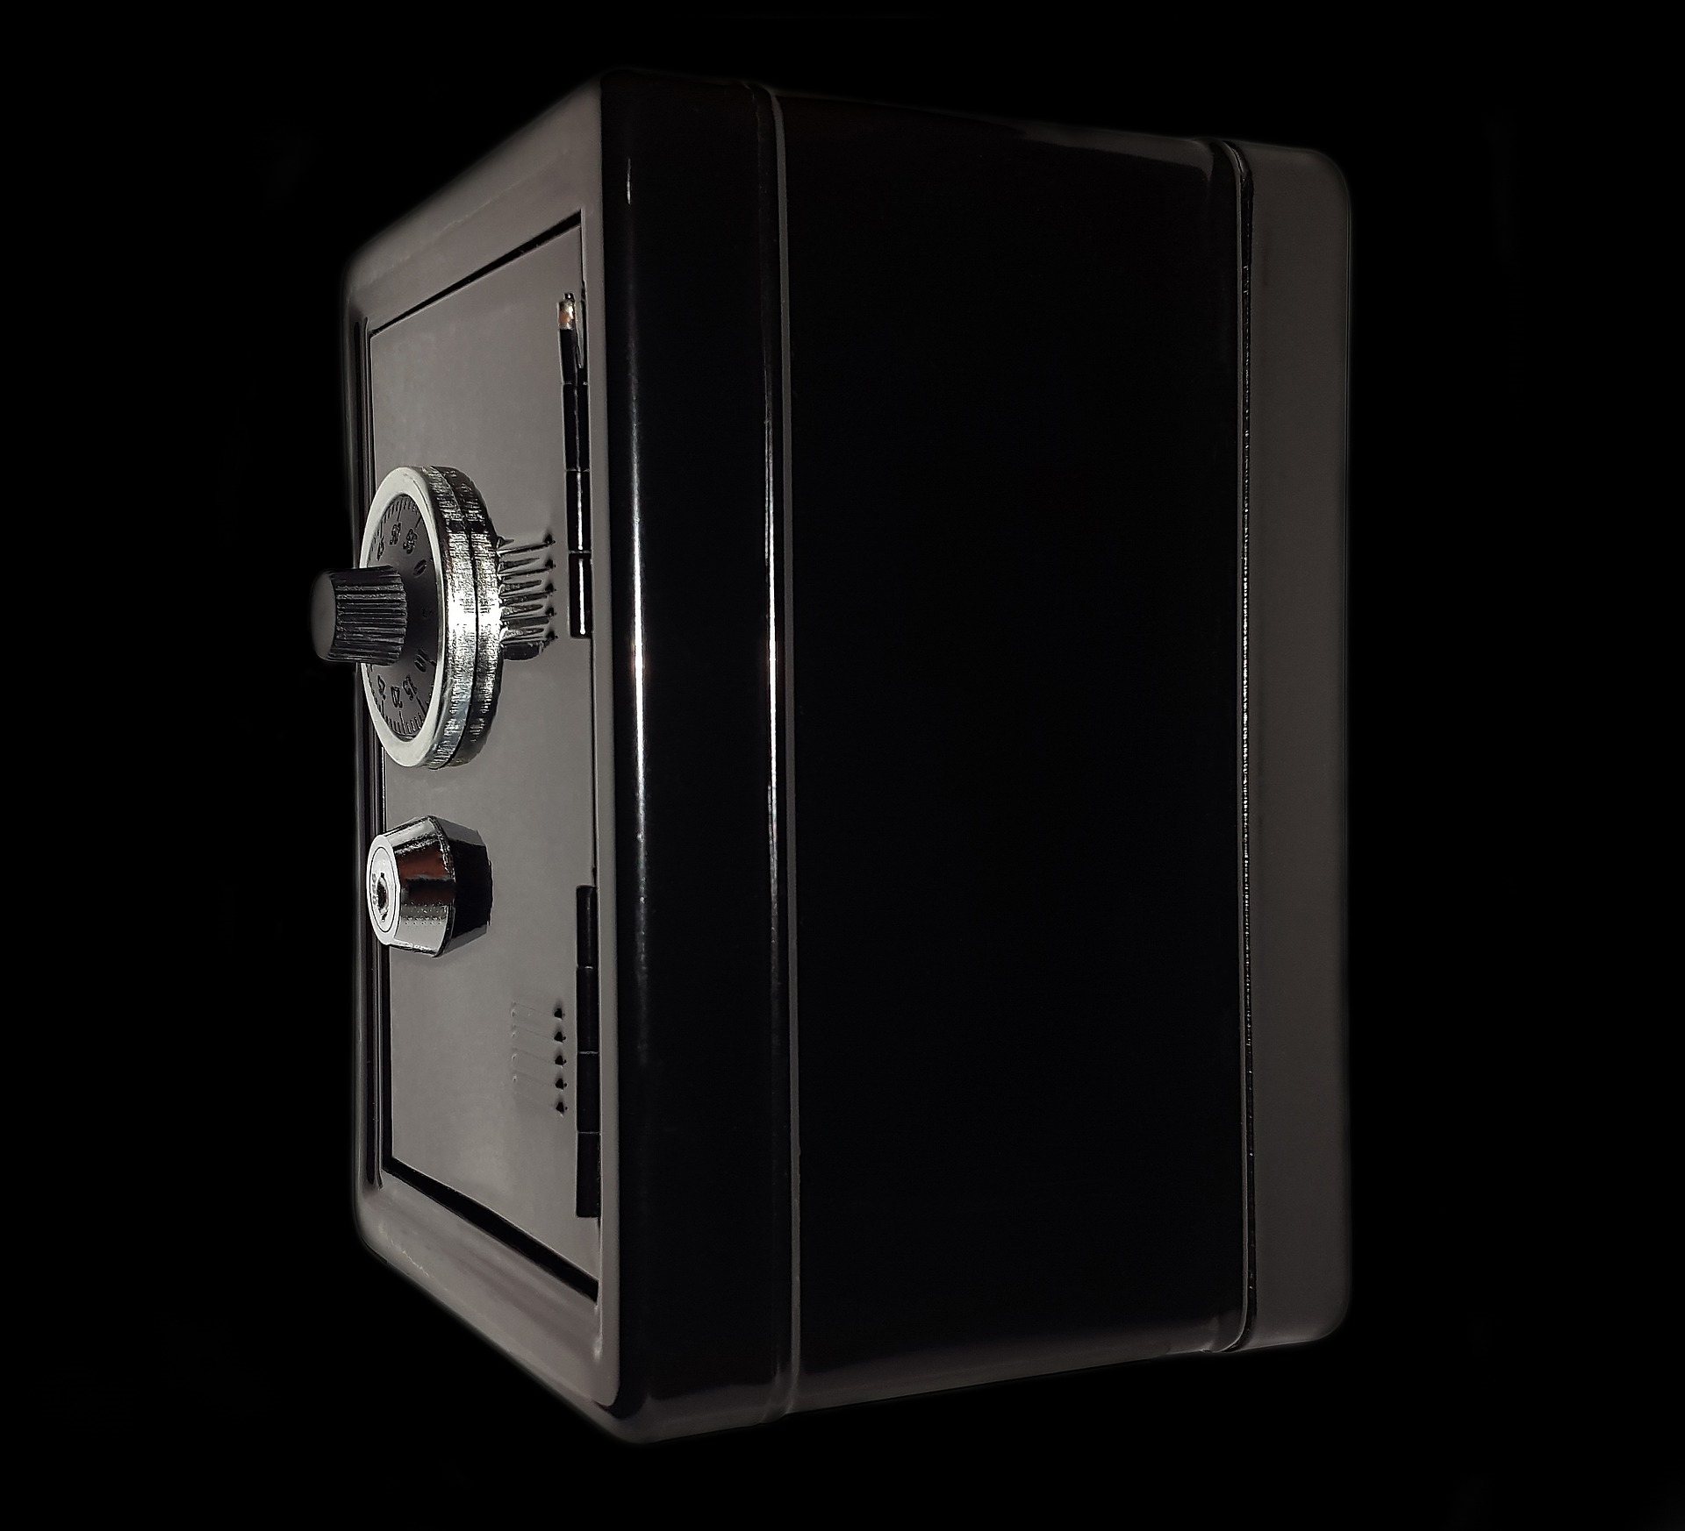
Creating Safety
They need to know that you care about them and their interests; show respect
Check that you are listening well.
Am I acting defensively or being condescending?
Am I valuing what they're saying even if you don’t agree?
Frontloading – start the conversation off gently
Point out what you agree on
Keep highlighting your common goal
Reflecting back what you see/hear
Notes:
One of the most important aspects in having a successful conversation is Creating Safety. Children need to know that you care about them and their interests; it is important to show them respect. Check that you are listening well. Am I acting defensively or being condescending? Am I valuing what they're saying even if you don’t agree? Try to begin by frontloading and start the conversation off gently - if the person talks first, nod intently to show that you're listening, and in return ask open ended questions. Also, point out what you agree on and try to pay a compliment to what they have said. Keep highlighting your common goal – this will help reinforce that you both have a solution focus and are aiming for the same or similar outcome. Reflect back what you see/hear – this shows you have been actively listening and invested in what they have said.
Hopefully some of the tips provided in this slide help you towards having a successful conversation and outcome.

Slide 10
What does look like? | What does look like?
Masking…picking and choosing in showing your true opinion/sarcasm Avoiding…deflecting or staying away from sensitive subjects/not addressing the real issues Withdrawing…exiting the conversation or exiting the room | Controlling…cutting others off/speaking over them/speaking in absolutes/change the subject Labelling…putting a label on people or ideas so they can be generalised Attacking…belittling and threatening
Notes:
10
On this slide, are 6 of the most common styles of conversation a person can adopt when they feel under pressure or stressed. Equally, a person can also display such styles when they only interested in their own point of view and voice. So…
Masking – picking and choosing in showing your true opinion or sarcasm. “Oh Yes that idea will work like a charm, Where do you come up with this stuff?” But what you are actually meaning is, it’s a silly idea.
Avoiding – which is deflecting or staying away from sensitive subjects or not addressing the real issues. People may change the subject or distract from the real issue.
Withdrawing – this is where a person may exit the conversation or exit the room. They may give an excuse as a way out and retract from any form on interaction.
Controlling – this is where a person may cut others off, speak over them, speak in absolutes, or change the subject. They may use words like should, must, always, or never.
Labelling – people may put a label on people or ideas so they can be generalised. For example, you are lazy and careless, you are no good at maths as I was never any good. These sort of statements should be avoided during conversations.
Attacking – this is where a person is belittling and threatening. For example they may say, if you don’t get this finished I will… or, don’t you dare do that or I will…
Hopefully this part of the session will help you to pick up on such signs and styles when in conversation with your child, which in return will help you towards a successful outcome from whichever conversation you have.

Slide 11
5 Steps to Tackling a Difficult Conversation
Prepare – opening statement, be honest about feelings, positive tone, show commitment to resolving the issue
2. Ask – be thankful for the conversation, ask for their point of view, open ended questions (why, what, how)
3. Recognise – give benefit of the doubt, don’t conclude they deliberately meant to hurt/offend, show active listening by validating their feelings and paraphrase their argument, be self-aware by recognising your role in the situation
Notes:
We have now reached the last section of the session. We will now go through 5 steps to tackling a difficult conversation. The first of which is:
Prepare – have an opening statement ready and be honest about your feelings. Try to maintain a positive tone and show commitment to resolving the issue.
Ask – show that you are thankful for the conversation taking place and remember to ask for their point of view. When asking any questions try to ensure they are open ended, for example begin each question with why, what, or how. The next step is…..
Recognise – try giving them the benefit of the doubt and don’t conclude they deliberately meant to hurt or offend. Show active listening by validating their feelings and paraphrase their argument. In addition to that, keep in mind to be self aware by recognising your role in the situation.

Slide 12
5 Steps to Tacking a Difficult Conversation (continued…)
4. Express – clarify your perspective but don’t minimise their take on it, be assertive about what matters to you – don’t agree just to end conversation, don’t be afraid of being vulnerable – don’t bury your feelings as showing feelings may encourage them to do the same, include their side of the story in your explanation
5. Solve – if some of their points are unclear go back and ask questions, ask them what they believe the solution could be, again be thankful for speaking with you.
Notes:
The fourth step is……..
Express – clarify your perspective but don’t minimise their take on it and be assertive about what matters to you – do not agree just to end the conversation and do not be afraid of being vulnerable. What we mean by that is try not to bury your feelings, as showing feelings may encourage them to do the same. And when you are putting your explanation across, remember to include their side of the story. And the last step in tackling a difficult conversation is………
Solve – for example if some of their points are unclear go back and ask questions, and ask them what they believe the solution could be – this will give them a sense of empowerment in being part of the solution themselves. And when finishing the conversation be thankful for their time and speaking with you.

Slide 13
Conclusion
Take away points:
Create Safety
Have a Plan
Follow the 5 Steps
Notes:
First of all, thank you for your time in completing the Conversation Matters session.
On the slide are some key take away points which we have covered during the session which will help you to have successful conversation with a solution focused outcome – remember to Create Safety, Have a Plan, and follow the 5 Steps.
I hope you have enjoyed the session and if you require any further information please see further links in the blog. Thanks again for your time and take care.

