Slide 1
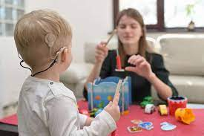
Supporting Deafness
Early years

Slide 2
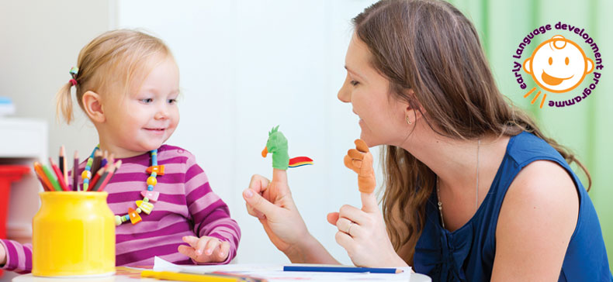
Learning Objectives
You will:
understand the role of a Teacher of the Deaf.
know the relationship between hearing loss and brain development.
be aware of how to create a ‘Deaf Friendly’ space.
be aware of the importance of reducing excess noise during key conversations and activities.
learn strategies to support deaf children.
be aware of hearing technology.

Slide 3
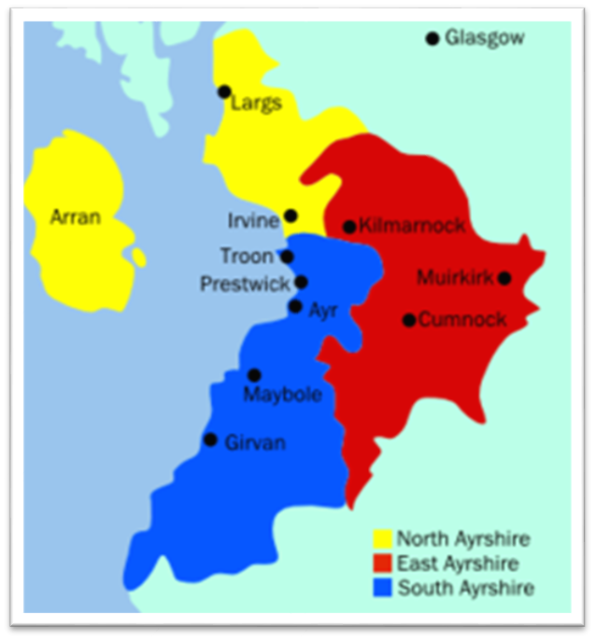
Who are we?
A Teacher of the Deaf (ToD) is a qualified and experienced primary or secondary teacher with an additional 2 year post-graduate diploma, specialising in teaching pupils with a hearing loss.
We are a team of qualified teachers of the deaf, covering North, South and East Ayrshire, working peripatetically.
Approximately 178 pupils (0-18yrs): diagnosis – school leaver
Service Co-ordinator: Stacey McCann
A wonderful BSL Sign Language tutor, Kat Bennett

Slide 4
Role of Teacher of the Deaf (Tod)
Supporting deaf children aged 0-18
Supporting parents after diagnosis & beyond
Modelling play & communication with deaf babies and toddlers
Reducing barriers to learning for deaf children & how to overcome these
Specialised assessments
Audiology & Hearing Technology

Slide 5
Brain DEVELOPMENT
An unborn baby hears at 20 weeks gestation and hearing pathways form in the brain and the cochlea is fully developed at 16 weeks' gestation.
After birth, these pathways continue to strengthen. Auditory brain centres are established.
Hearing loss in babies has been called a “neurodevelopmental emergency.”
If not aided and supported, there can be significant social, emotional, cognitive and educational delays.

Slide 6
Brain DEVELOPMENT
The baby’s brain must be exposed to meaningful sounds consistently in order for these auditory neural pathways in the brain to develop.
After about 3 ½ years of age, the brain has considerably less flexibility to develop effective skills to process auditory information. This is why children who have hearing loss that is identified late have a much harder time learning to listen and speak proficiently.

Slide 7
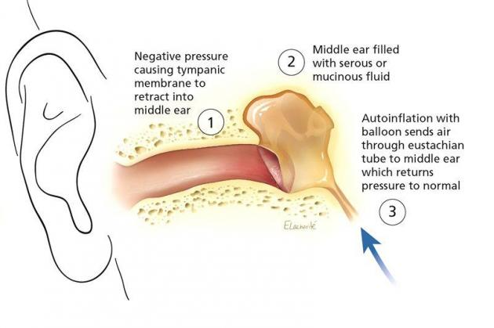
Glue Ear
Glue ear impacts a young child’s ability to develop early literacy skills, like phonics and reading.
Glue ear can be a temporary or a longstanding issue.
Children with glue ear can be fitted with hearing aids.

Slide 8
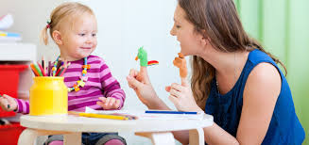
Signs of a Hearing Loss
If you work in the early years or a primary school, there is a high chance that a child in your care will have an undiagnosed hearing loss. These are common signs of hearing loss:
Does not respond when called.
Constantly says "what?" or asks for speech to be repeated.
Watches faces/lips intently.
Doesn’t always follow instructions straightaway.
Often misunderstands or ignores instructions.
Makes little or no contribution to group or activities or discussions.
Complains about not being able to hear.
Tires easily.
Talks louder or softer than expected.
Becomes easily frustrated.
Seems startled when people come into their line of vision.
Appears inattentive or as though daydreaming.

Slide 9
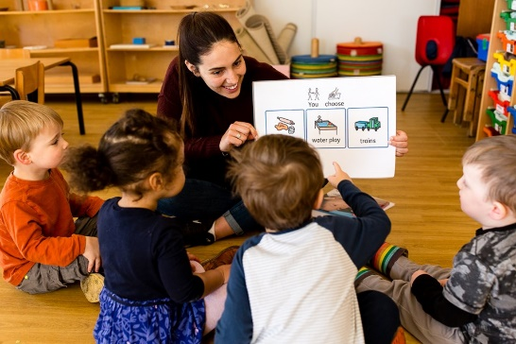
LEARNING THROUGH PLAY
We understand the benefits of learning through play, hearing children free to explore a language rich environment, gaining knowledge, building vocabulary and developing their social and communication skills.
However, early years settings are not conducive to an optimum listening environment for deaf children to have the same experiences.
A deaf child will struggle to hear speech with a high level of background noise, as a result they will miss a lot of incidental learning and conversational language from staff and their peers.

Slide 10
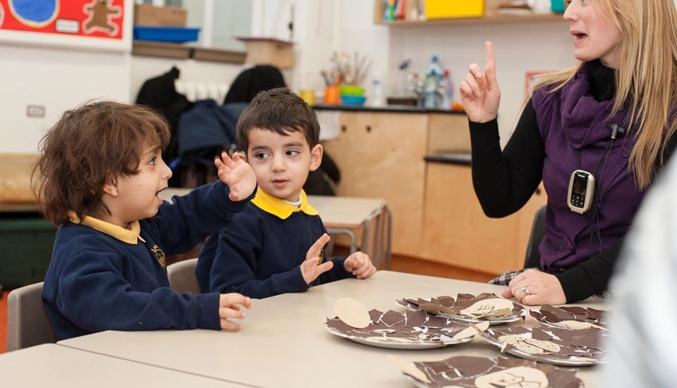
A ‘Deaf Friendly’ Environment
Ensure there is a quiet room/quiet corner in the playroom – carpeted, soft furnishings, reduced audio and visual distractions.
Pick a time when the deaf child will be able to listen without expending so much effort.
A staff member should play alongside them at the chosen activity, modelling and exploring the language related to that topic/activity.
Introduce other children - model a deaf friendly conversation.

Slide 11
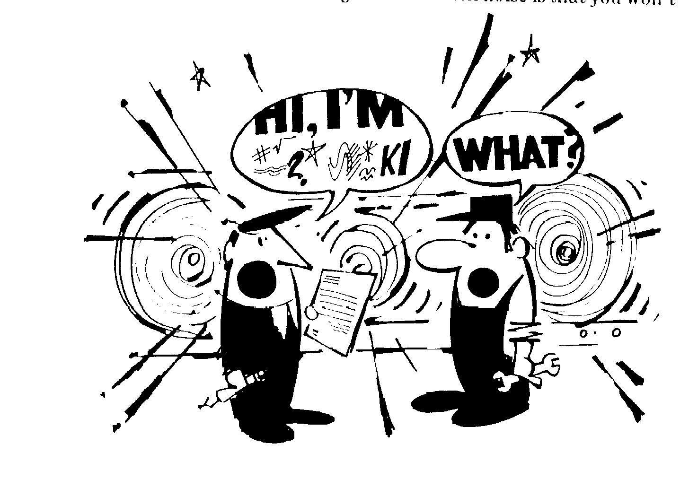
SPEECH PERCEPTION
Hearing loss interferes with how a deaf student perceives speech sounds.
Noise in the environment further interferes with a deaf student’s ability to pick up spoken language and can hinder their progress.
Example – Video Clip

Slide 12
‘FACE me when you talk’ National Deaf Children Society

Slide 13
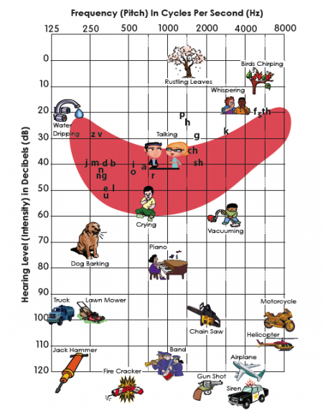
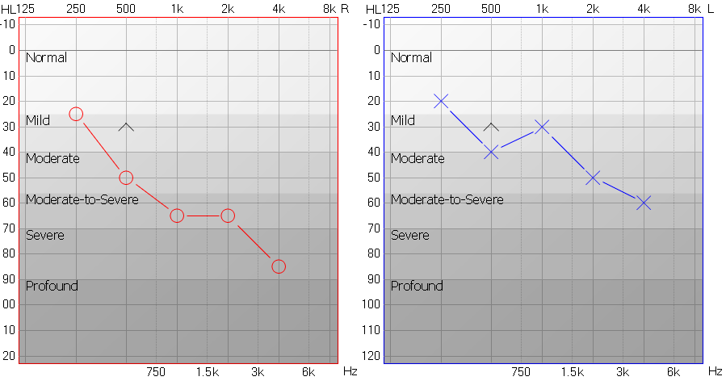
Example of an Audiogram
This audiogram shows that the young person has a bilateral,
moderate – severe hearing loss.

Slide 14
HEARING LOSS SIMULATION
Notes:
To try and show you how and audiogram translates to what a pupil hears this clip is excellent

Slide 15
Activity 1
Look at the following picture.
List how many sources of noise there are in the picture and think about what you can do to make the room more deaf friendly.
Think of your E.C.C playroom and consider all the noises within it and how you could alter them for a more deaf friendly environment.

Slide 16
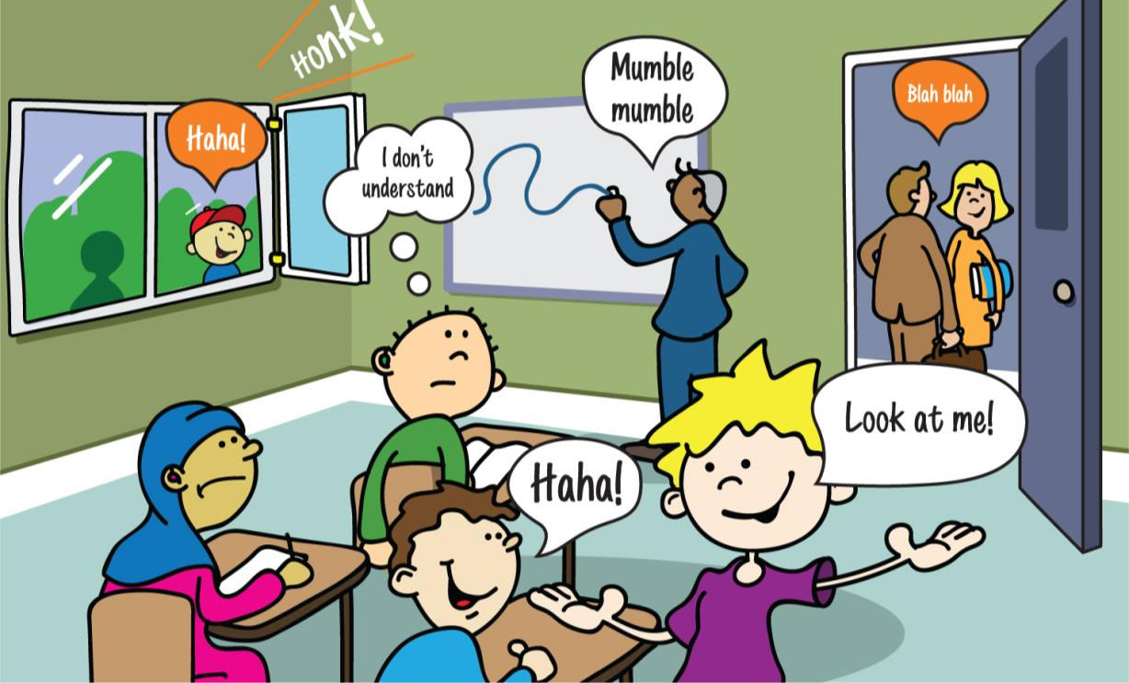
Missing information or instructions
Not looking at child to enable lip reading
Outdoor noise, traffic, works
Noise from other groups classes
Hard surfaces for noise to bounce off
Others talking or playing

Slide 17
Missing instructions
Not looking at child to enable lip reading
Look at the listener for lip pattern
Check understanding!
Outdoor noise, traffic, works
Noise from other groups classes
Close doors or find quiet areas.
Close windows and doors
Get listeners attention and encourage turn taking
Carpets, wall coverings, ceiling panels, cushions, bean bags
Others talking or playing
Hard surfaces for noise to bounce off

Slide 18
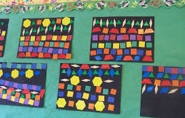
Group Time
Find a quiet space with a small peer group.
Use pictures to introduce new/unknown topic and vocabulary.
Point clearly to the visual clues and describe them.
Use ‘Word Aware’ strategy to support vocabulary building.
Allow enough time for the deaf pupil to look and explore the visual material before you start talking again.
NEVER assume a child knows what a word means.

Slide 19
Word Aware Strategy
Say the first sound.
Act out the word.
Use the word in a sentence.
Clap syllables.
Make a song.
How will you remember the word?
What does it mean?

Slide 20
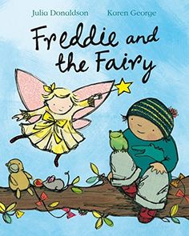
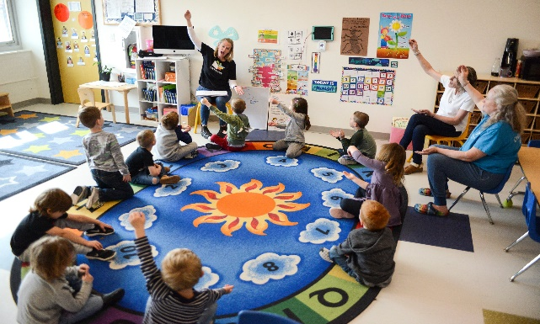
DEAF FRIENDLY STORY TIME
Give the child a chance to familiarize themselves with the book.
Smaller groups in a circle or horseshoe arrangement.
Make sure your child can see the book, your face and the signs you are using.
Make sure there is plenty of light on you so your child can see your lip-pattern, facial expressions and signs easily
Use lots of facial expressions to show how characters feel
Try and use voices, gestures and mannerisms that fit the characters in the story.
Remember, keep storytelling fun and be as expressive as you can.
Recap and check for understanding.

Slide 21
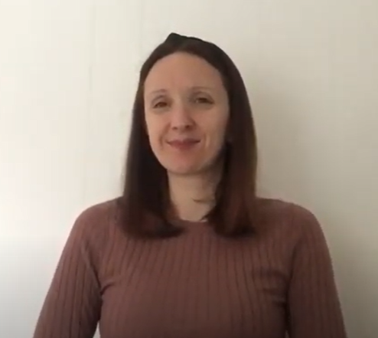
Ayrshire Deaf EDUCATION Service YouTube Channel
Our AMAZING British Sign Language (BSL) Tutor, Kat, has uploaded a series of useful BSL tutorials covering a range of topics. These would be beneficial in supporting early language acquisition of deaf children in the early years.
https://www.youtube.com/watch?v=Oy0UA4ucWhk

Slide 22
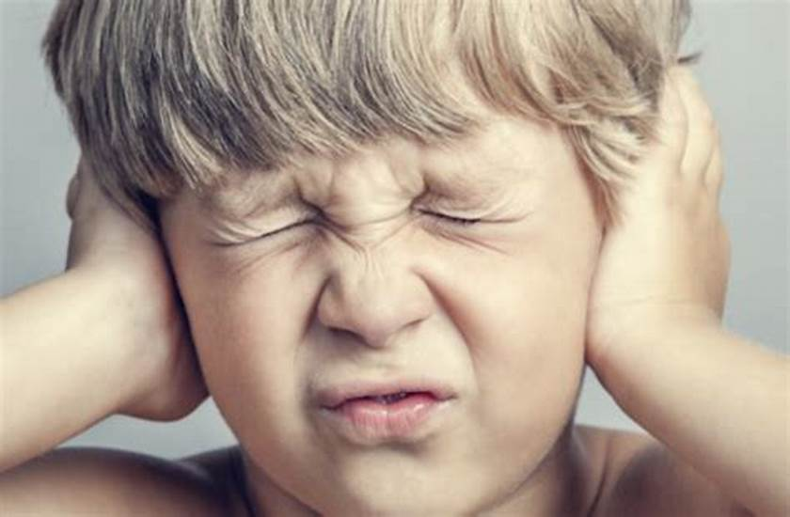
AMPLIFICATION
Hearing aids attempt to boost a deaf student’s access to speech sounds.
However, hearing aids can make all sounds louder.
Hearing aids do not cure deafness or return hearing to normal levels.
Listening with hearing aids is not easy, particularly in background noise.

Slide 23
TECHNOLOGY - HEARING AID
Ear Mould and Tubing

Slide 24
TECHNOLOGY – COCHLEAR IMPLANT

Slide 25
TECHNOLOGY – BONE ANCHORED HEARING AID (BAHA)

Slide 26
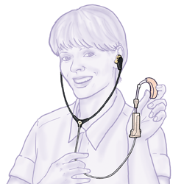
Hearing Aid Checks
Stetoclip – Tool used by ToDs to monitor the sound quality of a hearing aid.

Slide 27
EQUALITY ACT 2010
Under the Equality Act 2010, deaf students have the right to:
not be discriminated against because of their deafness.
expect public services such as nurseries, schools and the NHS to make reasonable adjustments to ensure their inclusion.
expect public services to consider how they can promote equality of opportunity for deaf children.

Slide 28
Profoundly Deaf Student, Cieran shares some tips!
"I need my teachers to know these tips. They are really important when I need to learn."

Slide 29
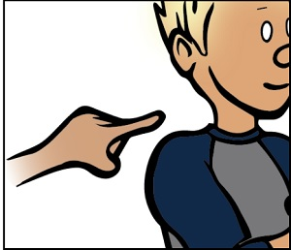
Get a deaf pupil’s attention before speaking.
Wave a hand or gently tap their desk or arm.
Smile – it relaxes a deaf pupil and lets them know you are ready to communicate with them.

Slide 30
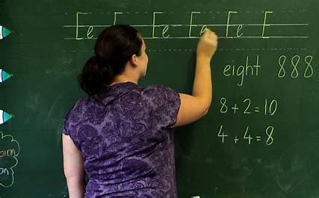
Face your deaf pupil
This allows access to facial expressions and lip pattern.
Stand close to the deaf pupil – no further than 1 metre.

Slide 31
DON’T COVER YOUR MOUTH.
Deaf children need access to your lip pattern and facial expressions to assist them in perceiving speech.
Putting your hand over your mouth muffles the sound and prevents them getting access to other communication cues.

Slide 32
Don’t shout
You do not need to raise your voice loudly. It can distort both your lip patterns and the speech signal to your deaf pupil’s hearing aids/cochlear implants.

Slide 33
Quiet times
Allowing deaf children to have quiet times at nursery or during the school day can be considered a ‘reasonable adjustment’.
Time to have a story read to them, play a game, revise phonics or work with a ToD in a quiet room, is important.
Deaf children need breaks in quiet – this eases frustration and reduces behaviour issues.

Slide 34
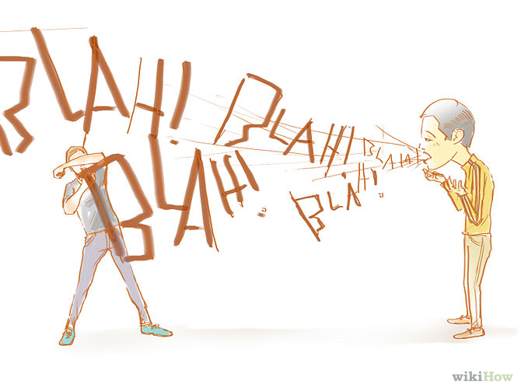
Speak clearly and at a normal pace
A calm, well-paced voice is reassuring.
This allows a deaf pupil to perceive and process speech optimally.

Slide 35
Explain New Vocabulary
Teach new vocabulary with explanations of a new word in a sentence and with an image/picture.
Revise new vocabulary and give this for homework.

Slide 36
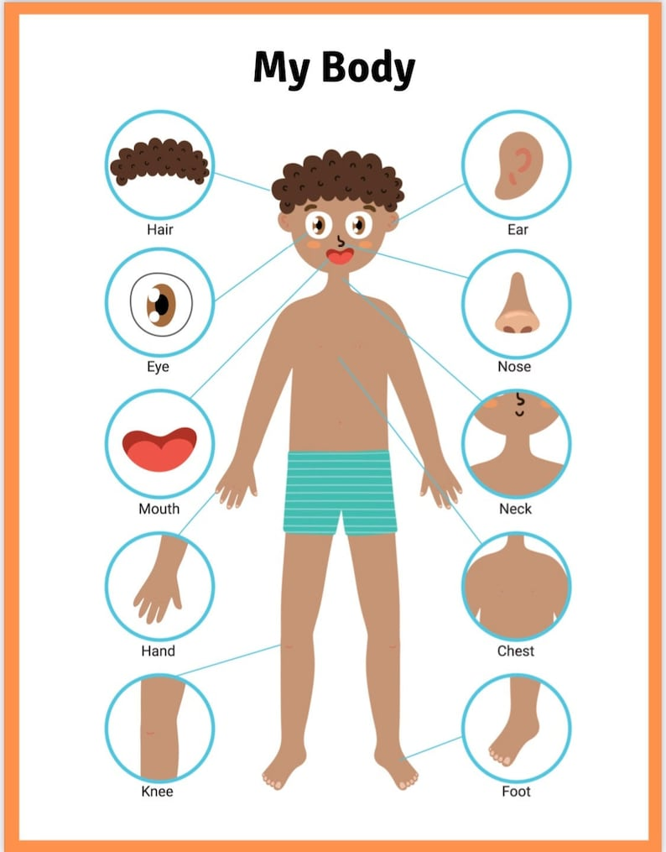
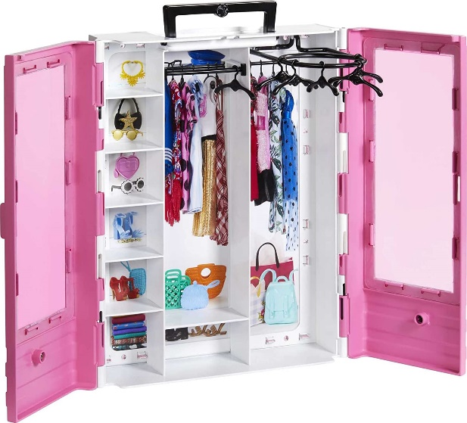
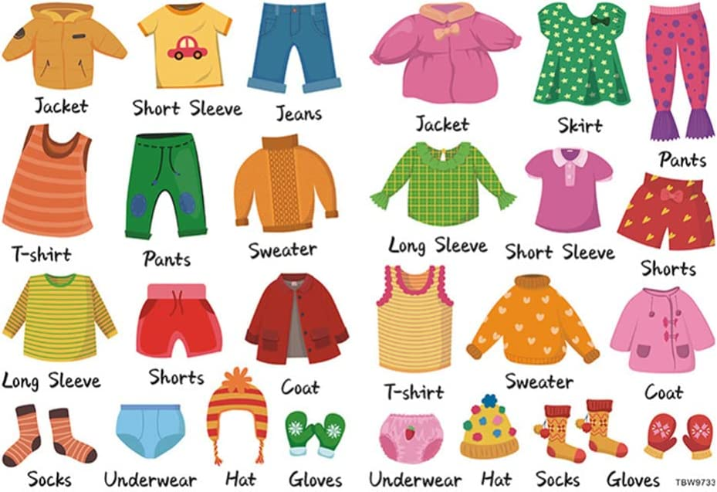
Use lots of visuals and concrete materials
Visuals help all learners.
Diagrams, drawings, images, photos, videos etc.

Slide 37
Repeat the contributions of others in the class
A deaf child, during a lesson, may not always hear other pupils’ answers to questions; it helps to repeat what another pupil has said. This ensures the deaf pupil is included.

Slide 38
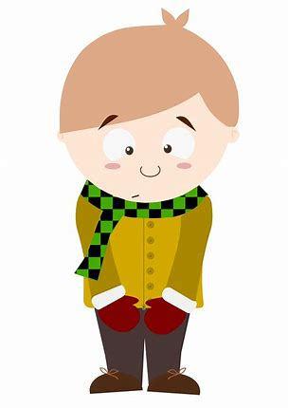
Get to know your deaf pupil and check in with them regularly
Deaf children do not always feel confident to tell you if something is not working well for them.
Plan times to check in with them, observe them and liaise with their ToD.

Slide 39
Thanks for Listening
Questions?

