Slide 1
Self-advocacy
Skills for deaf children and young people
Notes:
My name is Larissa McColgan. I am one of the teachers of the deaf working in East Ayrshire. I am going to talk to you about self-advocacy and why it’s important for deaf children and young people.

Slide 2
What is self-advocacy?
Self-advocacy is the ability to communicate your needs
Self-advocacy skills can be learned at any age
Notes:
For example, your teenager is studying for her exams just now. She is quite stressed and tells you: “Mum, Dad, I feel really stressed about my exams. Could we go for a walk so I can relax a bit? After the walk, I will feel less stressed and will be able to learn better.”
Your toddler tells you: “Too noisy!” And points at the washing machine. He is trying to tell you that he can’t hear you over the noise of the washing machine. You go into another room and close the door. That’s better, now you can hear what I am saying.

Slide 3
Why is it important for deaf children & young people?
more likely to do well in school, work, and life
feel confident
creates independence
empowers them to find solutions
Notes:
Bullet point 1:
Deaf children & young people who know how to self-advocate are more likely to do well in school, work, and life.
Bullet point 2:
They often feel confident in what they’re learning and doing.
Bullet point 3:
Self-advocacy also creates independence.
Bullet point 4:
And it empowers them to find solutions to problems that others might not be aware of.

Slide 4
Self-advocacy has three key elements:
Understanding your needs
Knowing what kind of support might help
Communicating these needs to others
Notes:
This where you can practice with your child/young person.
1) Understanding his/her needs: Ask your child what makes hearing or listening difficult? Is it too noisy? Did the person talk too fast? Do their friends all take over each other? Get your child to practice saying what it is that’s difficult.
2) Think together about what would help. You could say: What do you think would help? Turn the radio off? Close the door? Ask the person top slow down? Ask friends to talk one at a time?
3)Get your child to practice saying these phrases.
Build confidence

Slide 5
Example
Note-taking
Notes:
Say you’re a student who struggles with writing. But you’re in a history class that requires taking a lot of notes.
If you’re a strong self-advocate, you understand that taking notes is going to be a challenge for you. You know that support like pre-printed notes may help. You communicate your challenge to the teacher, and ask for pre-printed notes. If the teacher says no, you know you can reach out to your teacher of the deaf or other person for help.
People often learn self-advocacy in small steps. They may start with just understanding one of their challenges. Or they may be able to say that something is wrong, but not know what would help. This is self-advocacy, too.

Slide 6
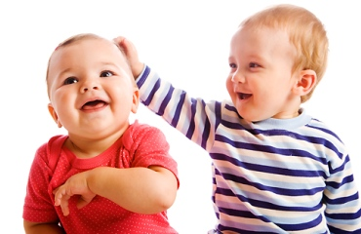
Equipping your child with self-advocacy skills
Have ongoing conversations about strengths and challenges
When your child runs into a challenge, ask what they think would help
Remind your child that asking for help is a good thing, and practise doing it
Give your child a say in decisions and a chance to solve problems before stepping in
Giving responsibility to your child helps build the foundation for self-advocacy
Let your child do certain things on their own
Praise kids when they speak up
Notes:
Self-advocacy isn’t easy for many children. But even young children can learn how to speak up for their needs. Here are things you can do to help:
Keep in mind that some kids may feel awkward or even guilty about asking for support. That’s especially true when kids feel embarrassed about their challenges.
When kids have confidence, it makes it easier for them to speak up when they need help. It also helps them explain their challenges to others.
Bullet points:
1) What the child is good at, what's difficult
2) You didn’t hear what the man said, did you? What could you do?
What would help?
4) What would you like? Do you want the red jumper or the yellow one? What would work here?
5) Responsibility: set an alarm & get yourself up, feed the fish, set the table
6) Independence: get dressed, walk to school/shop

Slide 7
Babies & toddlers
Point out new sounds
Point to your ear and say to your baby: ‘You heard that. It’s the door bell. Ding, dong!’
Or ask your baby: ‘Did you hear that?’ and look at them intently
Model language:
‘I hear you.’
‘What did you say?’
‘It’s too noisy in here. I can’t hear you.’
‘Let’s turn the TV off so you can hear me.’
Notes:
Teaching advocacy skills can start with very young children.
This way children hear the language needed for voicing their challenges and solutions.

Slide 8
Early years/nursery
Role-play to rehearse difficult encounters
Empowering strategies to stick up for themselves
Language that they can use in real life situations
Notes:
Kids may not know the words to say when they want or need something. But you can help them build that vocabulary by teaching them how to ask.
1) Use small world play figures (Duplo, Lego, Playmobil) or teddies and dolls to invent scenarios and rehearse little scripts.
Scenarios: child can’t hear, someone has taken their toy, someone has pushed them, their hearing aid is not working
2) Teaches empowering strategies to stick up for themselves, rather than bursting into tears or not telling anybody that they can’t hear/understand or are being picked on.
3) Practise the exact words that they can say
It can also shows them that speaking up when bad things are happening is another way to get help when they need it.

Slide 9
Primary School
Useful phrases:
I didn’t hear you, can you say that again?
It’s too noisy and I can’t hear.
I need to see your face when you talk to me.
Can you switch the Roger on, please?
Can you mute the Roger, please?
I don’t know what to do. Can you help me, please?
My hearing aid isn’t working. Can you help me?
Notes:
But younger children who are just starting school don’t always have that level of self-awareness — or the words to express what they’re struggling with. We need to teach them what to say.

Slide 10
Secondary School
Useful phrases:
Sorry, what did you say?
Can you repeat that, please?
Can you speak a bit louder, please?
Can you say that more slowly, please?
I didn’t hear all of that because I need you to face me.
It can be difficult for me to pick up accents, could you say that more slowly, please?
I don’t understand, can you say that a different way?
I am not sure I understand, can you show me what to do?
Is this what you mean? – repeat what you think was said.
Notes:
Secondary school can be hard for kids. Most kids don’t want to stand out from the crowd. They may hesitate to speak up for themselves, not only with other kids, but with teachers, too.
Deaf young people may be used to watching you advocate for them to help them get the support they need.
When they start secondary school, though, you’re not always going to be there when things get tough. So, it’s more important than ever for young people to learn self-advocacy skills. They might not be ready to be their only advocate, but there are ways to start teaching them to speak up for themselves.
Bullet points

Slide 11
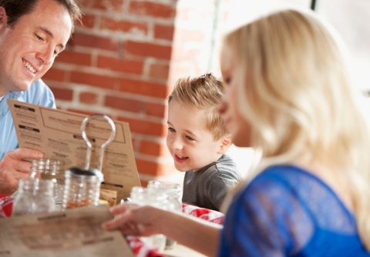
Give kids real-world opportunities to practise
Notes:
It’s one thing to practice at home with family members. It’s another thing to find your voice out in public. Encourage your child to ask for what they need outside of the house.
For instance, kids can order their own food at restaurants. You could say: ‘Tell the lady “Can I have a hamburger with chips, please?”
Facilitate communication with unfamiliar people.
Learning to self-advocate takes time, especially at a very young age.
For older children, you could support them with making phone calls, like making an appointment or booking a table in a restaurant. Rehearse what they are going to say.
Children who use BSL will rely on an adult to interpret. However, they should be encouraged to express their needs and what they want the person to do in BSL.
Be prepared to help your child with the language of asking for what they need for as long as it takes — until they start doing it on her own.

Slide 12
Questions Share your experiences

