Slide 1
Talking and Listening
Activity Three

Slide 2
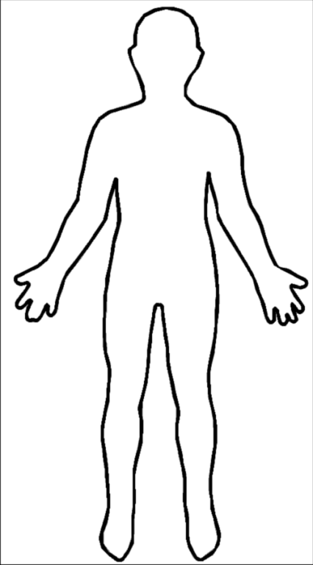
Listening Comprehension You will need a copy of the worksheet with the outline of a person and some coloured pens or pencils.
Listen carefully to the following instructions to complete the picture.
1.
2.
3.
4.
5.

