Slide 1


Spelling
WB 8.2.21

Slide 2

We are learning to -
Recognise and use single and joined phonemes
Say, make, break, read and write words which contain the ‘th’ phoneme
Use a variety of spelling strategies to spell common words

Slide 3

Say the alphabet. When we say the alphabet we use the letter names.
What sound does each of these letters make? These are single phonemes. One letter = one sound.
Task 1
There are 26 letters in the alphabet split into two groups, consonants and vowels.
How many vowels are there in the alphabet? What are the vowels?
Every word in the English language contains a vowel or a vowel sound.
Click on the link below and bring the alphabet to life with this memorable song and movement routine.
https://www.bbc.co.uk/teach/supermovers/ks1-english-alphabet-with-naomi-wilkinson/zjjy2sg

Slide 4

Do you know what sounds these phonemes make?
sh ck aw wh ai ue
ph qu ay th ow oy
ng oa ch oo ee ea
oi au a-e o-e u-e ss
ll ew ou igh i-e ff
e-e kn mb tch wr wa
These are joined phonemes. Joined phonemes are two or more letters which together make only one sound.

Slide 5
‘th’
Do you know what sound this phoneme makes?
Say the phoneme aloud and think about what your mouth is doing.
Write the phoneme in the air then on the table or carpet in front of you whilst making the sound.

Slide 6
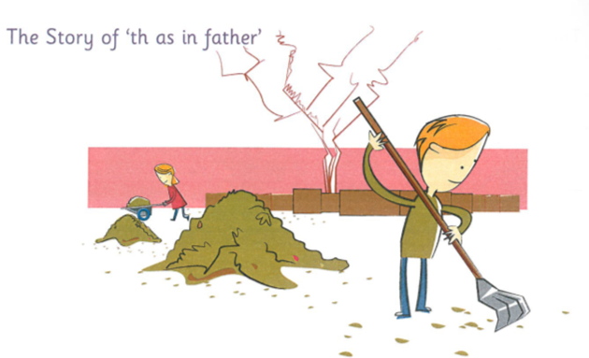
The story of ‘th’
Listen to the phoneme story for ‘th’. Which words do you hear the ‘th’ phoneme in?
The children had decided to help their grandfather to tidy up his backyard. There were lots of piles of leaves and paper. The twins gathered the leaves and Mother carefully put them in the garden waste bin.
“We could save those papers rather than burning them,” said Ben.
“That’s a good idea,” said Mother. When the children had finished gathering the papers, Mother drove the children to their local paper recycling bins.
Task - Can you think of any other words which contain the phoneme? - Make a list.

Slide 7
Phoneme Words
Use the activities in the spelling grid on the next slide or activities of your own choice to revise ‘th’ phoneme words.
Phoneme words
then
this
them
there
these
father
mother
that
rather
gather
their
Sentences
Choose three words from the list or three of your own words and write a sentence for each.
Remember your core targets –
capital letters
full stops
finger spaces
use a connective – and, but, because, so
Extension Task (optional)
Sumdog Challenge - Phoneme and common words

Slide 8
Playdough Write your words using playdough. | Magnetic letters Use your magnetic letters to spell out your words. Jumble them up then spell them again without looking at the word. | Lego Spell your words out using Lego bricks. You could take a photo and post it on Teams.
LaSaCaWaC Look, say, cover, write and check. Write each word 3 times. | Chalk Go outside and write your words on your path or pavement. | Ransom Words ‘Write’ your words by cutting letters out of a magazine/newspaper and gluing the letters onto paper to spell your words.
UPPER and lower Write your words in capitals and then in lowercase letters. e.g. PHONE phone | Art Attack Draw a picture to go with each of your words. | Online Activity Go to this website and type in your words to play the games. http://www.ictgames.com/lcwc.html
Rainbow Writing First write your spelling words in pencil. Trace over the words 3 times using a different colour each time. | Hidden Words Draw and colour a picture. Hide your spelling words inside your picture. | Word Art Use any materials – pasta, buttons, beads, lollipop sticks, leaves etc. to spell out your words.

Slide 9

Task 2 – Common Words
Look at the common word below.
spring
Read the word and say it aloud.
How many letters are in the word? Count them.
How many sounds/phonemes are in the word?

Slide 10
Task 2 – Common Words – contd.
Spelling Strategies
  Sounding out
  Word Shape
  Use a mnemonic
  Syllabification
  Compound words
  Words within words
  Tricky letters
  Use an analogy
Choose a spelling strategy to help you learn the word.
spring
Make the word with some magnetic letters if you have them. Look carefully at the word and ‘take a photograph of it ‘ in your mind.
Now close your eyes and jumble up the letters.
Can you spell the word again using the spelling strategy you chose to help you?

Slide 11
sunny those home
repeat the process with each of the common words above, choosing an appropriate spelling strategy for each word.
Core Task
Worksheet - Practise writing each word three times, using correct letter formation, complete spelling strategies grid and fill the gaps to complete the sentences.
Extension Task (optional)
Past common words – ask a parent to test you on your previous learning. How many words can you remember how to spell? A list of common words can be found in Files.
Forest Phonics Spelling Game - http://www.ictgames.com/mobilePage/forestPhonics/index.html
Funky Phonics PowerPoint – Practise your joined phonemes and common words to a disco beat. Add your own disco moves. You could post clips of your dance moves on Teams for your classmates to see.

Slide 12
Task 3 - Dictation
Listen to the sentences. I will say each sentence twice. Write them down on your whiteboard, a piece of paper or print off a copy of the worksheet provided. You can pause the recording at any point if you need more time to complete the sentence.
Remember your Core Targets
Capital letters
Full stops
Finger spaces
Easy - harder -
Read over your work when you have finished to ensure it makes sense.

Slide 13
Task 4 – Elkonin Boxes and Common Words
Phoneme words – Elkonin boxes
Choose either the easy word list or harder word list. Listen to the words. Make and break each word using your Elkonin boxes to record your answers. You can pause the recording at any time.
Easy words- Harder words -
Common words – Whiteboard/Paper/Word document/Worksheet
Now we are going to practise the common words. You can record these on a whiteboard, piece of paper or the worksheet provided. Think about what strategy you can apply to each word to help you spell it. Remember you can pause the recording at any time.

