Slide 1
Reading WB 8.2.21
L.I. I am learning to select and use strategies and resources before I read, and as I read, to help make the meaning of texts clear.
LIT 1-13a
To show my understanding, I can respond to different kinds of questions and other close reading tasks and I am learning to create some questions of my own.
ENG 1-17a

Slide 2
Task 1 – Bug Club Book
Before clicking on your book have a look at the front cover.
Do you think it is a fiction or non-fiction text? Why?
If it is a fiction text make some predictions as to what you think might happen in the story.
Now open your book but look at the pictures only. What is happening in each picture? What information does it show?
When you have gone through the whole book looking at the pictures go back to the beginning and read the text.
Finally answer the bugs.

Slide 3
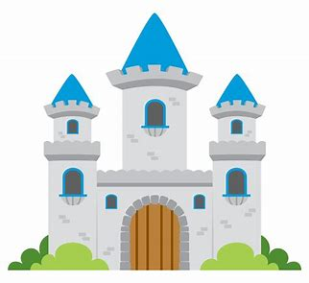
Task 2 – Reading Detectives Book Hunt
Explore your bookshelves. Can you complete the ten challenges as a reading detective? Write the name of the book for each challenge.
Can you find a book about a country?
Can you find a book about an animal?
Can you find a book about a sport?
Can you find a book about space?
Can you find a book that has one word as a title?
Can you find a fairy tale?
Can you find a comic book?
Can you find a non-fiction book?
Can you find a book about a family?
Can you find a book by an author whose name begins with the same letter as yours?
You can record your answers on a piece of paper, in a Word document or use the ‘Book Hunt’ worksheet.

Slide 4
Task 3 – Inference – Part 2
Writers don't always tell you everything, so sometimes you need to use reading skills to understand the story and characters better.
One of these reading skills is called inference.
Using inference is a bit like being a reading detective. You find clues in the text to help you learn more about what's happening.
You are going to practise inference by answering some questions about Roald Dahl's book George's Marvellous Medicine.
Task
Read the extract from George’s Marvellous Medicine again (or ask an adult to read it to you). Discuss the character of George with a family member then complete the activities.

Slide 5
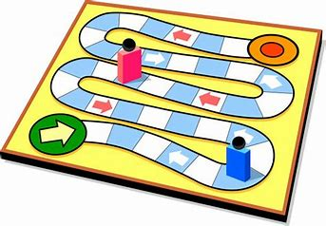
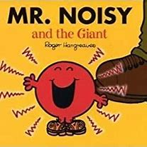
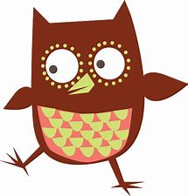
Task 4 – Reading for Enjoyment
I regularly select and read, listen to or watch texts which I enjoy and find interesting, and I can explain why I prefer certain texts and authors. LIT 1-11a
Choose from one of the following activities -
Read a Bug Club book.
Read the rules for how to play a board game then play the game with a family member.
Listen to the story Mr. Noisy and the Giant.
Visit the Oxford Owl Website and choose an ebook from their library.
https://www.oxfordowl.co.uk/for-home/find-a-book/library-page/

