Slide 2
What is a Carroll Diagram?
blue
not blue
A Carroll diagram is a way of sorting objects, numbers and shapes.
It looks like a table and has different criteria for you to sort with.
square
not square

Slide 3
Where do you think these shapes will fit in the Carroll diagram?
yellow
not yellow
circle
not circle

Slide 4
Where do you think these shapes will fit in the Carroll diagram?
quadrilateral
not quadrilateral
Sometimes there will be more than one shape in each box. Some boxes may even be empty.
orange
not orange

Slide 5
Where do you think these shapes will fit in the Carroll diagram?
has at least one curved side
no curved sides
green
not green

Slide 6
How could you sort these shapes using a Carroll diagram?
blue
Not blue
Less than
4 sides
4 or more
sides

Slide 7
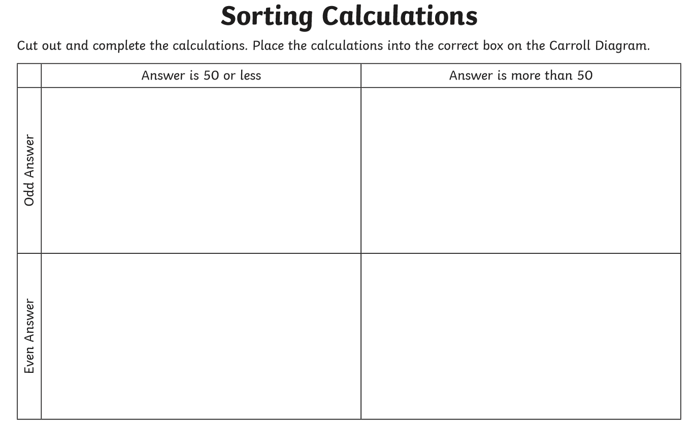
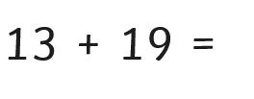
Core Task
32

