Slide 2
What is a Venn Diagram?
A Venn diagram is made up of two circles that overlap.
It can be used to sort objects, numbers or shapes.

Slide 3
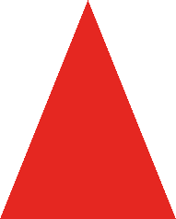
Sorting 2D Shapes
The blue rectangle fits in both parts of the diagram so needs to go in the middle of the diagram.
The blue circle needs to be in the part for blue shapes.
The red triangle is
not blue and does not
have four sides so it needs to stay out of both parts of the diagram.
blue
has four sides
The red square needs to be in the part for four-sided shapes.

Slide 4
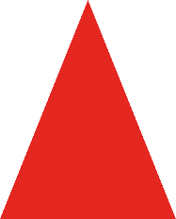
Where do these shapes need to move to?
The blue rectangle does not fit in
this diagram so it stays on the outside.
The red triangle needs to be in the part for three-sided shapes.
has three sides
yellow
The yellow triangle
needs to be in both parts of the
diagram so goes in the middle.
The yellow circle needs to be in the part for yellow shapes.

Slide 5
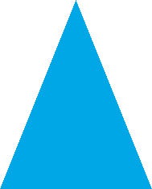
Where do these shapes need to move to? Discuss with a partner.
blue
has curved sides

Slide 6
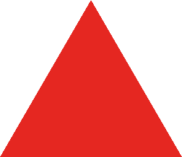
Where do these shapes need to move to? Discuss with a partner.
has three or more sides
purple

Slide 7
Where do these shapes need to move to? Discuss with a partner.
is a quadrilateral
green

Slide 8
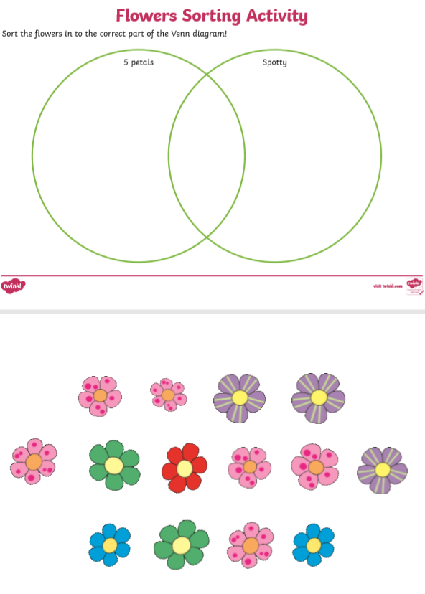
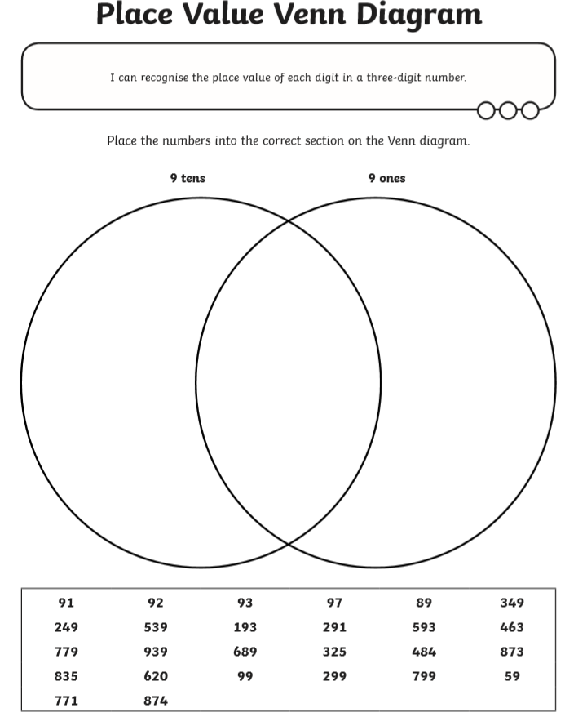
Core Task choices

