Slide 1
First Level
Notes:
Start your mornings with this lovely Maths PowerPoint, focusing on information handling & probability. There is one slide a day for five days, with three questions for each day. There are three different degrees of challenge; yellow boxes have the least challenge, red the middle and green are the most challenging. This three-year series of PowerPoints provide progression through First Level; beginning with First Level (a), through First Level (b) and finishing with First Level (c) so that activities are not repeated and there is an appropriate level of challenge for pupils at each stage.

Slide 2
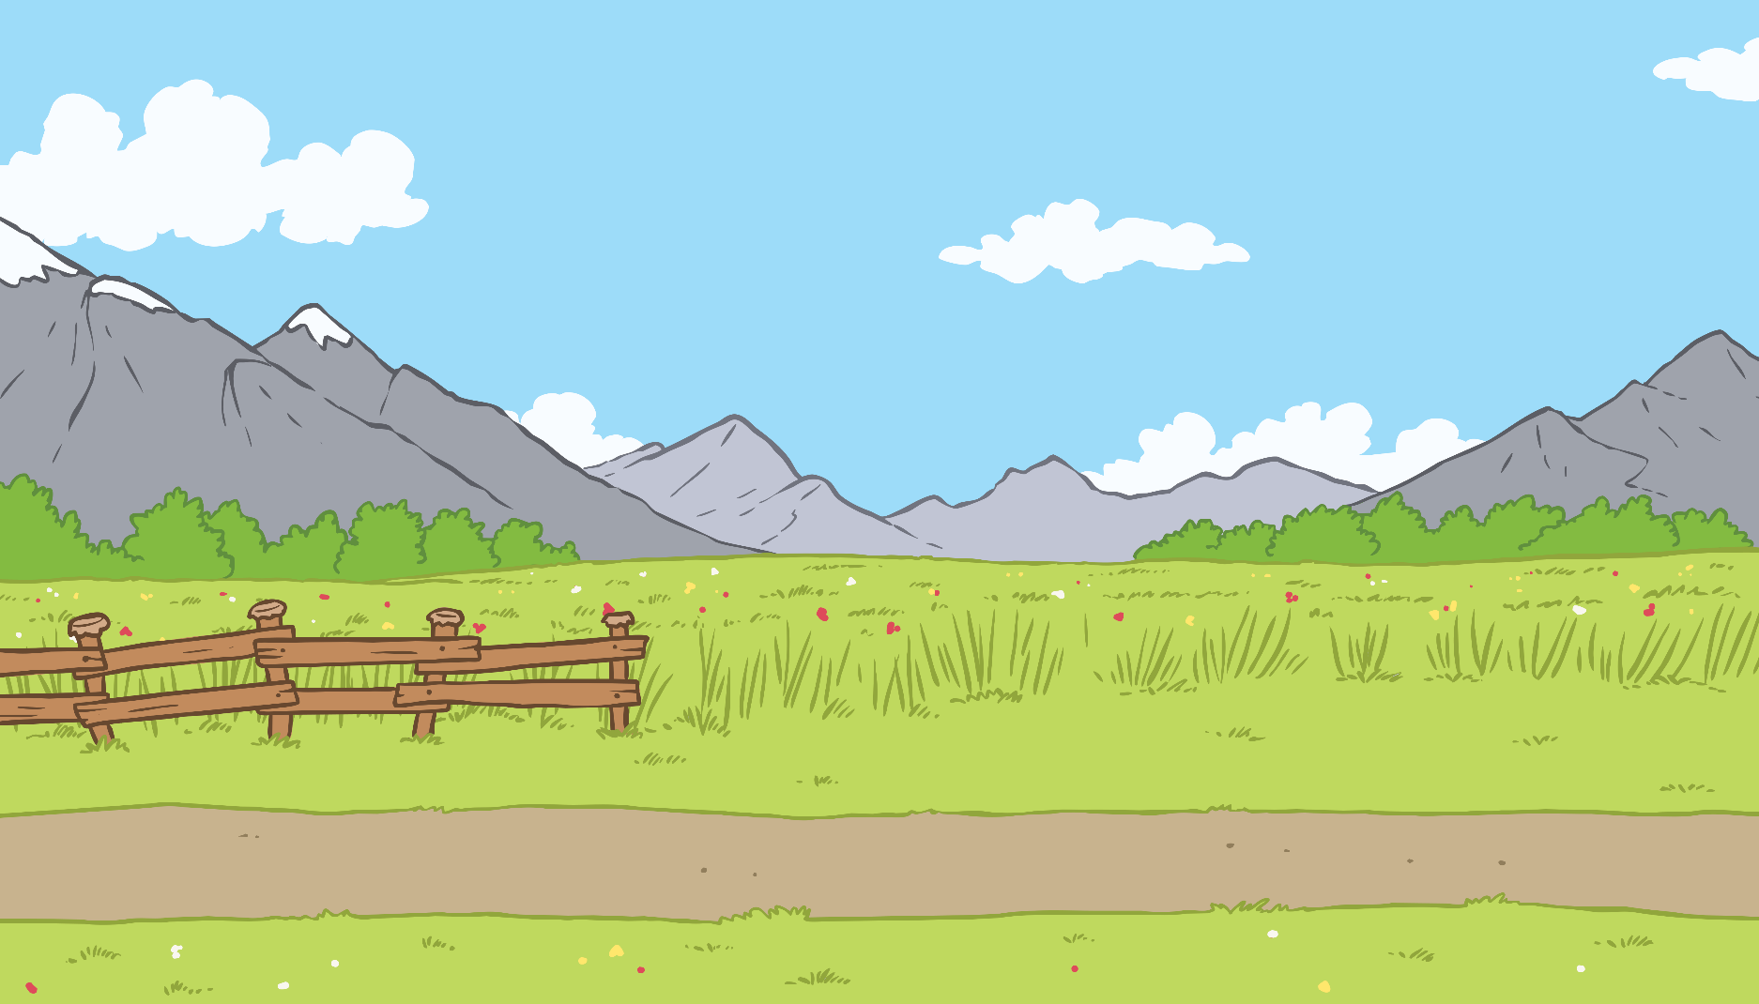
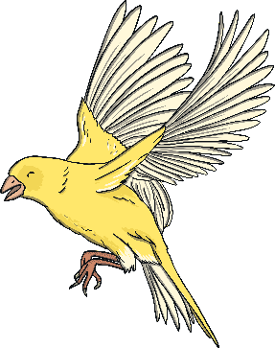
Contents
Day 1
Day 2
Day 3
Day 4
Day 5

Slide 3
Menu
Data Analysis
Gathering Data
Which was the most popular fruit? Which was the least popular fruit?
Use tally marks to find out how many of each animal is in the group.
Lions
Penguins
Tigers
Pandas
Parrots
Elephants
Zebras
Favourite Fruits
10
9
8
7
6
5
4
Reveal Answer
3
Probability
2
Write down the statement which is most likely to happen today.
The class will go on a boat.
I will play with my toys.
The class will be on a famous TV programme.
1
0
Reveal Answer
Fruit
Most popular - Bananas
Reveal Answer
Least popular - Grapes

Slide 4
Menu
Data Analysis
Ice Cream flavour
Tally
How many people liked each flavour of ice-cream?
Vanilla
Cookies & Cream
Mint Choc Chip
Other
Chocolate
Strawberry
Reveal Anser
Reveal Answer
6 3 2 10 4 5
Probability
Data Analysis
Write down the statement which will never happen today.
We will learn something today.
It will rain today.
The school will be taken over by aliens.
The bar graph below is about children’s favourite fruit. Can you think of a label for the x axis and the y axis?
Reveal Answer
5
4
3
2
1
0
An example answer for the x axis could be ‘Type of Fruit’. An example answer for the y axis could be ‘Number of Children’.
Reveal Answer

Slide 5
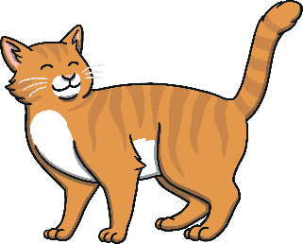
Menu
Probability
Write down the statement which will always happen everyday.
I will drink water or juice.
I will have pasta for dinner.
I will drive a car.
Reveal Answer
Probability
Gathering Data
Cat
What was the most popular pet?
What is the least popular pet?
What is the difference between the most and the least popular pets?
What chance is there that you will pull a circle out of the jar?
Likely, impossible or certain?
Fish
6
Favourite Pets
10
Reveal Answer
Reveal Answer
8
Likely
6
4
2
0
Dog Cat Fish Rabbit Hamster

Slide 6
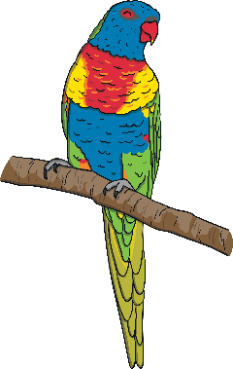
Menu
Data Analysis
Data Analysis
This bar graph shows how many people have their birthday in each month.
Favourite Colours
Birthdays
This bar graph is missing a label for one of its axis. Can you think of a label for it?
How many people had a birthday in:
January?
April?
June?
8
Number of Pupils
7
Reveal Answer
An example answer is colour.
2
Reveal Answer
Gathering Data
Draw tally marks for each of these numbers:
12 16 24
Reveal Answer

Slide 7
Menu
Gathering Data
Draw tally marks for these numbers:
6 10 4
Reveal Answer
Data Analysis
Data Analysis
What could be the title of this graph?
This bar graph shows how many people liked each fruit. How many people took part in this survey?
Reveal Answer
Example answers could be; Pets, Favourite Pets, Animals, Least Favourite Animals, etc.
6 + 4 + 5 + 1=
Reveal Answer
16

