Slide 1

Writing
Daily Writing Tasks
There are 5 vocabulary activities in this PowerPoint. Choose a different vocabulary activity for each day of the week.
Main Writing Activity
Uplevelling sentences to make them more descriptive.

Slide 2
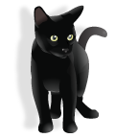
VOCABULARY
Think of at least 5 WOW words to describe a cat. (remember to use your senses)

Slide 3
VOCABULARY
Write one sentence including the following three nouns
house necklace dog

Slide 4
VOCABULARY
An adverb can be used to describe how something was done. They often end in ‘ly’.
E.g. walked - quickly, slowly, happily, shyly, quietly
Write as many adverbs as possible to describe the verb below.
Ate

Slide 5
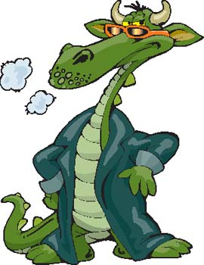
VOCABULARY
List as many words as possible to describe this characters appearance and personality.

Slide 6
VOCABULARY
List as many words as you can that could be used instead of ….
said
Can you use some of them in sentences?

Slide 8
Writing Task
Use VCOP (vocabulary, connectives, openers and punctuation) to uplevel sentences.
  Add an opener to your sentence (when? where?)
  Add punctuation – capital letter . , ! ?
  Add adjectives to describe the nouns (words in red)
  Add an adverb to describe the verb (words in green)
  Add a connective and extra details (and, but, because, so, then, when, if, before)
  Task (core)
  Uplevelling using VCOP worksheet
  Challenge (optional)
  Uplevel a paragraph
  Extension (optional)
  Write a paragraph about home-schooling/your weekend/a personal experience then try to improve it using VCOP.

