Slide 1
Reading WB 1.2.21
L.I. To show my understanding, I can respond to different kinds of questions and other close reading tasks and I am learning to create some questions of my own. ENG 1-17a

Slide 2
Task 1 – Bug Club Book
Before clicking on your book have a look at the front cover.
Do you think it is a fiction or non-fiction text? Why?
If it is a fiction text make some predictions as to what you think might happen in the story.
Now open your book but look at the pictures only. What is happening in each picture? What information does it show?
When you have gone through the whole book looking at the pictures go back to the beginning and read the text.
Finally answer the bugs.

Slide 3
Task 2 – Finding words
Choose a book – any book will do
Can you find 5 nouns?
Can you find 5 adjectives?
Can you find 5 verbs?
How many different types of punctuation can you find?
You can record your answers on a piece of paper, in a Word document or use the ‘Finding Words’ worksheet.
A noun is a naming word. It is the name of a person, place or thing.
An adjective is a describing word. It is used to describe a noun.
A verb is a doing word. It tells you what a noun is doing.

Slide 4
Task 3 – Inference
Writers don't always tell you everything, so sometimes you need to use reading skills to understand the story and characters better.
One of these reading skills is called inference.
Using inference is a bit like being a reading detective. You find clues in the text to help you learn more about what's happening.
You are going to practise inference by answering some questions about Roald Dahl's book George's Marvellous Medicine.
Task
Read the extract from George’s Marvellous Medicine (or ask an adult to read it to you). Discuss what you have read with a family member then answer the questions.

Slide 5
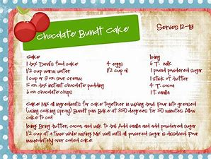
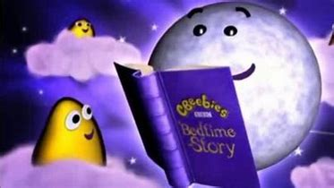
Task 4 – Reading for Enjoyment
I regularly select and read, listen to or watch texts which I enjoy and find interesting, and I can explain why I prefer certain texts and authors. LIT 1-11a
Choose from one of the following activities -
Read a book and then design a new cover for it.
Read the recipe for a cake/treat you would like to make. If you have time make it and post your photos on Teams.
Read a Bug Club book.
Visit the BBC iPlayer and listen to a story read by some famous faces.
https://www.bbc.co.uk/iplayer/episodes/b00jdlm2/cbeebies-bedtime-stories

