Slide 1
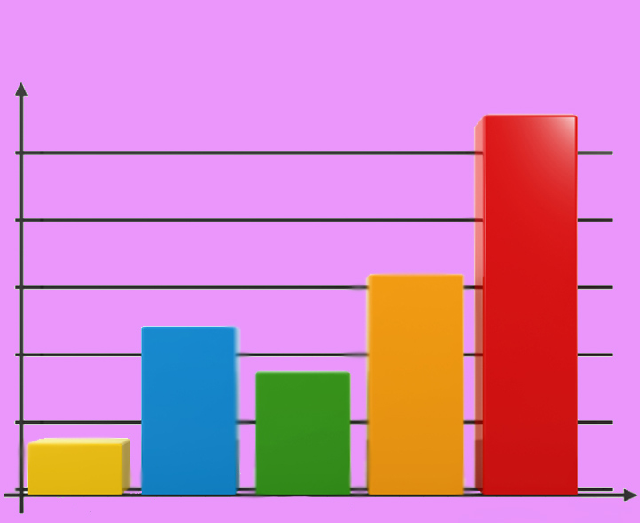
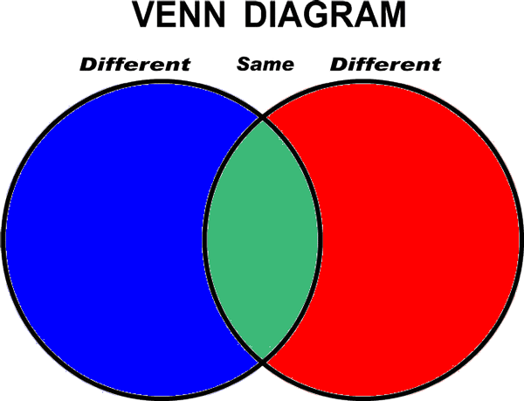
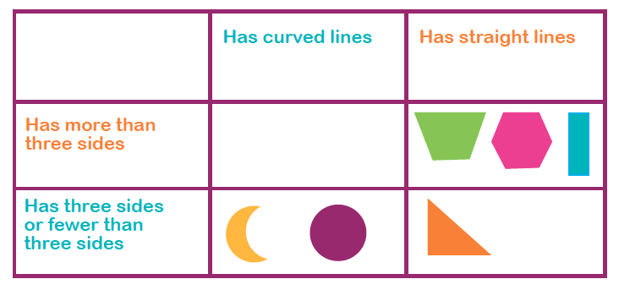
Information Handling - Introduction
Types of graph/Interpreting information

Slide 6
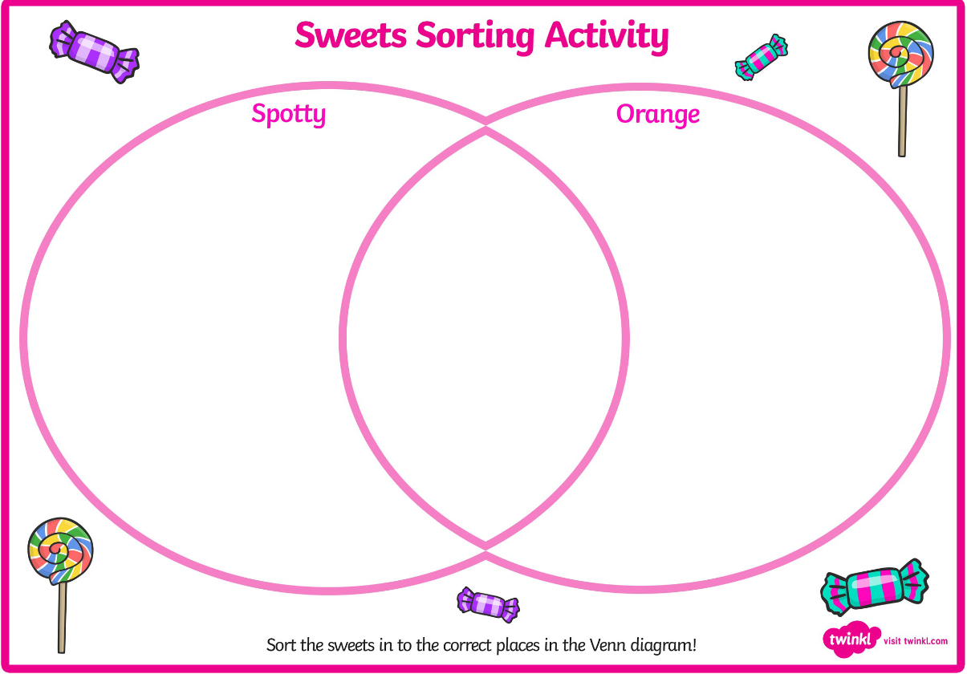
Venn Diagrams

Slide 7
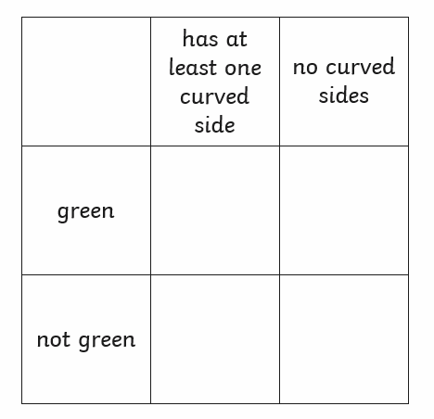

Slide 8
Interpreting information from a table
Favourite Dinners
Total
7
4
15
11
5
17

Slide 9
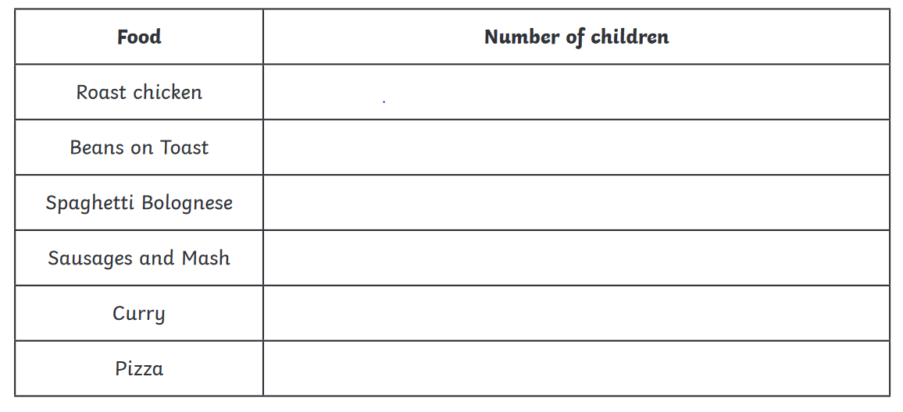
What is the most popular dinner?
What is the least popular dinner?
How many more children prefer spaghetti Bolognese than sausages and mash?
What is the difference between the most popular and least popular dinners?
Pizza
Beans on Toast
4
13

Slide 10
Interpreting information from a bar graph
5
How many cars were sold?
Which toy was the most popular?
How many more elephants than ducks were sold?
How many toys were sold altogether?
Drum
4
24

Slide 11
Interpreting information from a bar graph
Green
9
2
14

Slide 12
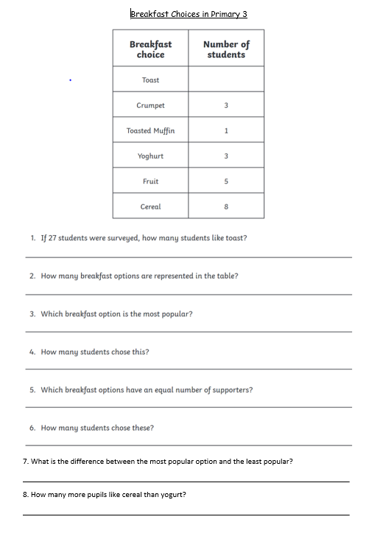
Core Task
Remember, you don’t have to print. You can
write your answers on a bit of paper and take
a picture.
Play the tally marks or Pictogram game if you
are looking for something else to do!
Tally Marks Game
Pictogram Game

