Slide 1

Writing
Daily Writing Tasks
There are 5 vocabulary activities in this PowerPoint. Choose a different vocabulary activity for each day of the week.
Main Writing Activity
This week we are going to practise uplevelling sentences to make our writing more descriptive.

Slide 2
VOCABULARY
Think of at least 5 WOW words to describe a sandwich. (remember to use your senses)

Slide 3

VOCABULARY
Write one sentence including the following three nouns
cat necklace fish

Slide 4

VOCABULARY
Improve the sentence below by adding vocabulary.
e.g. The mouse ate the cheese.
The greedy mouse carefully ate the stale cheese.
Now try
The cat sat on the mat.

Slide 5

VOCABULARY
List as many words as possible to describe this characters appearance (what he looks like).

Slide 6
VOCABULARY
List as many words as you can that could be used instead of ….
little
Can you use some of them in sentences?

Slide 8

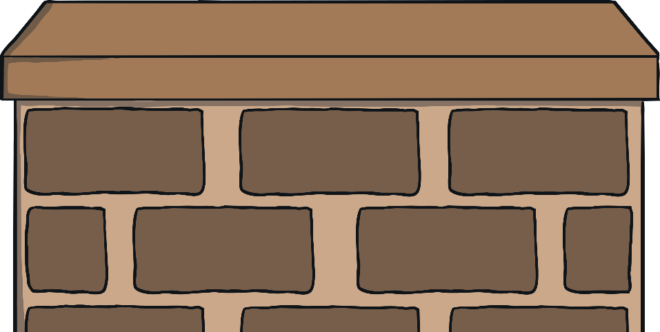
What Does ‘Uplevelling a
Sentence’ Mean?
To ‘uplevel’ a sentence is to make a boring sentence more interesting by including lots of extra details, such as changing...
I saw a cat
into
I saw a beautiful, furry cat sitting on the red, brick wall when I arrived home.
How has this sentence been improved?

Slide 9
What Have I Added?
Click on the extra details used to uplevel the sentence to find out more about them.
I saw a beautiful, furry cat sitting on the red, brick wall when I arrived home.
Can you see how much more interesting this sentence has become now that we know some extra details?

Slide 10
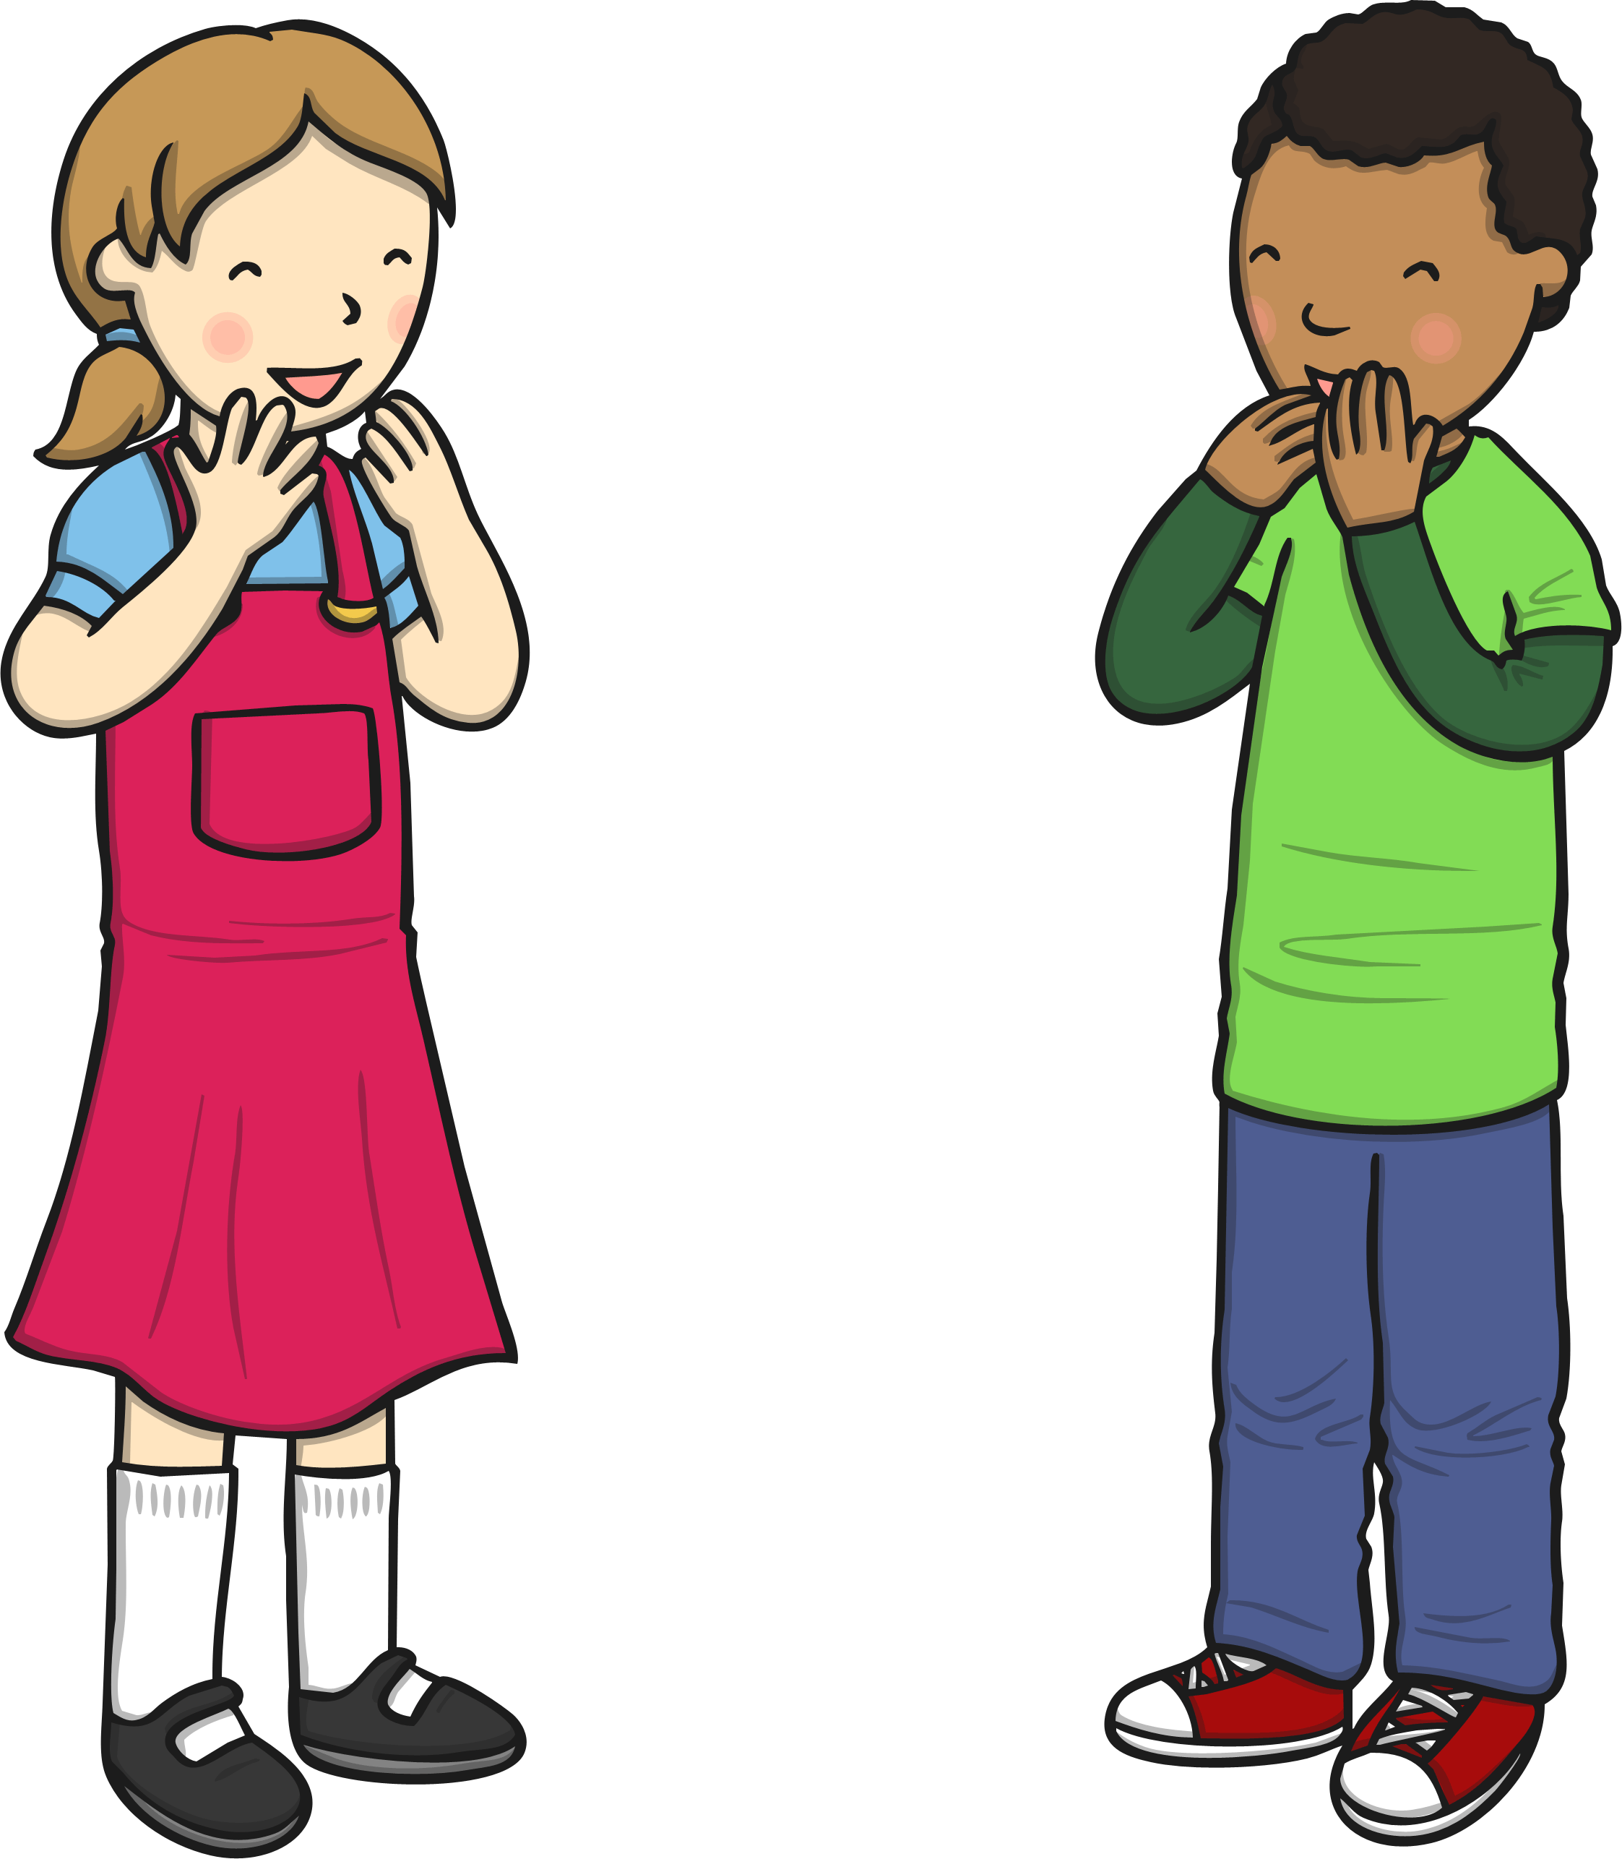
Punctuation
The very first step in uplevelling a sentence is making sure that it has all of the punctuation it needs, such as:
Emma and Frank went to London.
What time will the bus get here?
I need to buy butter, sugar and milk.
Back

Slide 11

Adding Adjectives
You can use adjectives to give more information within your sentences, such as:
the gigantic, ferocious lion
some kind, helpful children
three elegant, white swans

Slide 12
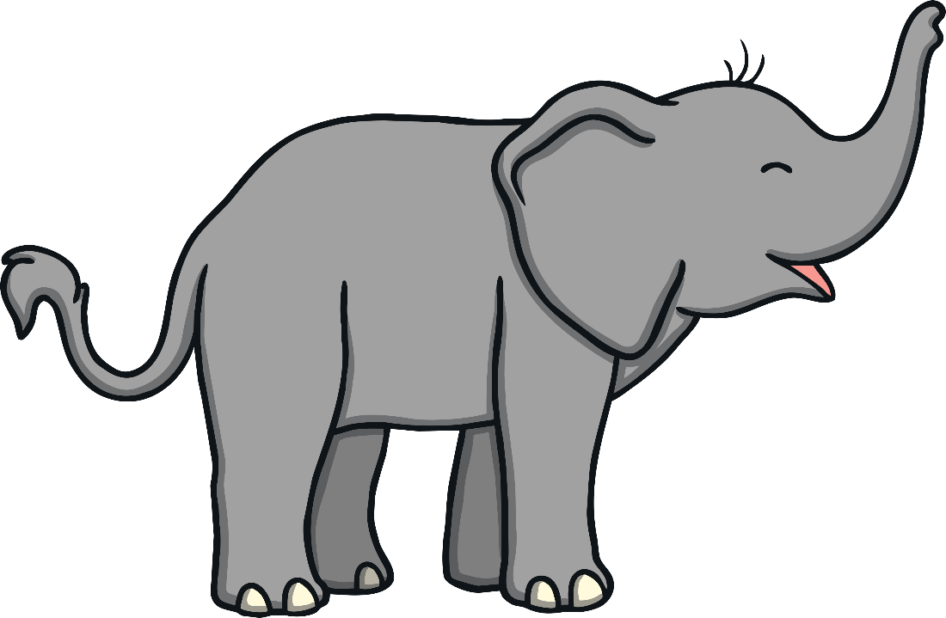
Joining Words (Connectives)
Linking words help you to add extra detail to your sentence, such as:
Emily wanted a pet elephant because she thought they were really interesting.
I will be late home if I stand talking for much longer.
Back
You may want to use:
when because if that

Slide 13
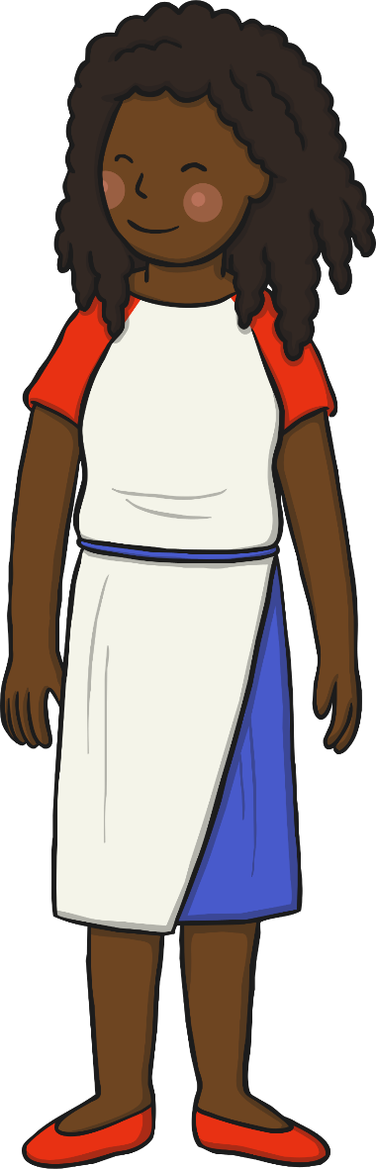
Let’s Start...
We are going to uplevel the following sentence one step at a time.
Are you ready?
my mum went to the shop
First, we will add the punctuation.
Next, we will add adjectives.
Finally, we will add joining words and extra details.

Slide 14
Punctuation Police
Which pieces of punctuation are missing from the sentence below?
my mum went to the shop
My mum went to the shop.
You have one minute to write the sentence on a whiteboard and add the missing punctuation.

Slide 15
Adjectives
Use adjectives to add extra information about both of the nouns in this sentence. Which two things will you be describing?
My mum went to the shop.
My kind, caring mum went to the
humongous, busy shop.
You have one minute to add adjectives to ‘my mum’ and ‘the shop’ on a whiteboard.

Slide 16
Joining Words (Connectives)
Choose one of the linking words and use it to add some extra details to your sentence. What extra information will you add to your sentence to make it interesting?
My kind, caring mum went to the
humongous, busy shop.
My kind, caring mum went to the humongous, busy shop because we needed some food to eat.
because
when
You have one minute to add a linking word and some extra detail to the end of your sentence.

