Slide 1


Spelling
WB 25.1.21

Slide 2

We are learning to -
Recognise and use single and joined phonemes
Say, make, break, read and write words which contain the ‘ea’ phoneme
Use a variety of spelling strategies to spell common words

Slide 3

Sing or say the alphabet. When we sing the alphabet we use the letter names.
What sound does each of these letters make? These are single phonemes. One letter = one sound.
Task 1
How many letters are in the alphabet?
The letters of the alphabet are split into two groups. What are they?
How many letters are in each group?

Slide 4

Do you know what sounds these phonemes make?
sh ck aw wh ai ue
ph qu ay th ow oy
ng oa ch oo ee ea
oi au a-e o-e u-e ss
ll ew ou igh i-e ff
e-e kn mb tch wr
These are joined phonemes. Joined phonemes are two or more letters which together make only one sound.

Slide 5
‘ea’ bread
Do you know what sound this phoneme makes?
Say the phoneme aloud and think about what your mouth is doing.
Write the phoneme in the air then on the table or carpet in front of you whilst making the sound.

Slide 6
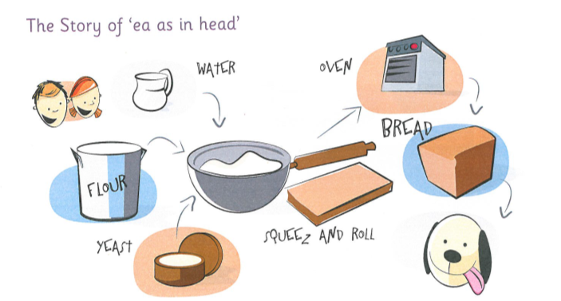
The story of ‘ea’
Listen to the phoneme story for ‘ea’. Which words do you hear the ‘ea’ phoneme in?
The weather was very pleasant so instead of playing games after breakfast, Mum asked Ben and Belle if they would like to make some fresh bread. They had to measure the flour and put it in a bowl then added some water and yeast. Now they had to squeeze and roll the dough out on the work top.
Soon the dough was ready to go in a bread tin and be put in the oven to cook.
“What a pleasant smell,” said Belle. “I hope it’s ready soon. I’m starving!”
Dasher nodded his head. Mum spread some butter onto the bread. They all ate it.
Task - Can you think of any other words which contain the phoneme? - Make a list.

Slide 7
Phoneme Words
Use the activities in your spelling grid, magnetic letters or activities of your own choice to revise ‘ea’ phoneme words.
Phoneme words
bread
head
deaf
ready
dead
instead
pleasant
pheasant
weather
feather
Sentences
Choose three words from the list or three of your own words and write a sentence for each.
Remember your core targets –
capital letters
full stops
finger spaces
use a connective – and, but, because, so
Extension Task (optional)
‘ea’ phoneme worksheet

Slide 8

Task 2 – Common Words
Look at the common word below.
learn
Read the word and say it aloud.
How many letters are in the word? Count them.
How many sounds/phonemes are in the word?

Slide 9
Task 2 – Common Words – contd.
Spelling Strategies
  Sounding out
  Word Shape
  Use a mnemonic
  Syllabification
  Compound words
  Words within words
  Tricky letters
  Use an analogy
Choose a spelling strategy to help you learn the word.
learn
Make the word with some magnetic letters if you have them. Look carefully at the word and ‘take a photograph of it ‘ in your mind.
Now close your eyes and jumble up the letters.
Can you spell the word again using the spelling strategy you chose to help you?

Slide 10
children because earth
repeat the process with each of the common words above, choosing an appropriate spelling strategy for each word.
Core Task
Worksheet - Practise writing each word three times, using correct letter formation, complete spelling strategies grid and fill the gaps to complete the sentences.
Extension Task (optional)
Common words word search

Slide 11
Task 3 - Dictation
Listen to the sentences. I will say each sentence twice. Write them down on your whiteboard, a piece of paper or print off a copy of the worksheet provided. You can pause the recording at any point if you need more time to complete the sentence.
Remember your Core Targets
Capital letters
Full stops
Finger spaces
Read over your work when you have finished to ensure it makes sense.

Slide 12
Task 4 – Elkonin Boxes and Common Words
Phoneme words – Elkonin boxes
Choose either the easy word list or harder word list. Listen to the words. Make and break each word using your Elkonin boxes to record your answers. You can pause the recording at any time.
Easy words- Harder words -
Common words – Whiteboard/Paper/Word document/Worksheet
Now we are going to practise the common words. You can record these on a whiteboard, piece of paper or the worksheet provided. Think about what strategy you can apply to each word to help you spell it. Remember you can pause the recording at any time.

