Slide 1
Reading WB 25.1.21
L.I. To show my understanding, I can respond to different kinds of questions and other close reading tasks and I am learning to create some questions of my own. ENG 1-17a

Slide 2
Task 1 – Bug Club Book
Before clicking on your book have a look at the front cover.
Do you think it is a fiction or non-fiction text? Why?
If it is a fiction text make some predictions as to what you think might happen in the story.
Now open your book but look at the pictures only. What is happening in each picture? What information does it show?
When you have gone through the whole book looking at the pictures go back to the beginning and read the text.
Finally answer the bugs.

Slide 3
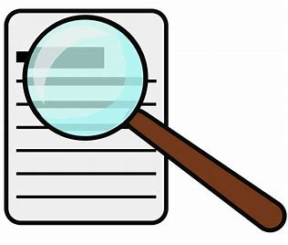
Task 2 – Finding words
Choose a book – any book will do
Can you find any words in your book which contain the ‘ea’ phoneme?
Can you find any words which rhyme with ‘away’?
Can you find any of the common words from this week? - learn, earth, children, because
Can you find words with two, three and four syllables?
You can record your answers on a piece of paper, in a Word document or use the ‘Finding words’ worksheet.

Slide 4
Task 3 – Winter Weather
Choose your level - *, **, or *** stars.
Read the text to yourself.
Then, if possible, read the text again to an adult.
Read through all the questions carefully. Do you understand the questions?
Read the passage again.
Answer the questions.
You do not need to print off the worksheet. You can type your answers in a Word
document and attach it to your assignment or simply write them down on a piece of paper.
Extension Task
Using the Winter Weather passage, can you make up 2 questions of your own? You could post them on Teams to test your classmates.

Slide 5
Task 4 – Reading for Enjoyment
I regularly select and read, listen to or watch texts which I enjoy and find interesting, and I can explain why I prefer certain texts and authors. LIT 1-11a
Choose from one of the following activities -
Read your favourite book to your pet.
Snuggle up on the couch and read a story about animals.
Read a Bug Club book.
Visit the David Walliams or Roald Dahl website
https://www.worldofdavidwalliams.com/
https://www.roalddahl.com/

