Slide 1
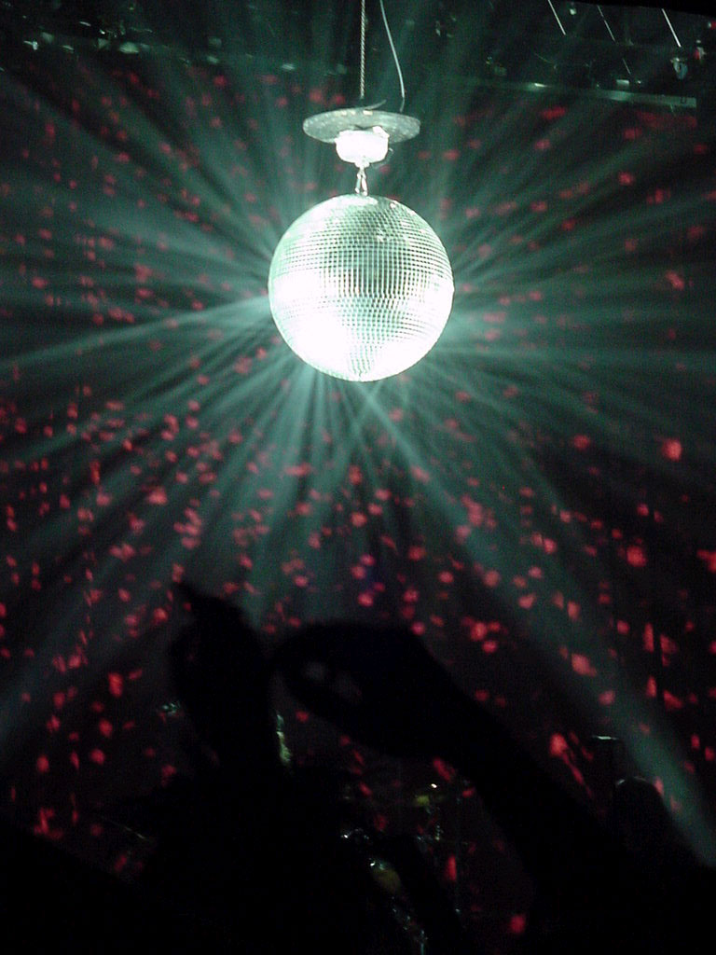
Bee Gees
Funky Phonics

Slide 2
ue

Slide 3
aw

Slide 4
oi

Slide 5
au

Slide 6
ew

Slide 7
ow

Slide 8
ou

Slide 9
igh

Slide 10
i-e

Slide 11
o-e

Slide 12
e-e

Slide 13
a-e

Slide 14
u-e

Slide 15
ea

Slide 16
tch

Slide 17
wr

Slide 18
each

Slide 19
year

Slide 20
away

Slide 21
always

Slide 22
another

Slide 23
watch

Slide 24
time

Slide 25
windy

Slide 26
gave

Slide 27
family

Slide 28
how

Slide 29
might

Slide 30
learn

Slide 31
children

Slide 32
because

Slide 33
earth

Slide 34
