Slide 1
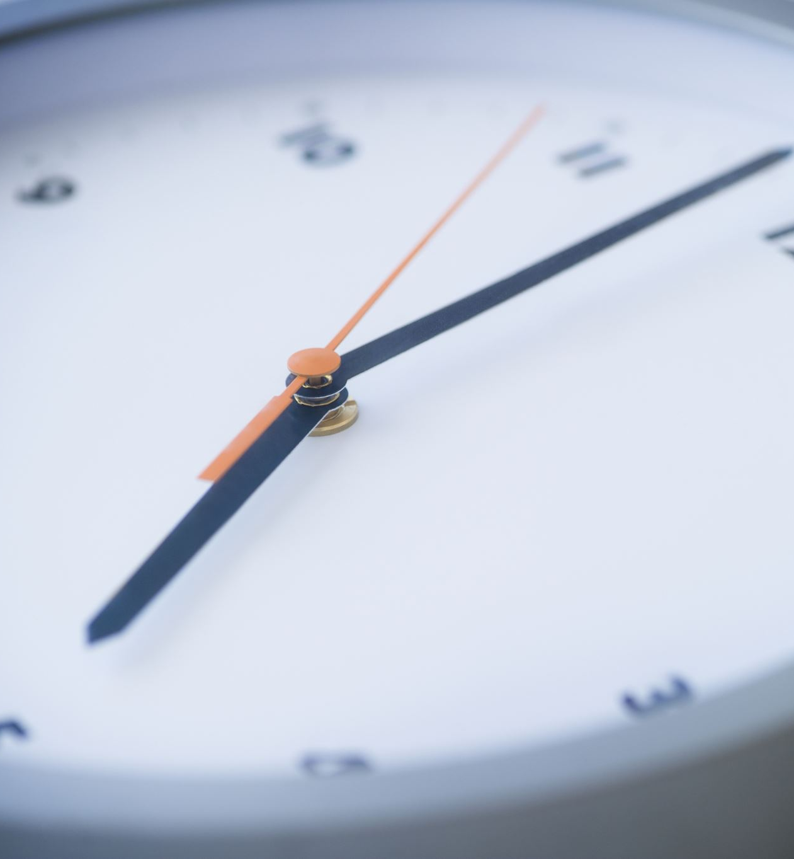
Durations
LI: To find the duration of different activities.

Slide 2
What does duration mean?
Duration just means how long something lasts.
For example, if I went to swimming lessons from 3 o’ clock to 4 o’ clock, the duration of that lesson would be 1 hour/60 minutes.
1 hour/
60 minutes
3:00
4:00

Slide 3
Have a look at the TV timetable below.
Our street, Beat the Bakers or Cartoon Time.
Live Football or Cooking Cakes

Slide 4
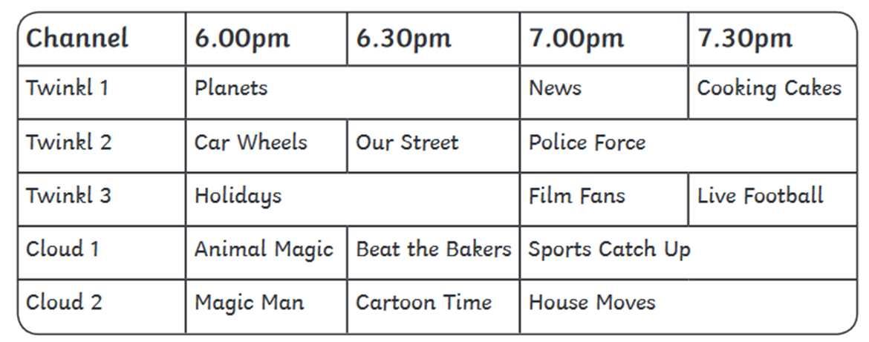
How long does the show ‘Holidays’ last?
How long does the show ‘Magic Man’ last?
How long would it take to watch ‘Car wheels’ and ‘Our Street’?
If I watch ‘Holidays’ and ‘News’, how long have I spent watching TV?
1 hour/60 minutes
Half an hour/ 30 minutes
1 hour/60 minutes
1 hour and a half/ 1 hour and 30 minutes.

Slide 5
Have a look at the bus timetable below:
Stops | Arrives
Glasgow | 09:00
Kilmarnock | 10:00
Prestwick | 10:30
Ayr | 11:00
First, the bus travels from Glasgow to Kilmarnock. How long does this take?
How long does it take to get from Kilmarnock to Prestwick?
What is the duration of the journey from Kilmarnock to Ayr?
What is the duration of the whole journey from Glasgow to Ayr?
1 hour/ 60 minutes
Half an hour/ 30 minutes
1 hour/ 60 minutes
2 hours

Slide 6
An extra challenge!
Stops | Arrives
Glasgow | 08:00
Loch Lomond | 08:45
Glencoe | 09:45
Fort William | 11:00
What is the duration of the journey from Glasgow to Loch Lomond?
How long does it take to get from Loch Lomond to Glencoe?
How long does it take to get from Glencoe to Fort William ?
How much time does the bus journey take altogether from Glasgow to Fort William?
45 minutes
1 hour/ 60 minutes
1 hour and 15 minutes
3 hours

