Slide 1
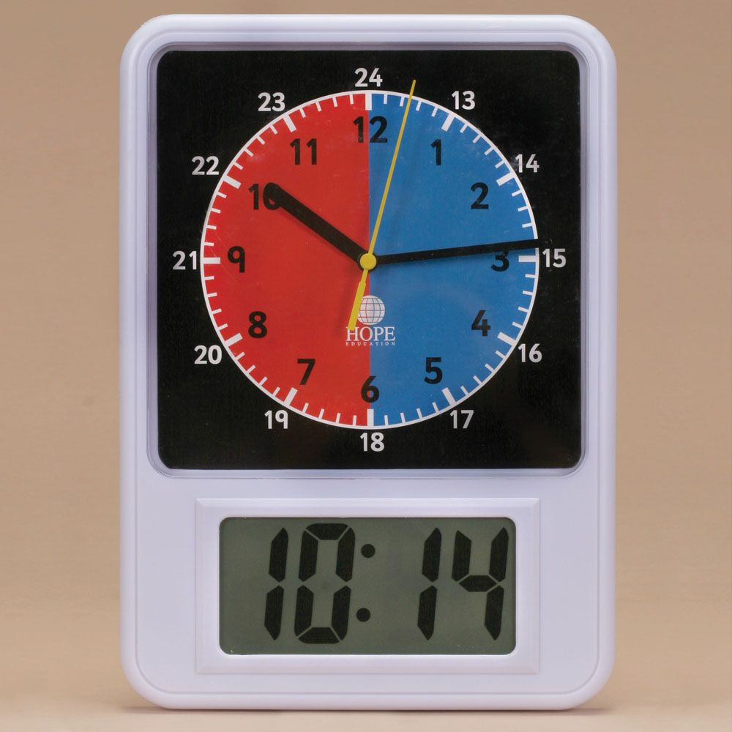
LI: To match digital and analogue clocks.

Slide 2
Recap
O’ clock
00
12
11
1
10
2
Quarter to
45
Quarter past
15
9
3
8
4
7
5
6
Half past
30

Slide 3
O’ clock
12
12
12
11
1
11
1
11
1
10
2
2
10
2
10
9
3
9
9
3
3
8
4
8
8
4
4
7
5
7
7
5
6
6
5
6
3 o’ clock
10 o’ clock
12 o’ clock
3:00
10:00
12:00

Slide 4
Half past
12
12
12
11
1
11
1
11
1
10
2
10
2
10
2
9
3
9
3
9
3
8
4
8
8
4
4
7
5
7
5
7
5
6
6
6
Half past 1
Half past 5
Half past 12
1:30
5:30
12:30

Slide 5
Quarter Past
12
12
12
11
1
11
1
11
1
10
2
10
2
10
2
9
3
9
3
9
3
8
4
8
8
4
4
7
5
7
5
7
5
6
6
6
Quarter past 3
Quarter past 10
Quarter past 12
3:15
10:15
12:15

Slide 6
Quarter to
12
12
12
11
1
11
1
11
1
10
2
10
2
10
2
9
3
9
3
9
3
8
4
8
8
4
4
7
5
7
5
7
5
6
6
6
Quarter to 2
Quarter to 6
Quarter to 1
1:45
5:45
12:45

Slide 7
Over to you!
12
11
1
10
2
9
3
2 o’ clock
2:00
8
4
7
5
6

Slide 8
Over to you!
12
11
1
10
2
9
3
7 o’ clock
7:00
8
4
7
5
6

Slide 9
Over to you!
12
11
1
10
2
9
3
Half past 2
2:30
8
4
7
5
6

Slide 10
Over to you!
12
11
1
10
2
9
3
Half past 7
7:30
8
4
7
5
6

Slide 11
Over to you!
12
11
1
10
2
9
3
Quarter past 7
7:15
8
4
7
5
6

Slide 12
Over to you!
12
11
1
10
2
9
3
Quarter past 8
8:15
8
4
7
5
6

Slide 13
Over to you!
12
11
1
10
2
9
3
Quarter to 8
7:45
8
4
7
5
6

Slide 14
Over to you!
12
11
1
10
2
9
3
Quarter to 10
9:45
8
4
7
5
6

Slide 15
Core Task

