Slide 1
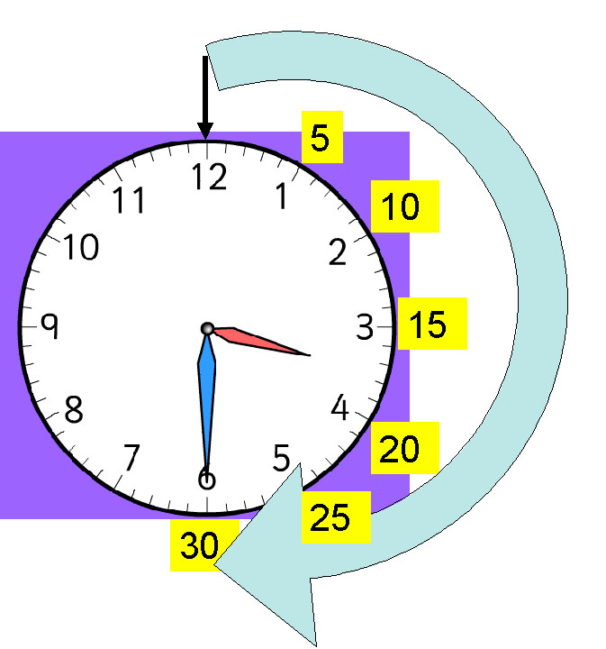
LI: To tell the time half an hour before and after.

Slide 2
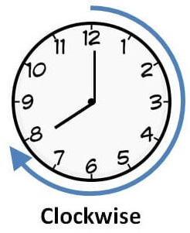
12
12
Half an hour after
11
1
11
1
10
2
10
2
9
3
9
3
8
4
8
4
7
6
5
7
5
6
9:00
9:30
12
12
11
1
11
1
10
2
10
2
When we are finding the time half an hour after,
the hands move clockwise around the clock.
9
3
9
3
8
4
8
4
7
5
7
6
5
6
7:30
8:00

Slide 3
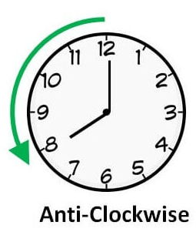
12
Half an hour before
11
1
12
11
1
10
2
10
2
9
3
9
3
8
4
8
4
7
6
5
7
5
6
9:00
8:30
12
12
11
1
11
1
10
2
10
2
When we are finding the time half an hour before,
the hands move anti-clockwise around the clock.
9
3
9
3
8
4
8
4
7
5
7
6
5
6
7:30
7:00

Slide 4
Over to you!
Half an hour before
Half an hour after
12
12
12
11
1
11
1
11
1
10
2
10
2
2
10
9
9
3
9
3
3
8
8
4
8
4
4
7
7
5
5
6
7
5
6
6
3:00
2:30
3:30

Slide 5
Over to you!
Half an hour before
Half an hour after
12
12
12
11
1
11
1
11
1
10
2
10
2
10
2
9
9
3
9
3
3
8
8
4
8
4
4
7
7
5
7
5
6
6
5
6
10:00
10:30
9:30

Slide 6
Over to you!
Half an hour before
Half an hour after
12
12
12
11
1
11
1
11
1
10
2
10
2
2
10
9
9
3
3
9
3
8
8
4
4
8
4
7
7
5
5
6
7
5
6
6
12:00
11:30
12:30

Slide 7
Over to you!
Half an hour before
Half an hour after
12
12
12
11
1
11
1
11
1
2
2
10
2
10
10
9
9
3
9
3
3
8
8
8
4
4
4
7
7
5
7
5
6
5
6
6
1:00
1:30
2:00

Slide 8
Over to you!
Half an hour before
Half an hour after
12
12
12
11
1
11
1
11
1
10
2
10
2
2
10
9
3
9
3
9
3
8
4
8
4
8
4
7
5
7
5
7
6
6
6
5
5:00
5:30
6:00

Slide 9
Over to you!
Half an hour before
Half an hour after
12
12
11
1
11
1
12
11
1
10
2
2
10
10
2
9
3
9
3
9
3
8
4
8
4
8
4
7
5
7
5
6
6
7
5
6
12:00
12:30
1:00

Slide 10
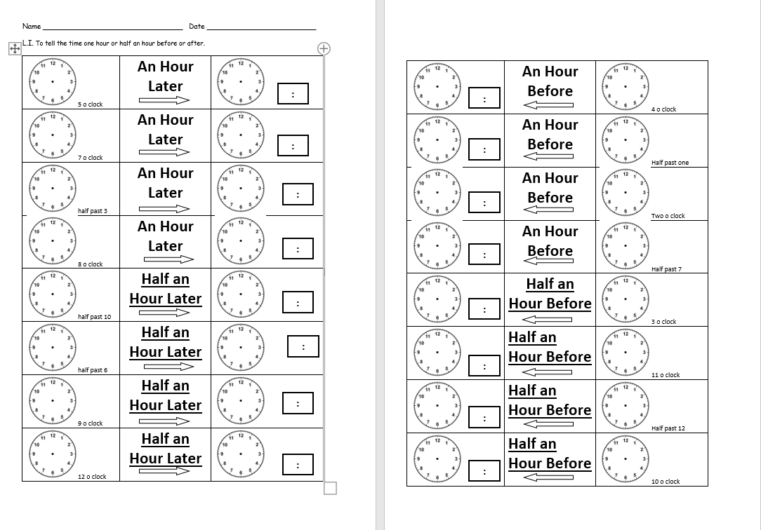
Core Task

