Slide 1
LI: To tell the time 1 hour before and after.

Slide 2
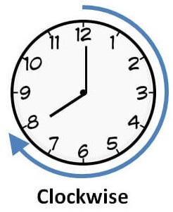
12
12
11
1
11
1
1 hour after
10
2
10
2
9
3
9
3
8
4
8
4
7
6
5
7
5
6
9:00
10:00
12
12
11
1
11
1
10
2
10
2
When we are finding the time an hour after,
the hands move clockwise around the clock.
9
3
9
3
8
4
8
4
7
5
7
6
5
6
7:30
8:30

Slide 3
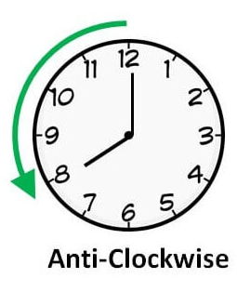
12
12
1 hour before
11
1
11
1
10
2
10
2
9
3
9
3
8
4
8
4
7
6
5
7
5
6
9:00
8:00
12
12
11
1
11
1
10
2
10
2
When we are finding the time an hour before,
the hands move anti-clockwise around the clock.
9
3
9
3
8
4
8
4
7
5
7
6
5
6
7:30
6:30

Slide 4
Over to you!
1 hour before
1 hour after
12
12
12
11
1
11
1
11
1
10
2
2
10
2
10
9
3
9
9
3
3
8
4
8
8
4
4
7
5
7
6
7
5
6
5
6
3:00
2:00
4:00

Slide 5
Over to you!
1 hour before
1 hour after
12
12
12
11
1
11
1
11
1
10
2
10
2
10
2
9
3
9
3
9
3
8
4
8
4
8
4
7
5
7
5
7
6
6
6
5
9:00
10:00
11:00

Slide 6
Over to you!
1 hour before
1 hour after
12
12
12
11
1
11
1
11
1
10
2
2
2
10
10
9
3
9
3
9
3
8
4
8
8
4
4
7
5
7
5
7
6
6
6
5
11:00
12:00
1:00

Slide 7
Over to you!
1 hour before
1 hour after
12
12
12
11
1
11
1
11
1
10
2
2
2
10
10
9
3
9
3
9
3
8
4
8
8
4
4
7
5
7
5
7
6
6
6
5
12:30
1:30
2:30

Slide 8
Over to you!
1 hour before
1 hour after
12
12
12
11
1
11
1
11
1
10
2
10
2
2
10
9
3
9
3
9
3
8
4
8
4
8
4
7
5
7
5
7
6
6
6
5
4:30
5:30
6:30

Slide 9
Over to you!
1 hour before
1 hour after
12
12
12
11
1
11
1
11
1
2
10
2
2
10
10
9
3
9
9
3
3
8
4
8
8
4
4
7
5
7
5
6
7
5
6
6
12:30
11:30
1:30

Slide 10
Core Task

