Slide 1
Spelling WB 18.1.21

Slide 2
We are learning to -
Recognise and use single and joined phonemes
Say, make, break, read and write words which contain the ‘wr’ phoneme
use a variety of spelling strategies to spell common words

Slide 3
Sing or say the alphabet. When we sing the alphabet we use the letter names. What sound does each of these letters make? These are single phonemes. One letter = one sound.
Task 1
How many letters are in the alphabet?
The letters of the alphabet are split into two groups. What are they?
How many letters are in each group?

Slide 4
Do you know what sounds these phonemes make?
sh ck aw wh ai ue
ph qu ay th ow oy
ng oa ch oo ee ea
oi au a-e o-e u-e ss
ll ew ou igh i-e ff
e-e kn mb tch
These are joined phonemes. Joined phonemes are two or more letters which together make only one sound.

Slide 5
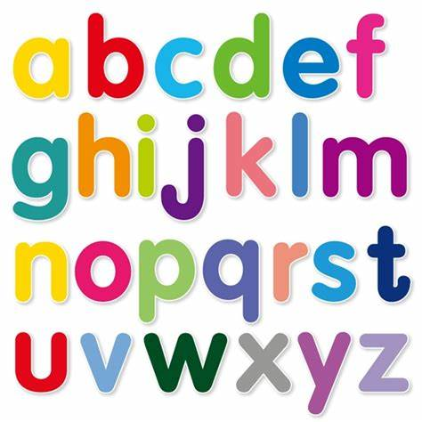
‘wr’
Do you know what sound this phoneme makes?
Say the phoneme aloud and think about what your mouth is doing.
Write the phoneme in the air then on the table or carpet in front of you whilst making the sound.

Slide 6
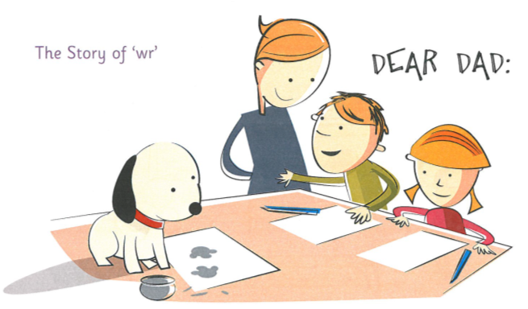
The story of ‘wr’ Listen to the phoneme story for ‘wr’. Which words do you hear the ‘wr’ phoneme in?
Ben and Belle’s dad had gone back to his army unit. The children sat down to write him a long letter. In fact they wrote so much that they had sore wrists! Mum helped with the spelling words they had got wrong.
“Poor Dasher,” said Belle. “He can’t write.”
They got some wrinkly paper and got Dasher to put his paw print on it. They wrapped Dasher’s print in with the letters they had written.
“Be careful with the ink. You don’t want Dasher to wreck your work by spilling it,” said Mum.
Task - Can you think of any other words which contain the phoneme? - Make a list.

Slide 7
Phoneme Words Use the activities in your spelling grid, magnetic letters or activities of your own choice to revise ‘wr’ phoneme words.
Phoneme words
write
wrist
wrote
wrong
wrinkle
wren
wreck
wrap
written
Sentences
Choose three words from the list or three of your own words and write a sentence for each.
Remember your core targets –
capital letters
full stops
finger spaces
use a connective – and, but, because, so

Slide 8
Task 2 – Common Words
Look at the common word below.
gave
Read the word and say it aloud.
How many letters are in the word? Count them.
How many sounds/phonemes are in the word?

Slide 9
Task 2 – Common Words – contd.
Spelling Strategies
Sounding out
Word Shape
Use a mnemonic
Syllabification
Compound words
Words within words
Tricky letters
Use an analogy
Choose a spelling strategy to help you learn the word.
Make the word with some magnetic letters if you have them. Look carefully at the word and ‘take a photograph of it ‘ in your mind.
Now close your eyes and jumble up the letters.
Can you spell the word again using the spelling strategy you chose to help you?

Slide 10
family how might
repeat the process with each of the common words above, choosing an appropriate spelling strategy for each word.
Written Task
Worksheet - Practise writing each word three times, using correct letter formation, complete spelling strategies grid and fill the gaps to complete the sentences.

Slide 11
Task 3 - Dictation
Listen to the sentences. I will say each sentence twice. Write them down on your whiteboard or a piece of paper. You can pause the recording if you need more time to complete the sentence.
Remember your Core Targets
Capital letters
Full stops
Finger spaces
Remember to read over your work when you have finished to ensure it makes sense.

Slide 12
Task 4 – Elkonin Boxes
Phoneme words – Elkonin boxes
Listen to the following words. Make and break each word using your elkonin boxes to record your answers. You can pause the recording at any time.
Common words – Whiteboard/Paper/Word document
Now we are going to practise our common words. You can record these on a whiteboard, piece of paper or on a word document. Think about what strategy you can apply to each word to help you spell it. Remember you can pause the recording at any time.

