Slide 1
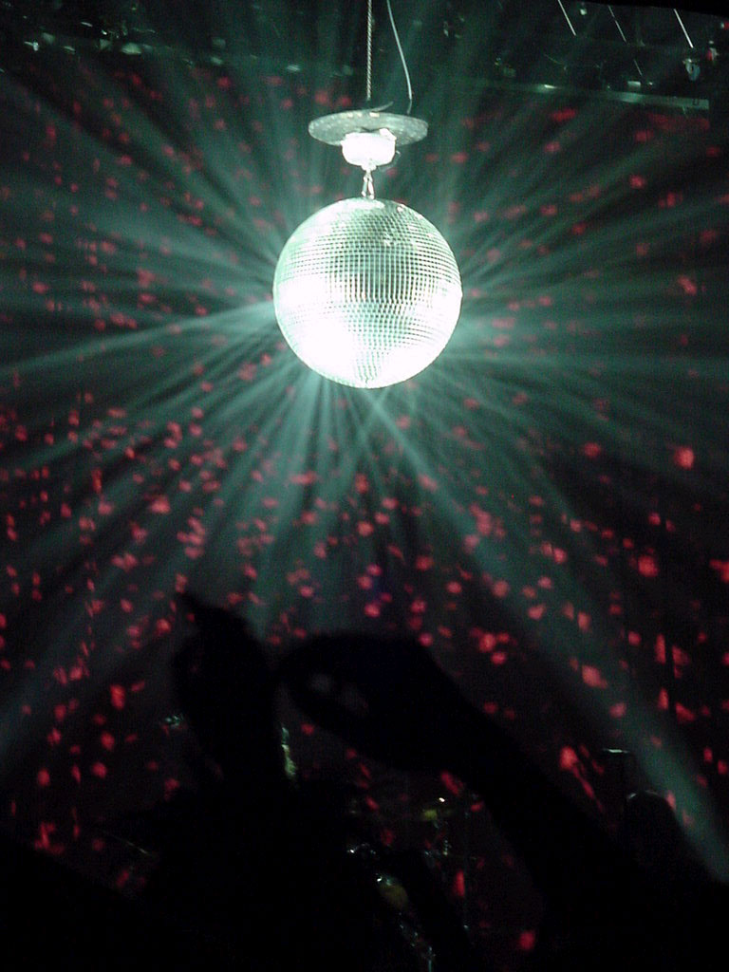
Bee Gees
Funky Phonics

Slide 2
ue

Slide 3
aw

Slide 4
oi

Slide 5
au

Slide 6
ew

Slide 7
ow

Slide 8
ou

Slide 9
igh

Slide 10
i-e

Slide 11
o-e

Slide 12
e-e

Slide 13
a-e

Slide 14
u-e

Slide 15
ea

Slide 16
tch

Slide 17
which

Slide 18
what

Slide 19
bring

Slide 20
long

Slide 21
three

Slide 22
again

Slide 23
these

Slide 24
people

Slide 25
always

Slide 26
school

Slide 27
some

Slide 28
never

Slide 29
know

Slide 30
yellow

Slide 31
father

Slide 32
mother

Slide 33
watch

Slide 34
