Slide 1
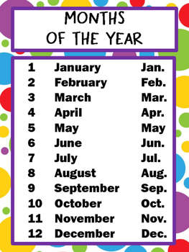
Time – Months and Seasons

Slide 2
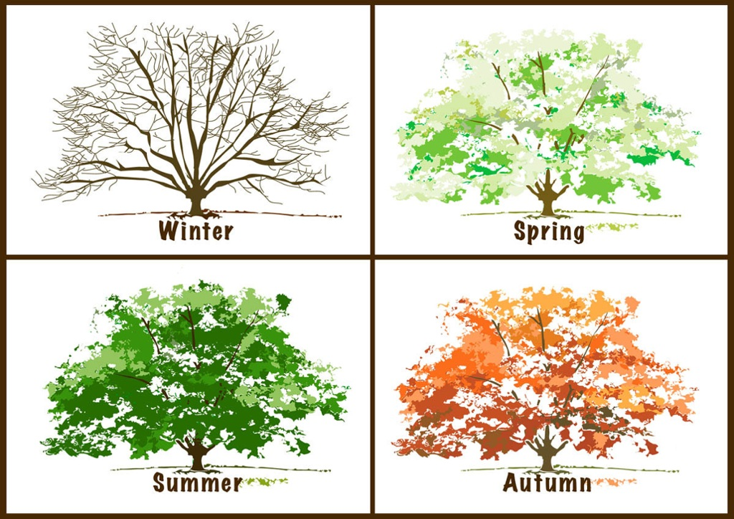
What is your favourite month?
What is the month before/after?
Can you remember the 4 seasons?

Slide 3
Seasons and Months

Slide 4
Core Task

