Slide 1
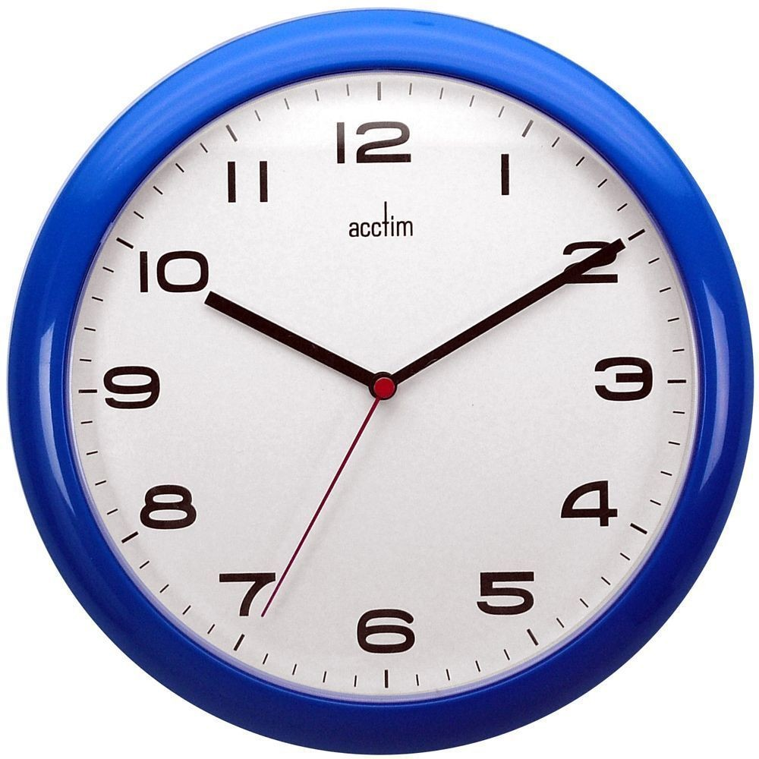
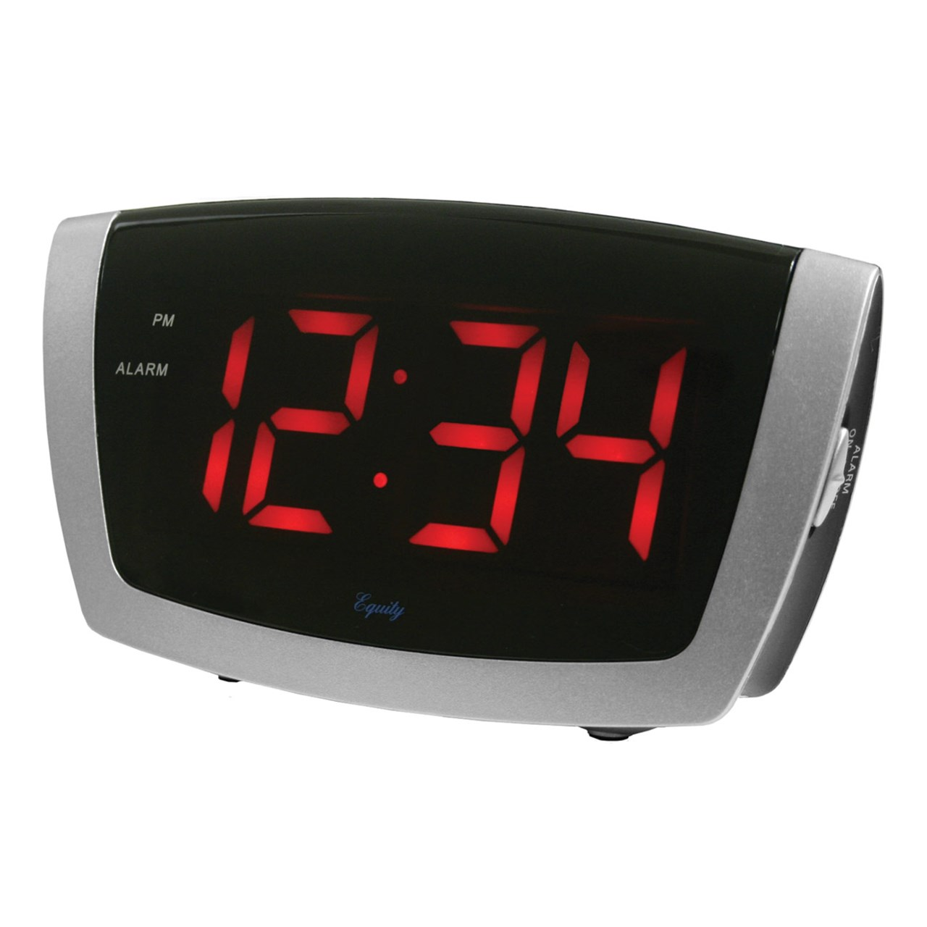
Time
Why is time important?
Discuss with an adult or sibling or write down some ideas.
You could even make a poster of all the reasons you think time is important and illustrate it!

Slide 2
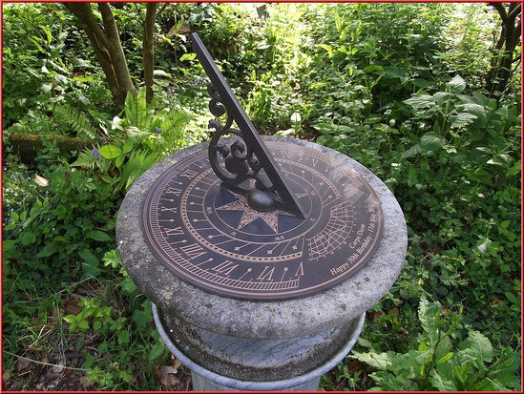
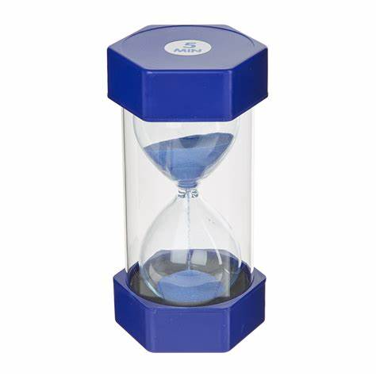
How do we measure time?
Analogue
clock
Stopwatch
Sundial
Timer
Digital clock

Slide 3
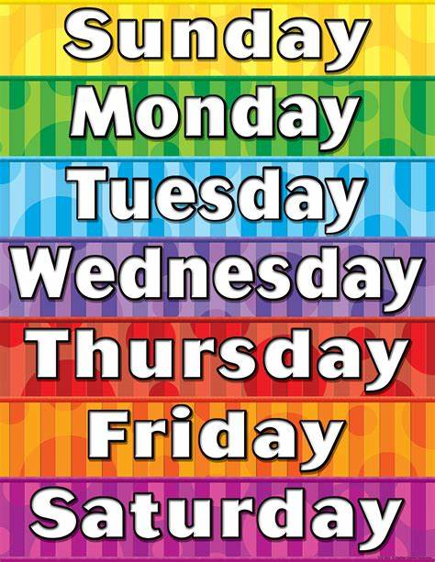
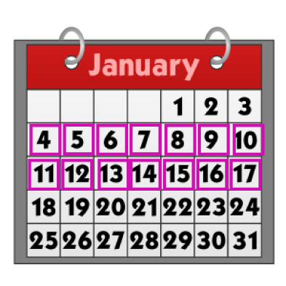
Units of Time
60 seconds = 1 minute
60 minutes = 1 hour
24 hours = 1 day (split into am and pm)
7 days = 1 week
2 weeks = 1 fortnight

