Slide 2
Consonant or Vowel?
Sort the letters of the alphabet into two groups: consonants and vowels.
a
b
c
d
e
f
g
h
i
j
k
l
m
n
o
p
q
r
s
t
u
v
w
x
y
z
Consonants
Vowels
b
c
d
f
g
j
h
k
l
m
a
e
i
o
u
n
p
q
r
t
y
s
v
w
x
z

Slide 3
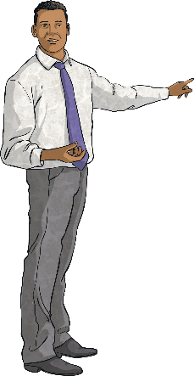
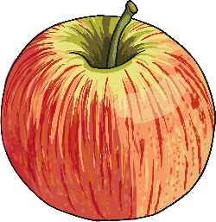
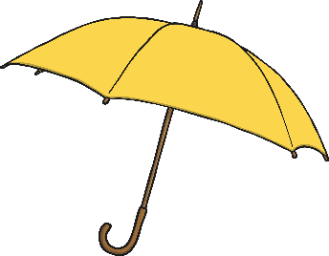
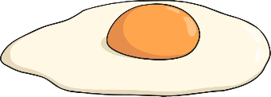
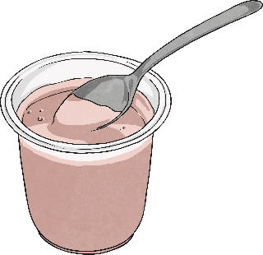
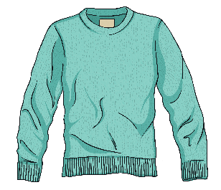
Sort the Words!
Words starting with a consonant
Words starting with a vowel
teacher
jumper
laptop
book
yoghurt
egg
apple
otter
umbrella
icicle

Slide 4
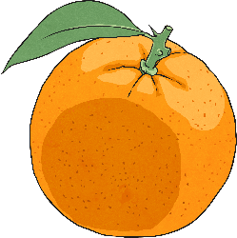
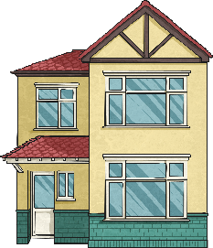
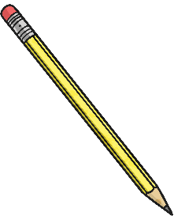
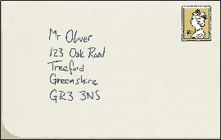
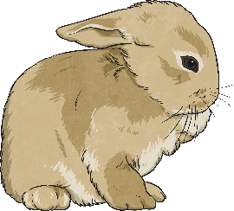
‘a’ or ‘an’?
a
an
house
orange
a
an
pencil
envelope
a
an
rabbit
apple
Usually, we put ‘a’ before words that start with a consonant and ‘an’ before words that start with a vowel.

Slide 5
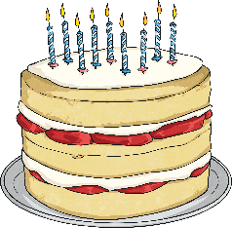
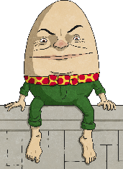
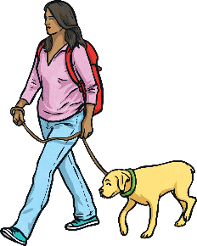
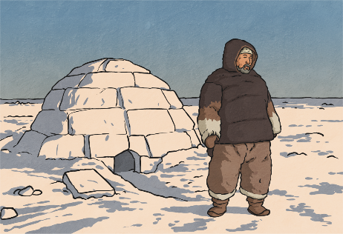
‘a’ or ‘an’?
Try these sentences – should it be ‘a’ or ‘an’?
a
Tomorrow, I am going to party.
Humpty Dumpty was egg.
I always have umbrella in my bag in case it rains.
The dog was on lead.
You can make house out of snow, which is called igloo.
an
an
a
a
an

Slide 6
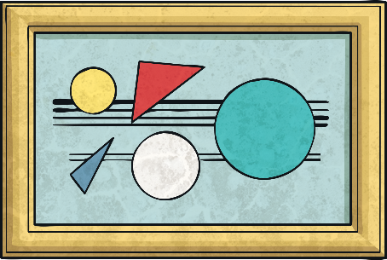
‘a’ or ‘an’?
Which sounds correct?
It was a unique painting.
It was an unique painting.
Although ‘unique’ starts with a vowel, the letter ‘u’ makes the ‘y’ sound, so ‘a’ is used instead of ‘an’.

Slide 7
‘a’ or ‘an’?
Which sounds correct?
It was a honest mistake.
It was an honest mistake.
Although ‘honest’ starts with a consonant, the letter ‘h’ makes the short ‘o’ sound, so ‘an’ is used instead of ‘a’.

Slide 8
‘a’ or ‘an’?
Listen to the sound at the start of the underlined word. Does it make a vowel sound or a consonant sound?
an
It took hour to get to the zoo.
I have to wear uniform to school.
We flew to universe far, far away.
I would love to ride on unicorn.
The king wanted heir to the throne.
It was honour to meet the Queen.
a
a
a
an
an

Slide 9
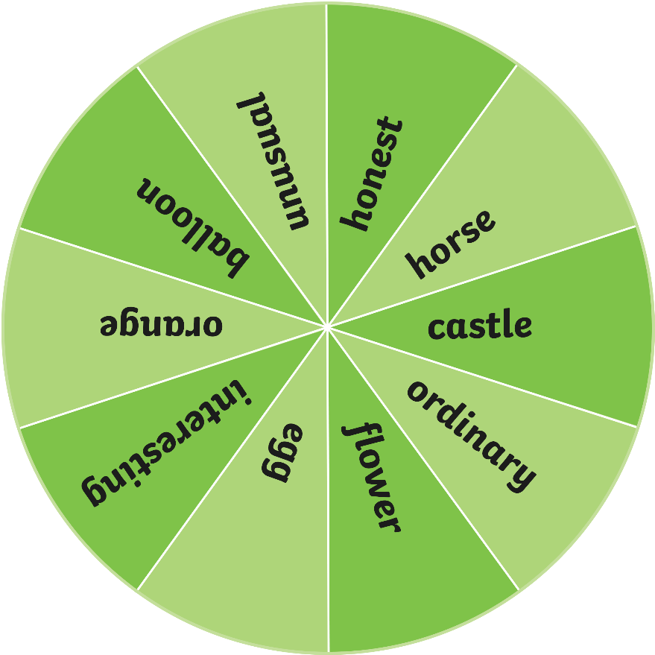
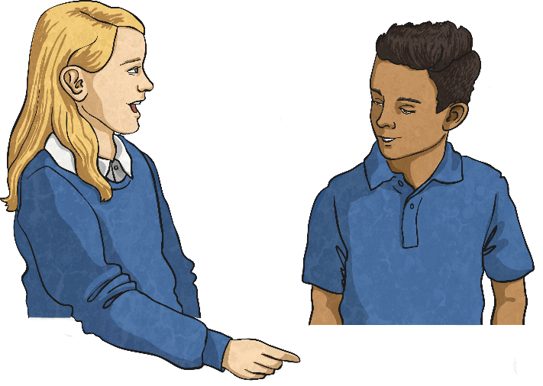
Spin the Wheel!
Spin the wheel to select a word.
Would you use ‘a’ or ‘an’ before the word?
On your whiteboards, write a sentence using the word with the correct choice of ‘a’ or ‘an’. Make your sentence as interesting as you can!
Spin

Slide 10
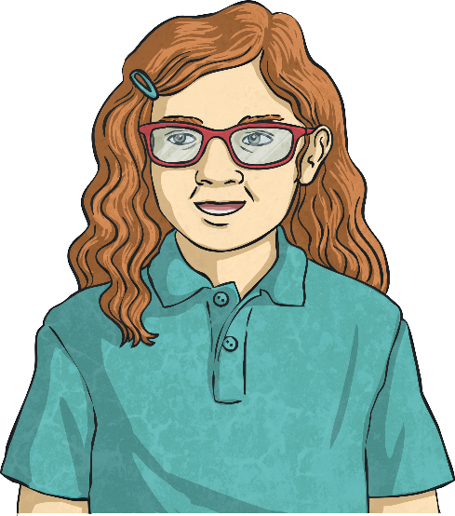
‘a’ or ‘an’ Word Search
How many words can you think of in two minutes that need ‘a’ or ‘an’ before them?
‘a’
‘an’
Complete the table on your whiteboard.
Start
Time’s up!

Slide 11
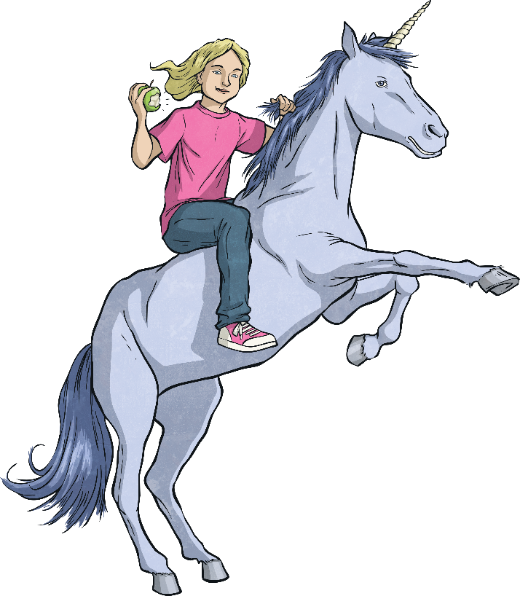
What do we know about using ‘a’ or ‘an’?
We use ‘a’ when the next word starts with a consonant sound.
We use ‘an’ when the next word starts with a vowel sound.
Say it aloud - does it sound right?
It was a unique painting of an honest girl riding a unicorn while eating an apple.

Slide 12
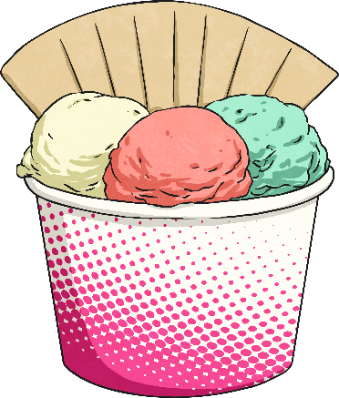
‘a’ or ‘an’ Quick Quiz
Take a quiz to see if you are an expert!
Which is correct?
a ice cream
an ice cream

Slide 13
‘a’ or ‘an’ Quick Quiz
Take a quiz to see if you are an expert!
Which is correct?
a caterpillar
an caterpillar

Slide 14
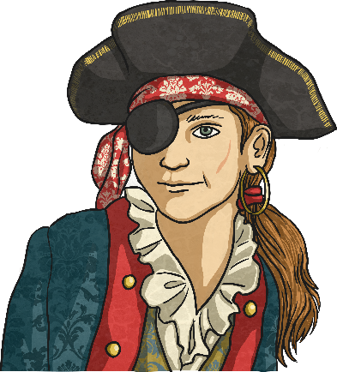
‘a’ or ‘an’ Quick Quiz
Take a quiz to see if you are an expert!
Which is correct?
Captain Jonas was a one-eyed pirate.
Captain Jonas was an one-eyed pirate.

Slide 15
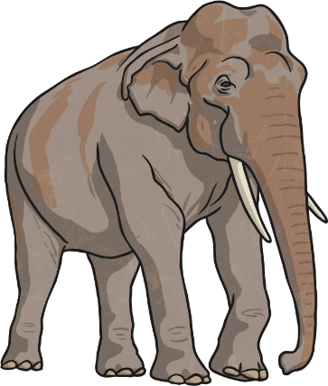
‘a’ or ‘an’ Quick Quiz
Take a quiz to see if you are an expert!
Which is correct?
There was a enormous elephant at the zoo.
There was an enormous elephant at the zoo.

Slide 16
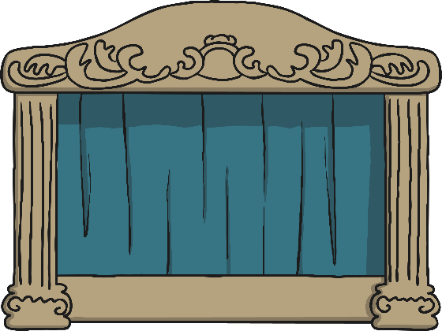
‘a’ or ‘an’ Quick Quiz
Take a quiz to see if you are an expert!
Which is correct?
The show lasted for a hour.
The show lasted for an hour.

Slide 17
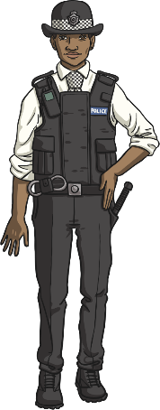
‘a’ or ‘an’ Quick Quiz
Take a quiz to see if you are an expert!
Which is correct?
The policewoman wore a uniform.
The policewoman wore an uniform.

