Slide 1
Thursday 13th January
The Pirate

Slide 2
Writing Task
Write sentences to describe what the pirate looks like and what he is wearing.
Each sentence should have:
Capital letter
Full stop
Finger spaces
Connective
Challenge!
Can you use an adjective to describe something?

Slide 3
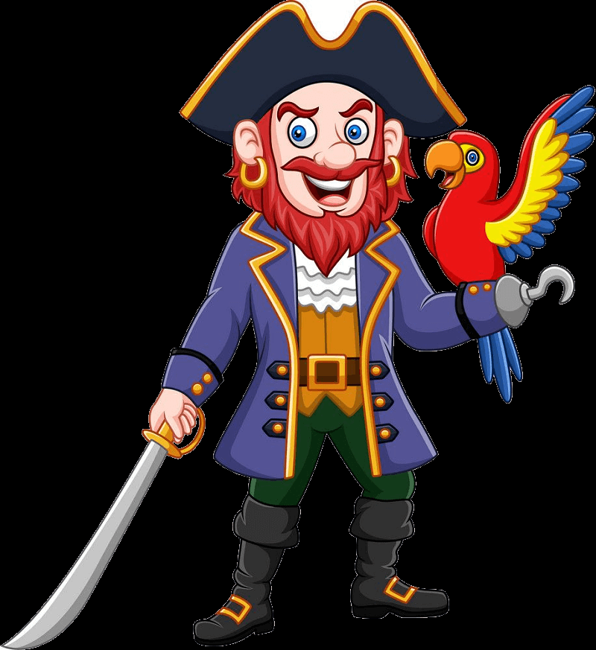
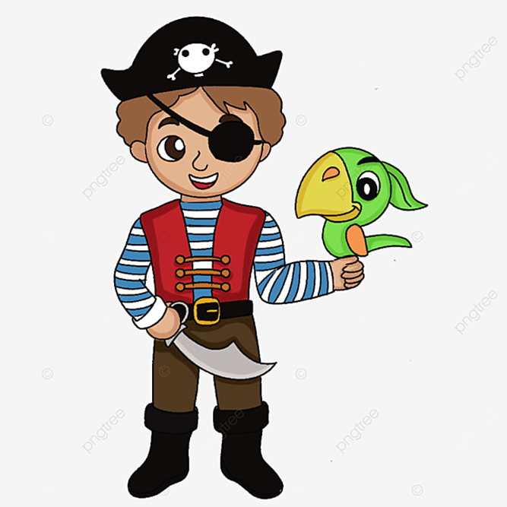

Slide 4
Pirate Word Bank
wearing
hat
beard
belt
boots
coat
earrings
hook
parrot
eye patch
black
brown
silver
gold
shiny
sword
stripy
trousers
skull
crossbones

